Slide 1
Computational Abstractions:
Strategies for Scaling Up Applications
Douglas Thain
University of Notre Dame
Institute for Computational Economics
University of Chicago
27 July 2012

Slide 2
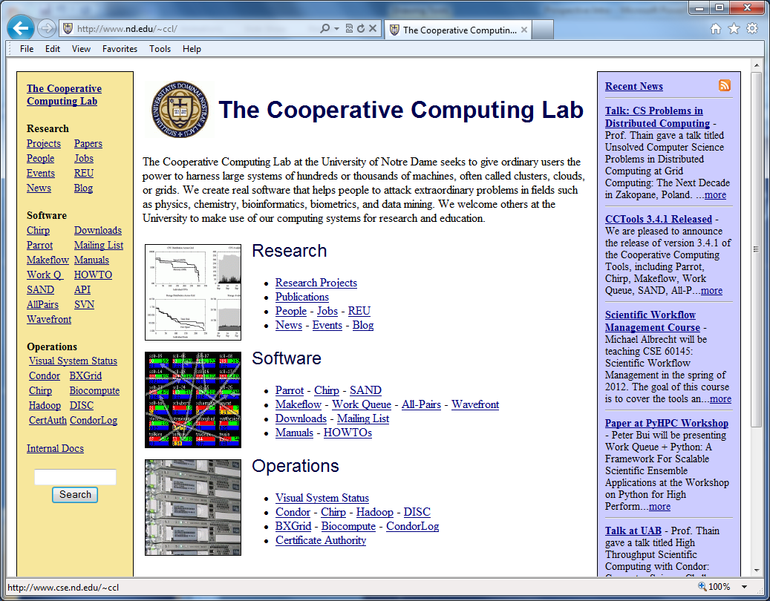
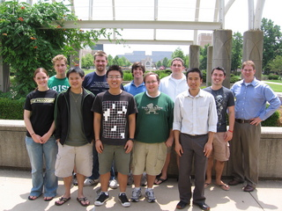
The Cooperative Computing Lab

Slide 3
The Cooperative Computing Lab
We collaborate with people who have large scale computing problems in science, engineering, and other fields.
We operate computer systems on the O(10,000) cores: clusters, clouds, grids.
We conduct computer science research in the context of real people and problems.
We release open source software for large scale distributed computing.
http://www.nd.edu/~ccl

Slide 4
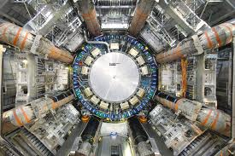
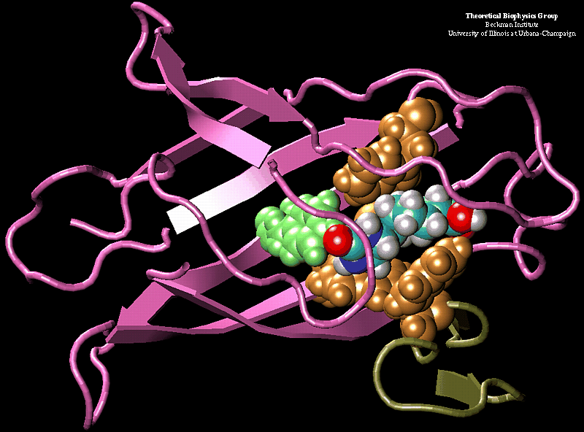
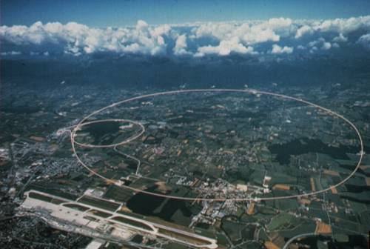
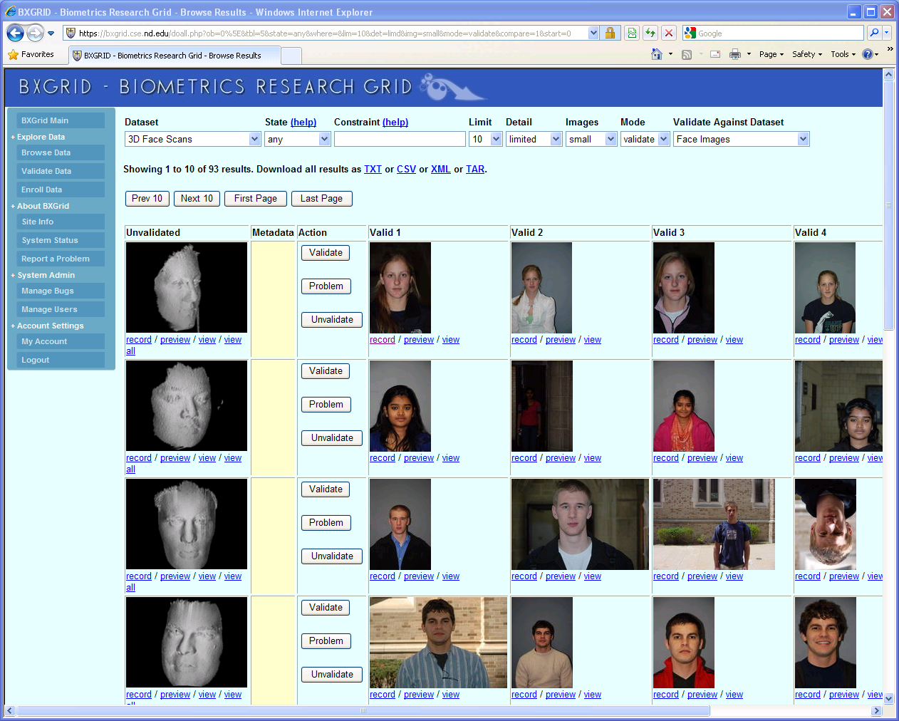
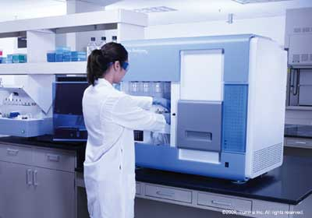

Our Collaborators
AGTCCGTACGATGCTATTAGCGAGCGTGA…

Slide 5
Why Work with Science Apps?
Highly motivated to get a result that is bigger, faster, or higher resolution.
Willing to take risks and move rapidly, but don’t have the effort/time for major retooling.
Often already have access to thousands of machines in various forms.
Keep us CS types honest about what solutions actually work!

Slide 6
Today’s Message:
Large scale computing is plentiful.
Scaling up is a real pain (even for experts!)
Strategy: Computational abstractions.
Examples:
  All-Pairs for combinatorial problems.
  Wavefront for dynamic programming.
  Makeflow for irregular graphs.
  Work Queue for iterative algorithms.

Slide 7
What this talk is not:
How to use our software.
What this talk is about:
How to think about designing a large scale computation.

Slide 8
The Good News:
Computing is Plentiful!

Slide 9
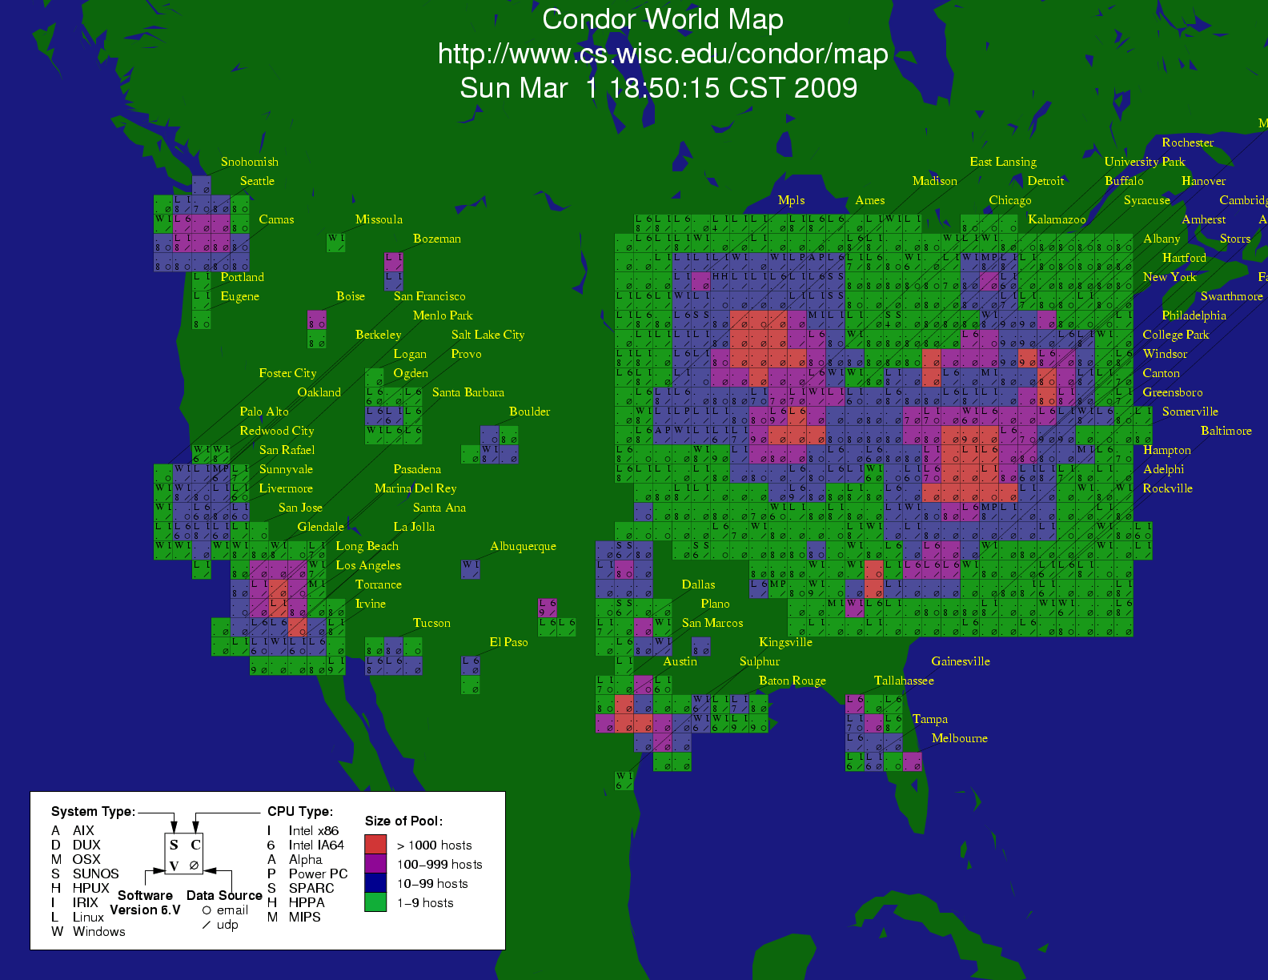
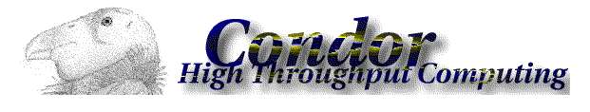

Slide 10
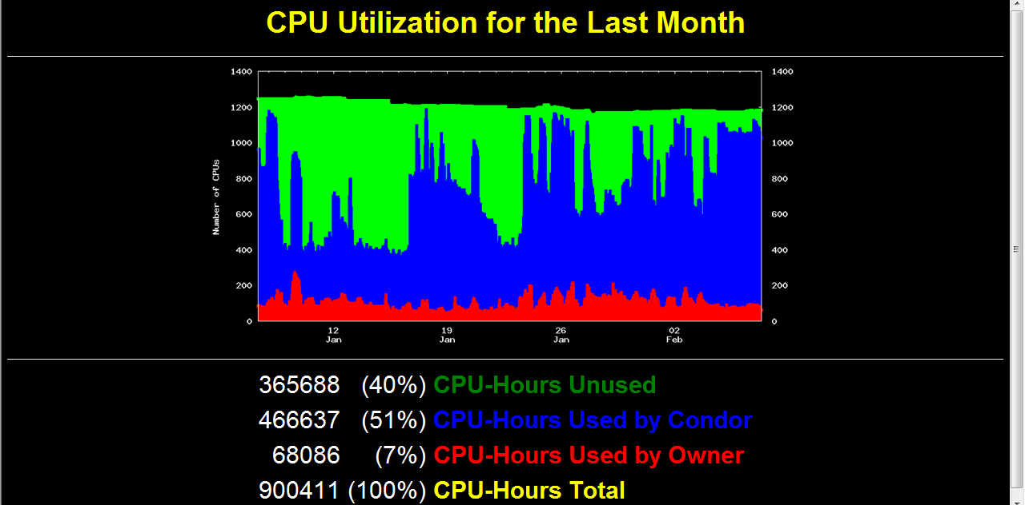

Slide 11
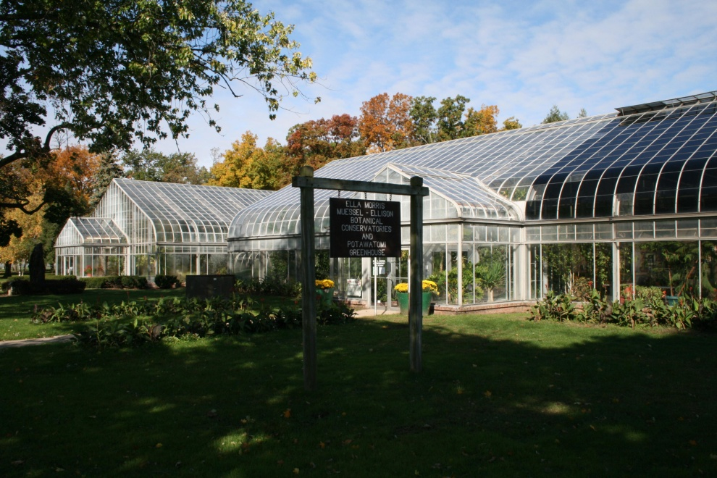
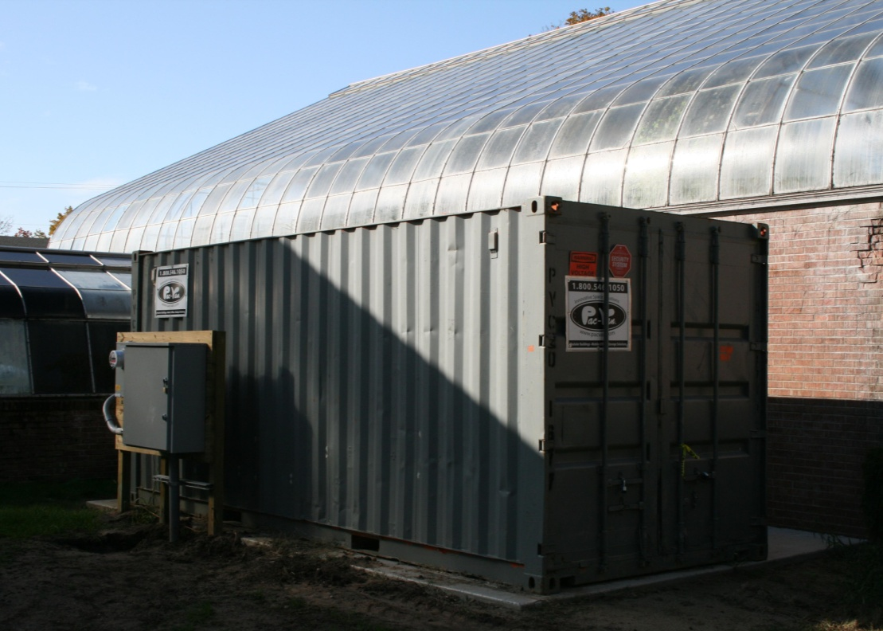
greencloud.crc.nd.edu

Slide 12
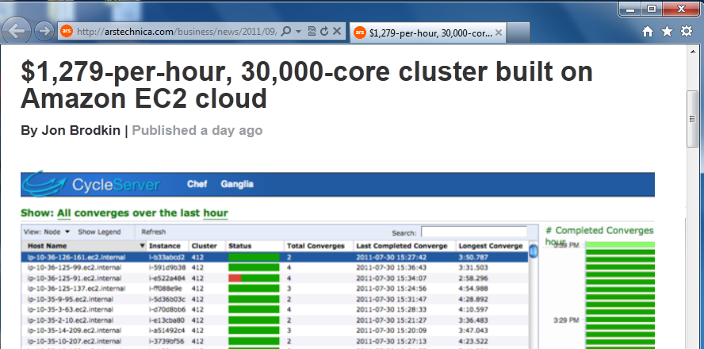
Superclusters by the Hour
http://arstechnica.com/business/news/2011/09/30000-core-cluster-built-on-amazon-ec2-cloud.ars

Slide 13
The Bad News:
It is inconvenient.

Slide 14


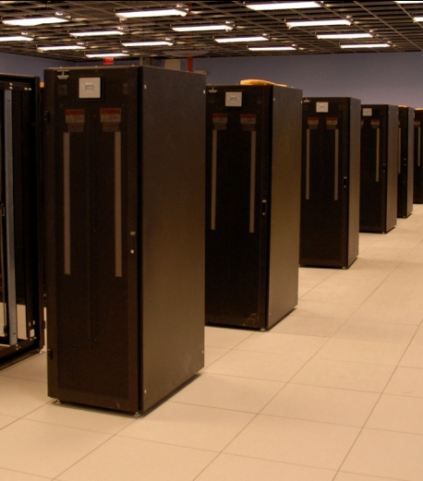
I have a standard, debugged, trusted application that runs on my laptop.
A toy problem completes in one hour.
A real problem will take a month (I think.)
Can I get a single result faster?
Can I get more results in the same time?
Last year,
I heard about
this grid thing.
This year,
I heard about
this cloud thing.
What do I do next?

Slide 15
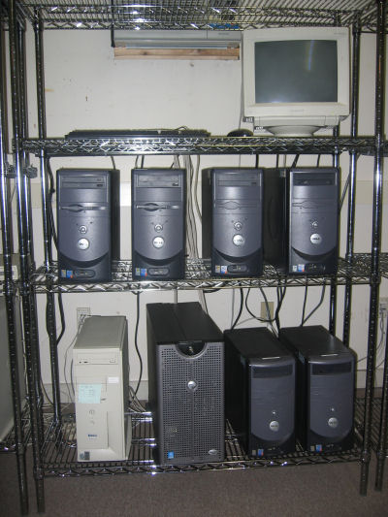
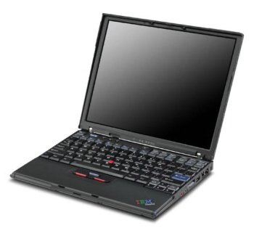
What you want.
What you get.

Slide 16
What goes wrong? Everything!
Scaling up from 10 to 10,000 tasks violates ten different hard coded limits in the kernel, the filesystem, the network, and the application.
Failures are everywhere! Exposing error messages is confusing, but hiding errors causes unbounded delays.
User didn’t know that program relies on 1TB of configuration files, all scattered around the home filesystem.
User discovers that the program only runs correctly on Blue Sock Linux 3.2.4.7.8.2.3.5.1!
User discovers that program generates different results when run on different machines.

Slide 17



Example: Biometrics Research
Goal: Design robust face comparison function.
F
F
0.97
0.05

Slide 18
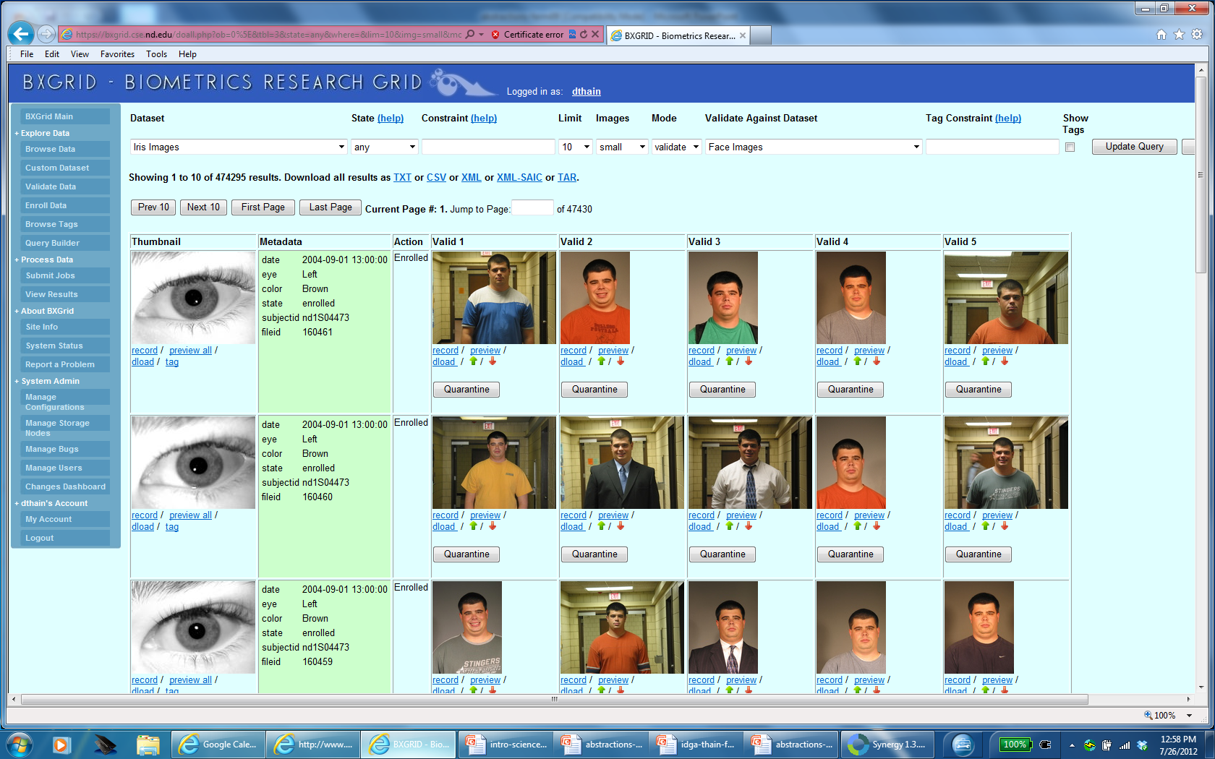

Slide 19






Similarity Matrix Construction
 | 1.0 | 0.8 | 0.1 | 0.0 | 0.0 | 0.1
 |  | 1.0 | 0.0 | 0.1 | 0.1 | 0.0
 |  |  | 1.0 | 0.0 | 0.1 | 0.3
 |  |  |  | 1.0 | 0.0 | 0.0
 |  |  |  |  | 1.0 | 0.1
 |  |  |  |  |  | 1.0
Challenge Workload:
60,000 images
1MB each
.02s per F
833 CPU-days
600 TB of I/O

Slide 20
This is easy, right?
for all a in list A
for all b in list B
qsub compare.exe a b >output

Slide 21
This is easy, right?
Try 1: Each F is a batch job.
Failure: Dispatch latency >> F runtime.
Try 2: Each row is a batch job.
Failure: Too many small ops on FS.
CPU
CPU
CPU
CPU
CPU
F
F
F
F
F
F
F
F
F
F
F
F
F
F
F
CPU
F
CPU
F
CPU
F
CPU
F
CPU
F
F
F
F
F
F
HN
HN
Try 3: Bundle all files into one package.
Failure: Everyone loads 1GB at once.
Try 4: User gives up and attempts
to solve an easier or smaller problem.
F
F
F
F
F
F
F
F
F
F
CPU
F
CPU
F
CPU
F
CPU
F
CPU
F
F
F
F
F
F
HN

Slide 22
Distributed systems always have unexpected costs/limits that are not exposed in the programming model.

Slide 23
Strategy:
Identify an abstraction that solves a specific category of problems very well.
Plug your computational kernel into that abstraction.

Slide 24
All-Pairs Abstraction
AllPairs( set A, set B, function F )
returns matrix M where
M[i][j] = F( A[i], B[j] ) for all i,j
A1
A1
A2
A3
A1
allpairs A B F.exe
An
AllPairs(A,B,F)
B1
F
F
F
B1
B1
Bn
B2
F
F
F
F
B3
F
F
F

Slide 25
How Does the Abstraction Help?
The custom workflow engine:
  Chooses right data transfer strategy.
  Chooses the right number of resources.
  Chooses blocking of functions into jobs.
  Recovers from a larger number of failures.
  Predicts overall runtime accurately.
All of these tasks are nearly impossible for arbitrary workloads, but are tractable (not trivial) to solve for a specific abstraction.

Slide 26
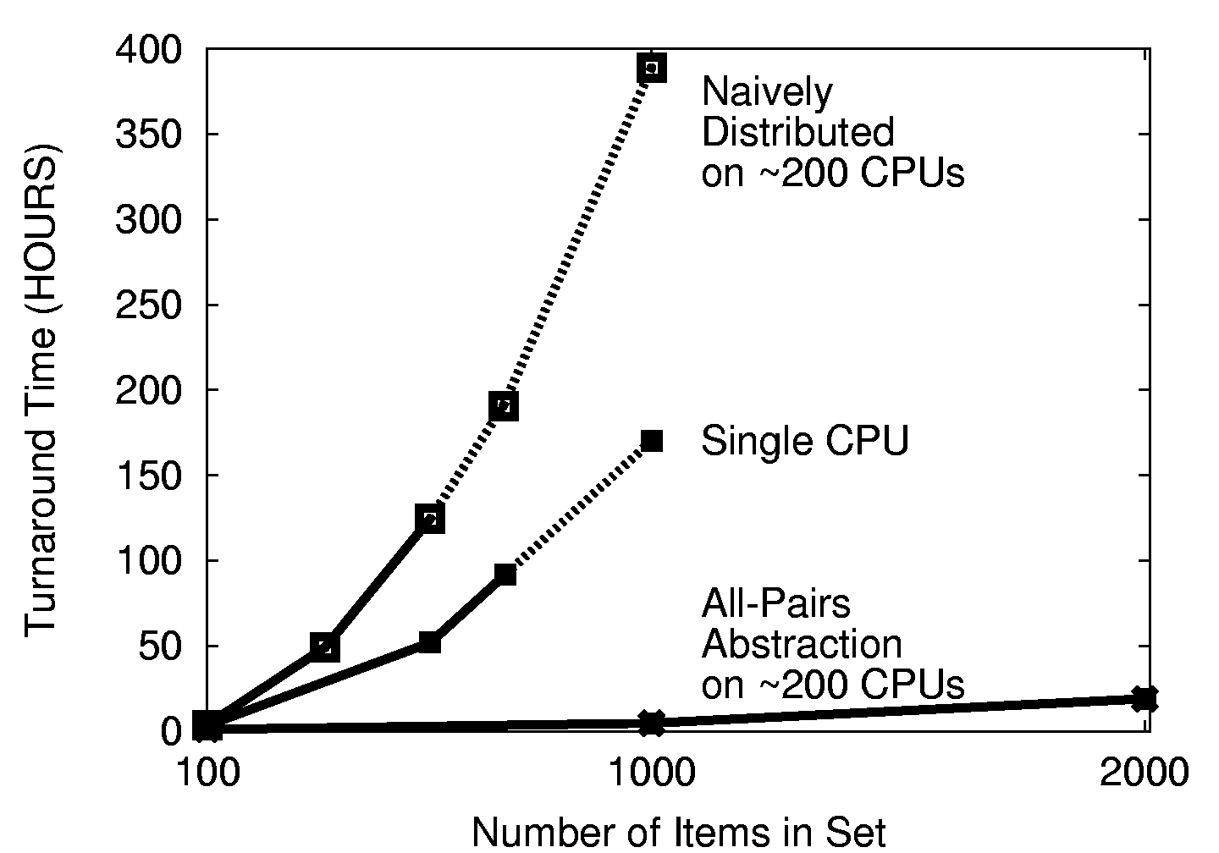

Slide 27
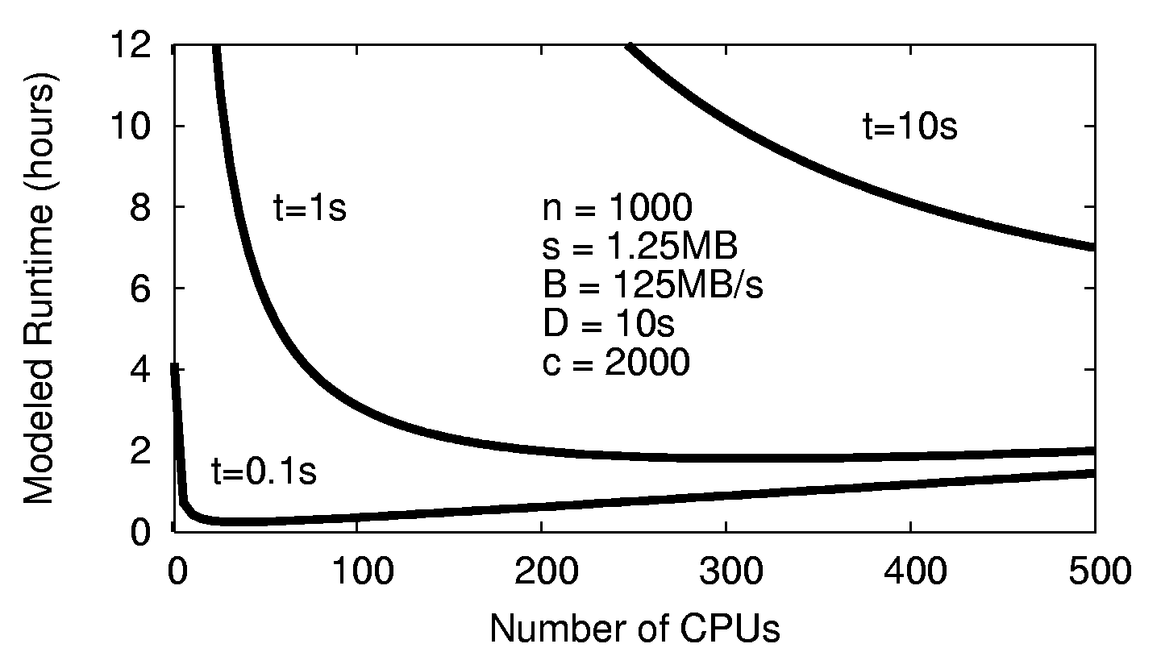
Choose the Right # of CPUs

Slide 28
All-Pairs in Production
Our All-Pairs implementation has provided over 57 CPU-years of computation to the ND biometrics research group in the first year.
Largest run so far: 58,396 irises from the Face Recognition Grand Challenge. The largest experiment ever run on publically available data.
Competing biometric research relies on samples of 100-1000 images, which can miss important population effects.
Reduced computation time from 833 days to 10 days, making it feasible to repeat multiple times for a graduate thesis. (We can go faster yet.)

Slide 29
All-Pairs Abstraction
AllPairs( set A, set B, function F )
returns matrix M where
M[i][j] = F( A[i], B[j] ) for all i,j
A1
A1
A2
A3
A1
allpairs A B F.exe
An
AllPairs(A,B,F)
B1
F
F
F
B1
B1
Bn
B2
F
F
F
F
B3
F
F
F

Slide 30
Division of Concerns
The end user provides an ordinary program that contains the algorithmic kernel that they care about. (Scholarship)
The abstraction provides the coordination, parallelism, and resource management. (Plumbing)
Keep the scholarship and the plumbing separate wherever possible!

Slide 31
Strategy:
Identify an abstraction that solves a specific category of problems very well.
Plug your computational kernel into that abstraction.

Slide 32
Are there other abstractions?

Slide 33
Wavefront( matrix M, function F(x,y,d) )
returns matrix M such that
M[i,j] = F( M[i-1,j], M[I,j-1], M[i-1,j-1] )
M[0,4]
M[2,4]
M[3,4]
M[4,4]
x
F
d
y
M[0,3]
M[3,2]
M[4,3]
Wavefront(M,F)
x
F
x
F
M
d
y
d
y
M[0,2]
x
M[4,2]
x
F
x
F
F
d
y
d
y
d
y
F
M[0,1]
x
F
x
F
x
F
x
F
d
y
d
y
d
y
d
y
M[0,0]
M[1,0]
M[2,0]
M[3,0]
M[4,0]

Slide 34
The Performance Problem
Dispatch latency really matters: a delay in one holds up all of its children.
If we dispatch larger sub-problems:
  Concurrency on each node increases.
  Distributed concurrency decreases.
If we dispatch smaller sub-problems:
  Concurrency on each node decreases.
  Spend more time waiting for jobs to be dispatched.
So, model the system to choose the block size.
And, build a fast-dispatch execution system.

Slide 35
100s of workers
dispatched via
Condor/SGE/SSH
worker
worker
worker
worker
worker
worker
queue
tasks
wavefront
work
queue
put F.exe
put in.txt
exec F.exe <in.txt >out.txt
get out.txt
worker
tasks
done
In.txt
F
out.txt

Slide 36
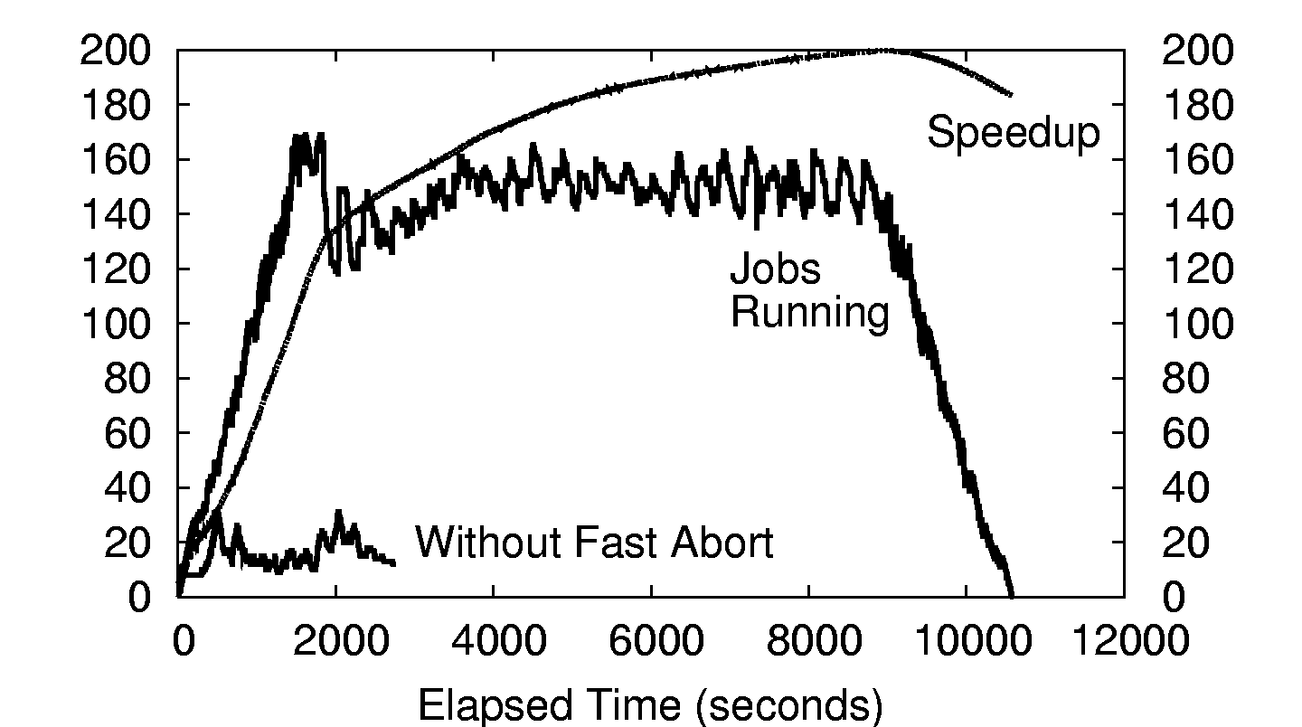
500x500 Wavefront on ~200 CPUs

Slide 37
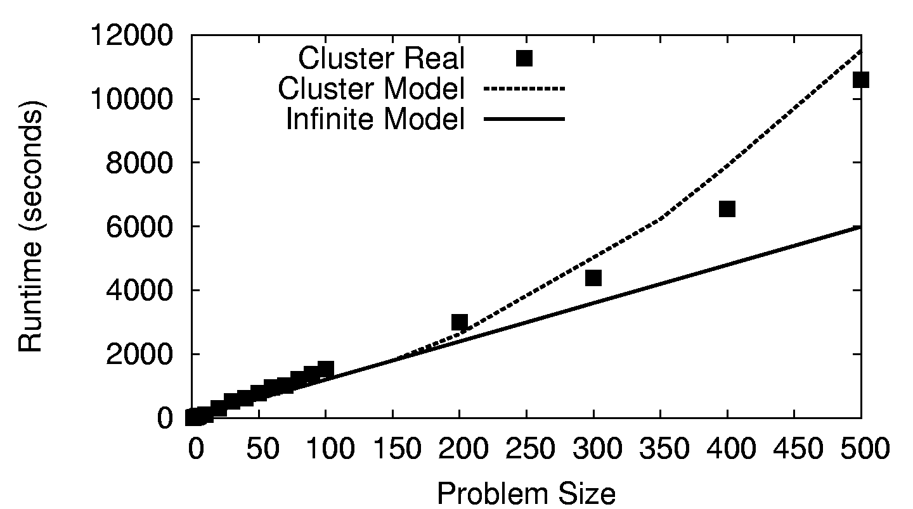
Wavefront on a 200-CPU Cluster

Slide 38
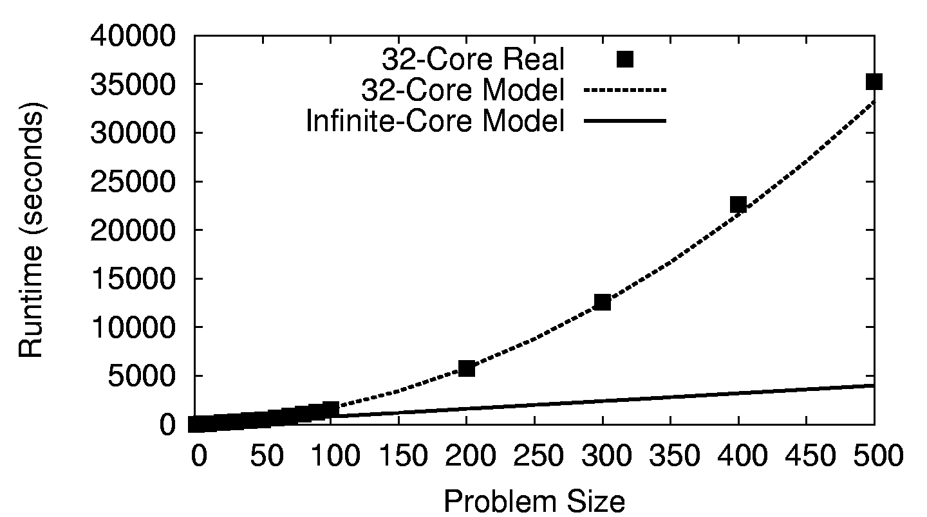
Wavefront on a 32-Core CPU

Slide 39
What if you don’t have a regular graph?
Use a directed graph abstraction.

Slide 40
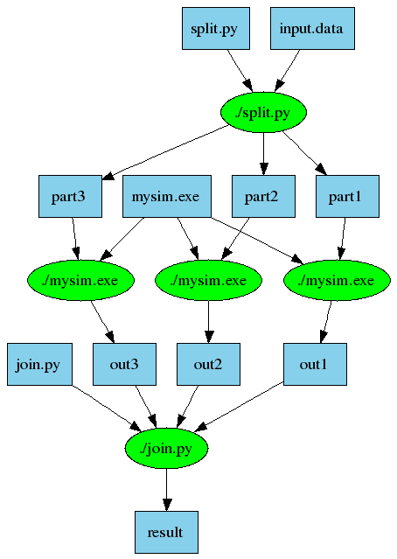
An Old Idea: Make
part1 part2 part3: input.data split.py
./split.py input.data
out1: part1 mysim.exe
./mysim.exe part1 >out1
out2: part2 mysim.exe
./mysim.exe part2 >out2
out3: part3 mysim.exe
./mysim.exe part3 >out3
result: out1 out2 out3 join.py
./join.py out1 out2 out3 > result

Slide 41
Makeflow = Make + Workflow
Provides portability across batch systems.
Enable parallelism (but not too much!)
Fault tolerance at multiple scales.
Data and resource management.
Makeflow
Local
Condor
Torque
Work
Queue
http://www.nd.edu/~ccl/software/makeflow

Slide 42
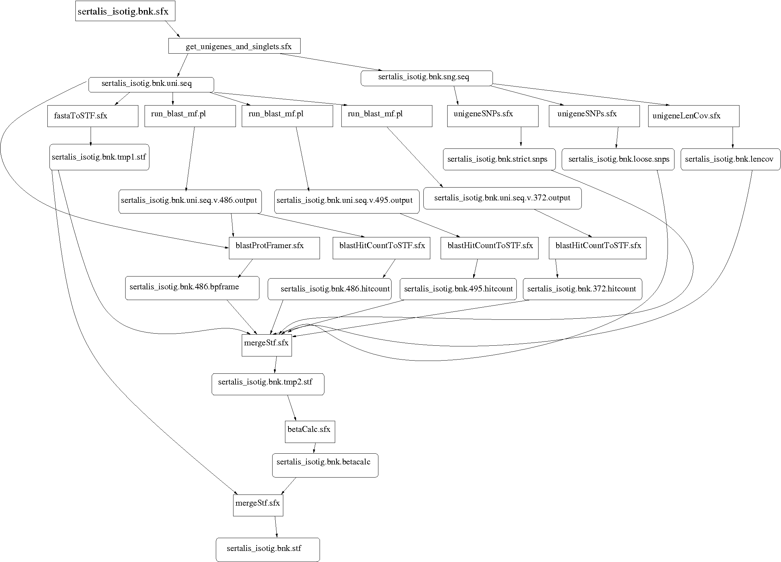
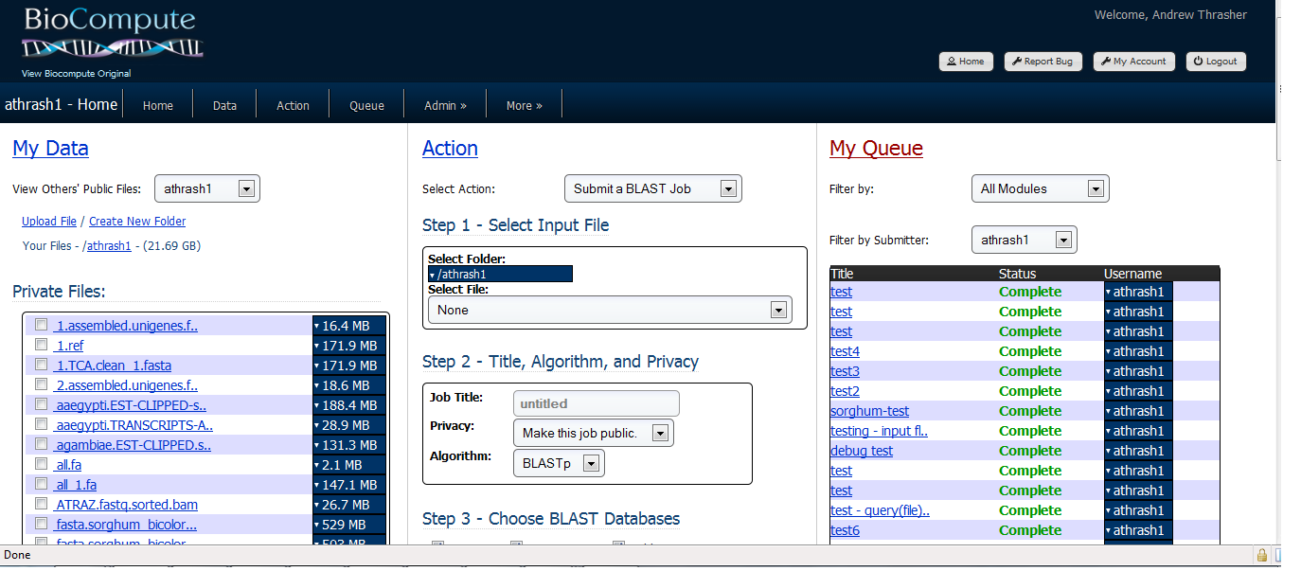
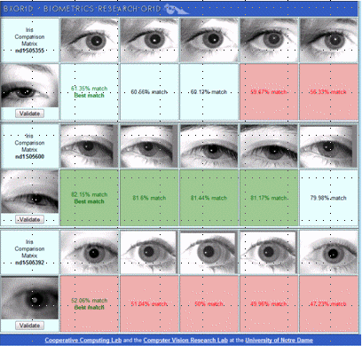
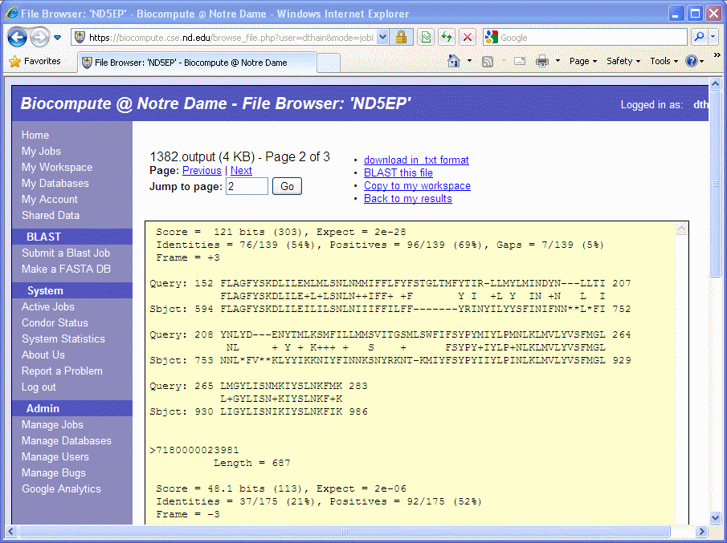
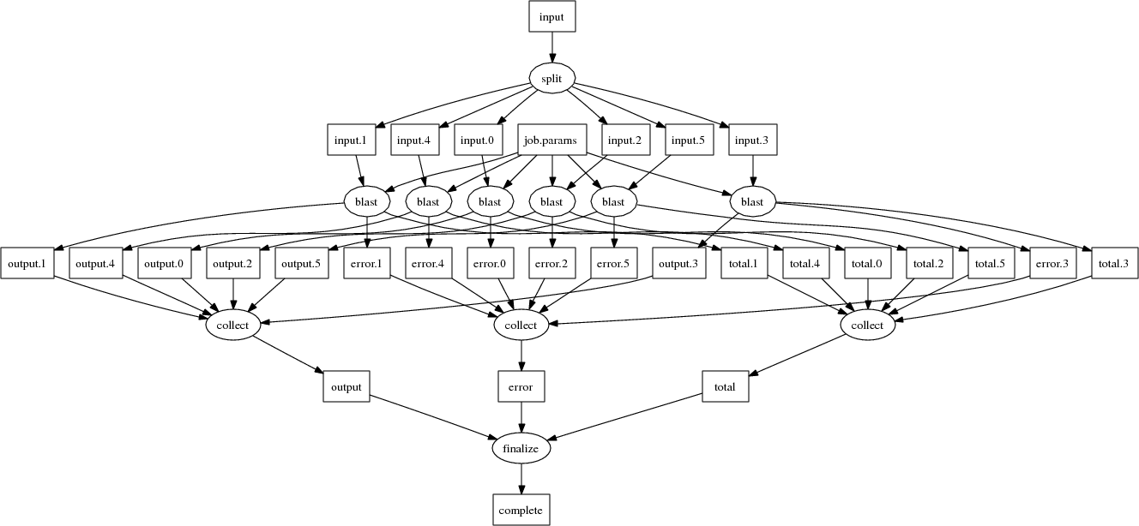
Makeflow Applications

Slide 43
Why Users Like Makeflow
Use existing applications without change.
Use an existing language everyone knows. (Some apps are already in Make.)
Via Workers, harness all available resources: desktop to cluster to cloud.
Transparent fault tolerance means you can harness unreliable resources.
Transparent data movement means no shared filesystem is required.

Slide 44
What if you have a dynamic algorithm?
Use a submit-wait abstraction.

Slide 45
Work Queue API
#include “work_queue.h”
while( not done ) {
while (more work ready) {
task = work_queue_task_create();
// add some details to the task
work_queue_submit(queue, task);
}
task = work_queue_wait(queue);
// process the completed task
}
http://www.nd.edu/~ccl/software/workqueue

Slide 46
Work Queue System
1000s of workers
dispatched to clusters, clouds, and grids
worker
worker
worker
worker
worker
worker
Work Queue Program
C / Python / Perl
Work Queue Library
put P.exe
put in.txt
exec P.exe <in.txt >out.txt
get out.txt
worker
In.txt
P
out.txt
http://www.nd.edu/~ccl/software/workqueue

Slide 47
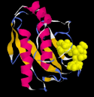
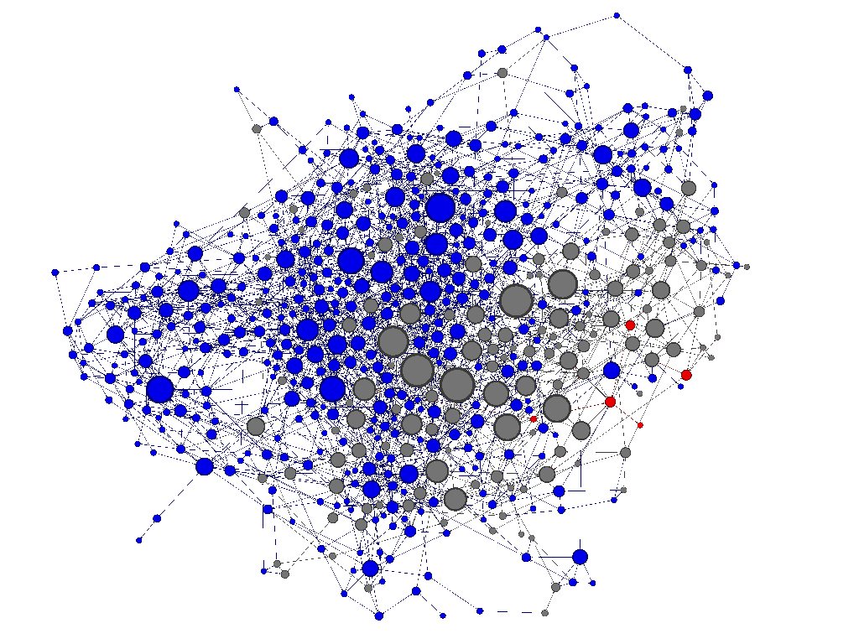
Adaptive Weighted Ensemble
Proteins fold into a number of distinctive states, each of which affects its function in the organism.
How common is each state?
How does the protein transition between states?
How common are those transitions?

Slide 48
AWE Using Work Queue
Simplified Algorithm:
  Submit N short simulations in various states.
  Wait for them to finish.
  When done, record all state transitions.
  If too many are in one state, redistribute them.
  Stop if enough data has been collected.
  Continue back at step 2.

Slide 49
AWE on Clusters, Clouds, and Grids
sge_submit_workers
Private
Cluster
Shared
SGE
Cluster
Work Queue App
Wv
W
Hundreds of Workers in a
Personal Cloud
W
submit
tasks
W
W
W
Work Queue API
Campus
Condor
Pool
Public
Cloud
Provider
W
W
W
W
W
W
W
Local Files and Programs
condor_submit_workers
ssh

Slide 50
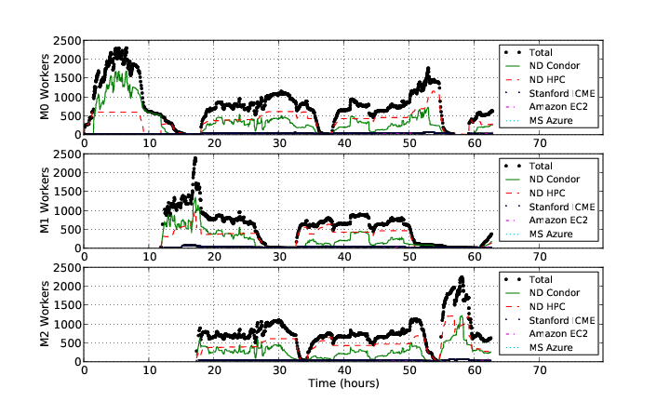
AWE on Clusters, Clouds, and Grids

Slide 51
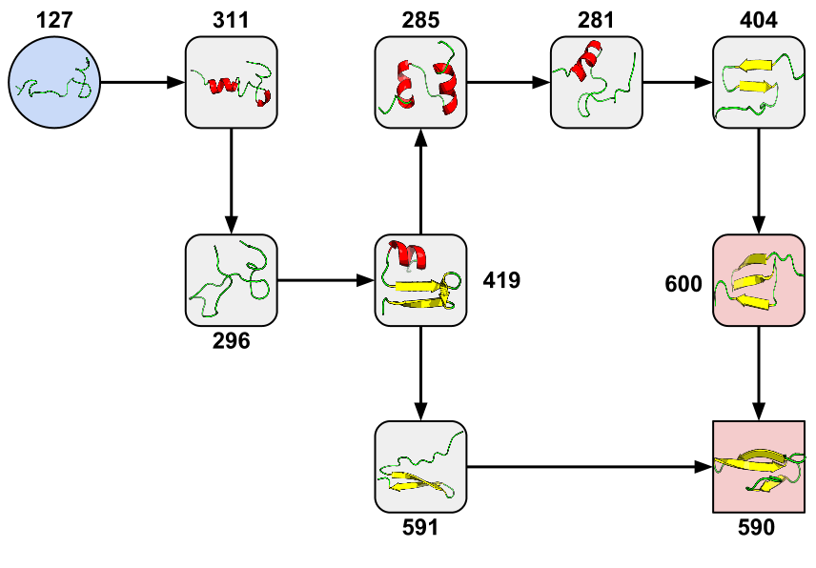
New Pathway Found!
Credit: Joint work in progress with Badi Abdul-Wahid, Dinesh Rajan, Haoyun Feng, Jesus Izaguirre, and Eric Darve.

Slide 52
Cooperative Computing Tools
All-Pairs
Wavefront
Makeflow
Custom
Apps
Work Queue Library
Hundreds of Workers in a
Personal Cloud
Public
Cloud
Provider
Shared
SGE
Cluster
Campus
Condor
Pool
Private
Cluster
W
W
Wv
W
W
W
W
W
W
http://www.nd.edu/~ccl

Slide 53
Ruminations

Slide 54
I would like to posit that computing’s central challenge how not to make a mess of it has not yet been met.
- Edsger Djikstra

Slide 55
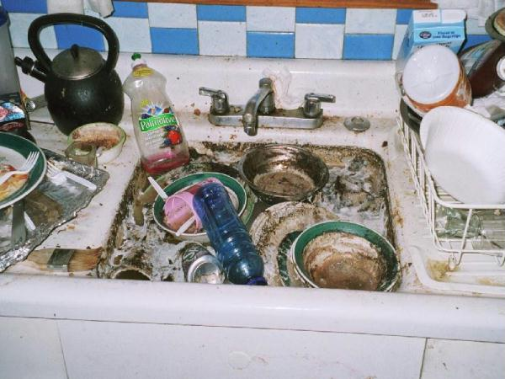
The Most Common
Programming Model?
Every program attempts to grow until it can read mail. - Jamie Zawinski

Slide 56
An Old Idea: The Unix Model
input < grep | sort | uniq > output

Slide 57
Advantages of Little Processes
Easy to distribute across machines.
Easy to develop and test independently.
Easy to checkpoint halfway.
Easy to troubleshoot and continue.
Easy to observe the dependencies between components.
Easy to control resource assignments from an outside process.

Slide 58
Avoid writing new code!
Instead, create coordinators that organize multiple existing programs.
(Keeps the scholarly logic separate from the plumbing.)

Slide 59
Distributed Computing is a Social Activity
M[0,4]
x
F
M[2,4]
M[3,4]
M[4,4]
M[0,3]
d
y
M[3,2]
M[4,3]
x
F
x
F
System
Designer
End User
M[0,2]
d
y
d
y
M[4,2]
x
F
x
F
x
F
M[0,1]
d
y
d
y
d
y
x
F
x
F
x
F
x
F
M[0,0]
d
y
d
y
d
y
d
y
M[1,0]
M[2,0]
M[3,0]
M[4,0]
System
Operators

Slide 60
In allocating resources, strive to avoid disaster, rather than obtain an optimum.
- Butler Lampson

Slide 61
Strategy:
Identify an abstraction that solves a specific category of problems very well.
Plug your computational kernel into that abstraction.

Slide 62
Research is a Team Sport
Faculty Collaborators:
Patrick Flynn (ND)
Scott Emrich (ND)
Jesus Izaguirre (ND)
Eric Darve (Stanford)
Vijay Pande (Stanford)
Sekou Remy (Clemson)
Current Graduate Students:
Michael Albrecht
Patrick Donnelly
Dinesh Rajan
Peter Sempolinski
Li Yu
Recent CCL PhDs
Peter Bui (UWEC)
Hoang Bui (Rutgers)
Chris Moretti (Princeton)
Summer REU Students:
Chris Bauschka
Iheanyi Ekechuku
Joe Fetsch

Slide 63
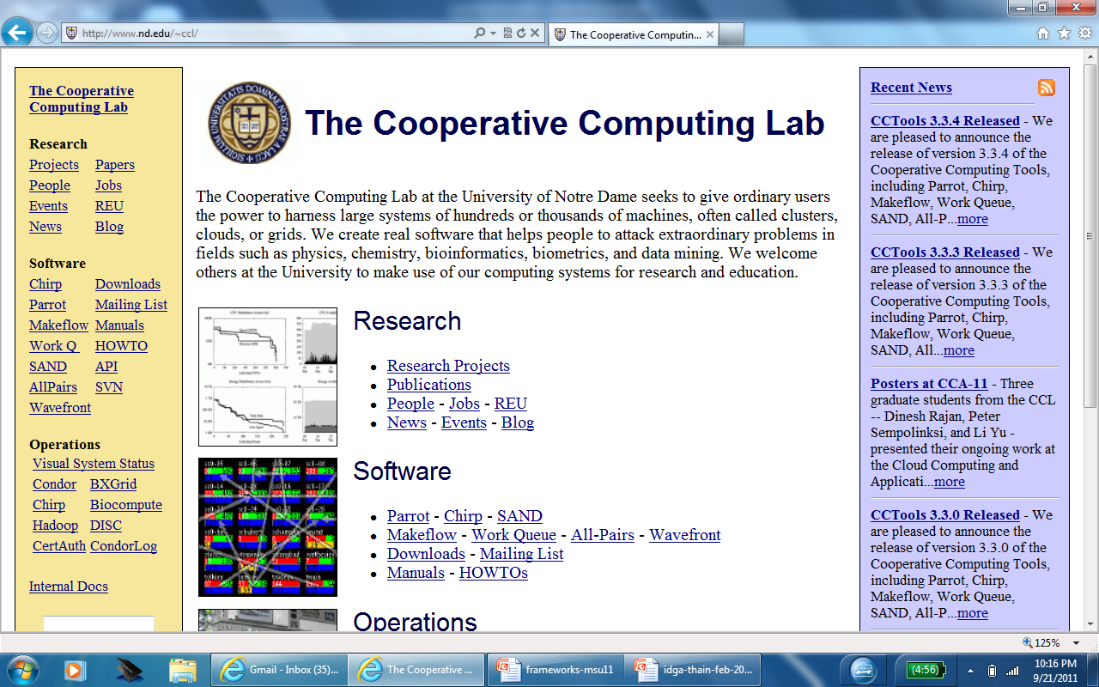

Papers, Software, Manuals, …
http://www.nd.edu/~ccl
This work was supported by
NSF Grants CCF-0621434, CNS-0643229
and CNS-08554087.

