Slide 1
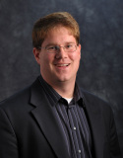
Reconsidering the Filesystem for Distributed Data Processing
Prof. Douglas Thain, University of Notre Dame
http://www.nd.edu/~dthain
dthain@nd.edu
@ProfThain

Slide 2
Reconsidering the Filesystem for Distributed Data Processing for DAG Structured Workflows
Prof. Douglas Thain, University of Notre Dame
http://www.nd.edu/~dthain
dthain@nd.edu
@ProfThain

Slide 3
The Cooperative Computing Lab
We collaborate with people who have large scale computing problems in science, engineering, and other fields.
We operate computer systems on the O(10,000) cores: clusters, clouds, grids.
We conduct computer science research in the context of real people and problems.
We develop open source software for large scale distributed computing.
http://ccl.cse.nd.edu

Slide 4
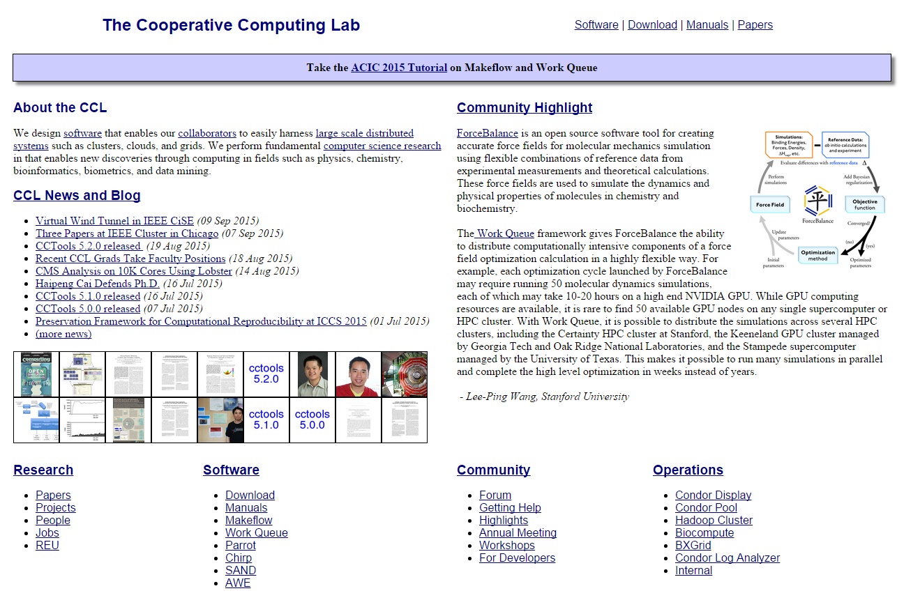
http://ccl.cse.nd.edu

Slide 5
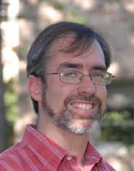
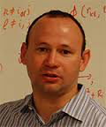
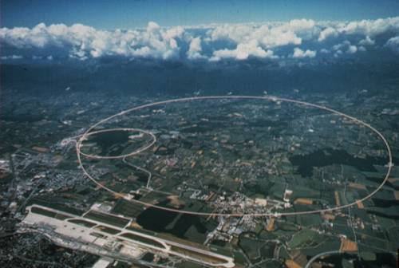
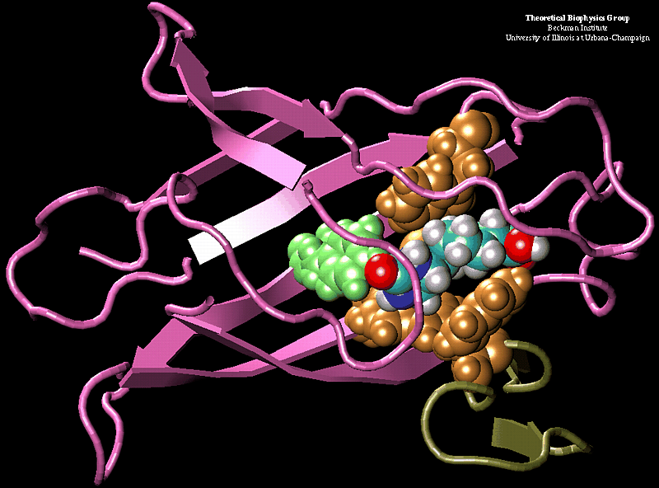
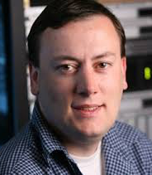
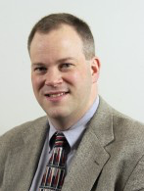
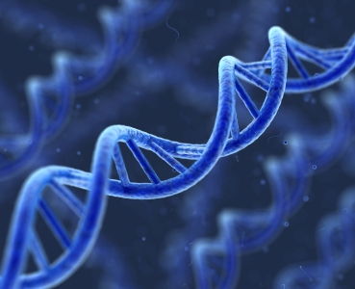
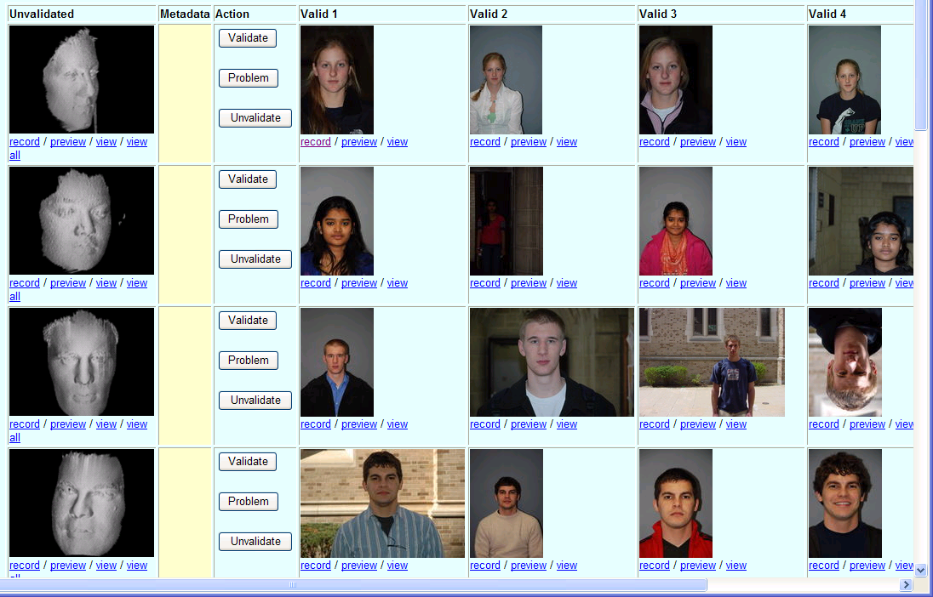
Some of Our Collaborators
K. Lannon: Analyze 2PB of data produced by the LHC experiment at CERN
J. Izaguirre: Simulate 10M different configurations of a complex protein.
S. Emrich: Analyze DNA in thousands of genomes for similar sub-sequences.
P. Flynn: Computational experiments on millions of acquired face videos.

Slide 6
Scientific Computing
Has Really Interesting CS Problems!
Our collaborators always want to push the limits of computing: bigger, faster, more reliable, . . .
Programming a 10K core system means thinking about all the hard problems: parallelism, fault tolerance, data locality, consistency
We get to work with real people, real datasets, and real applications, not toy examples. (but that means we need to deliver things that work.)
We can contribute to problems that advance human health and understanding.

Slide 7
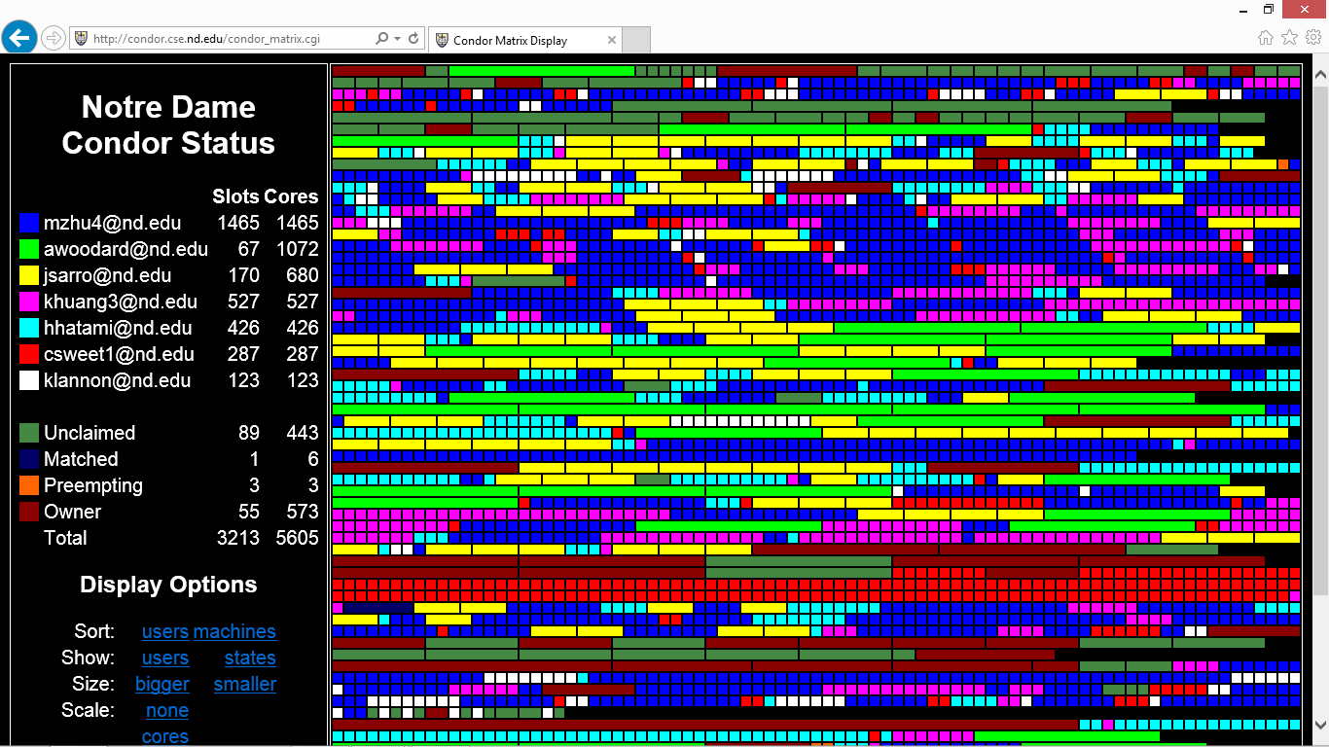
Harnessing Cycles with HTCondor

Slide 8
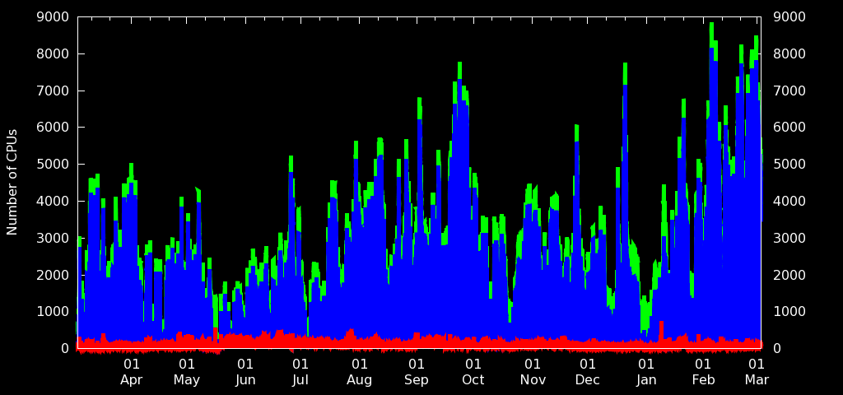

Resources Vary Over Time

Slide 9
Outline
Scientific Computing at Notre Dame
About DAG Structured Workflows
Workflows + Filesystems = Trouble!
Exploit Workflow Structure!
  Metadata Distribution
  Explicit Data Movement
Lessons Learned and Future Thoughts

Slide 10

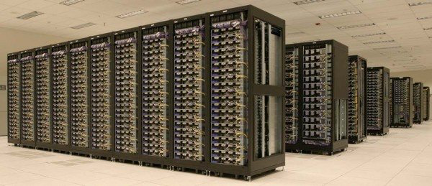

From the scientist's perspective…
It took a while (most of a year) but now I have my code written, installed, debugged, calibrated, and verified on my laptop.
Now I want to run at a scale 1000x larger by using a cluster, cloud, grid, or whatever you computer people are calling it today.
There is no way you are going to convince me to re-write this valuable program in order to run on your crazy cluster / OS / framework!
(Important science codes outlive OS/HW.)

Slide 11
Starting Point: One Job
"sim.exe –p 50 in.dat -o output.dat"
Input
File
Calib
File
Job Description File
Exec. Environment
Software
and Scripts
(and OS?)
Unix
Program
submit
Resources:
  4 cores
  8GB RAM
  3GB Disk
  1 Hour
Batch System:
HTCondor
Sun Grid Engine
PBS/Torque
Cluster Mgr:
Mesos
Kubernetes
Amazon Batch
Output
File

Slide 12
Some researchers ask:
"How do I make one job faster?"
(high performance computing)
Others are interested in:
"How can I do more in the same amount of time?"
(high throughput computing)

Slide 13
DAG: Directed Acyclic Graph
(a.k.a. Workflow)
Generate
Model
Simulate
-p 1
Simulate
-p 2
Simulate
-p 3
Trace
Trace
Trace
Graph
Analyze
Analyze
Analyze
Plot
Result
Result
Result

Slide 14
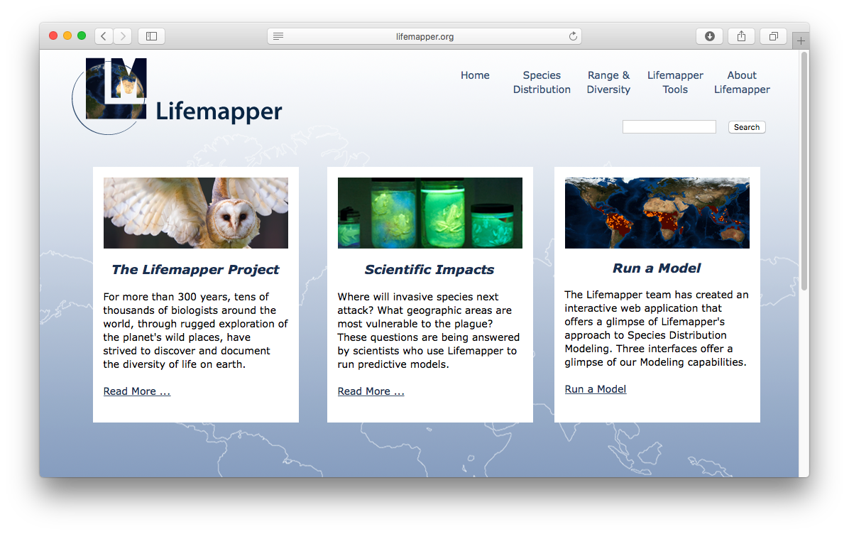
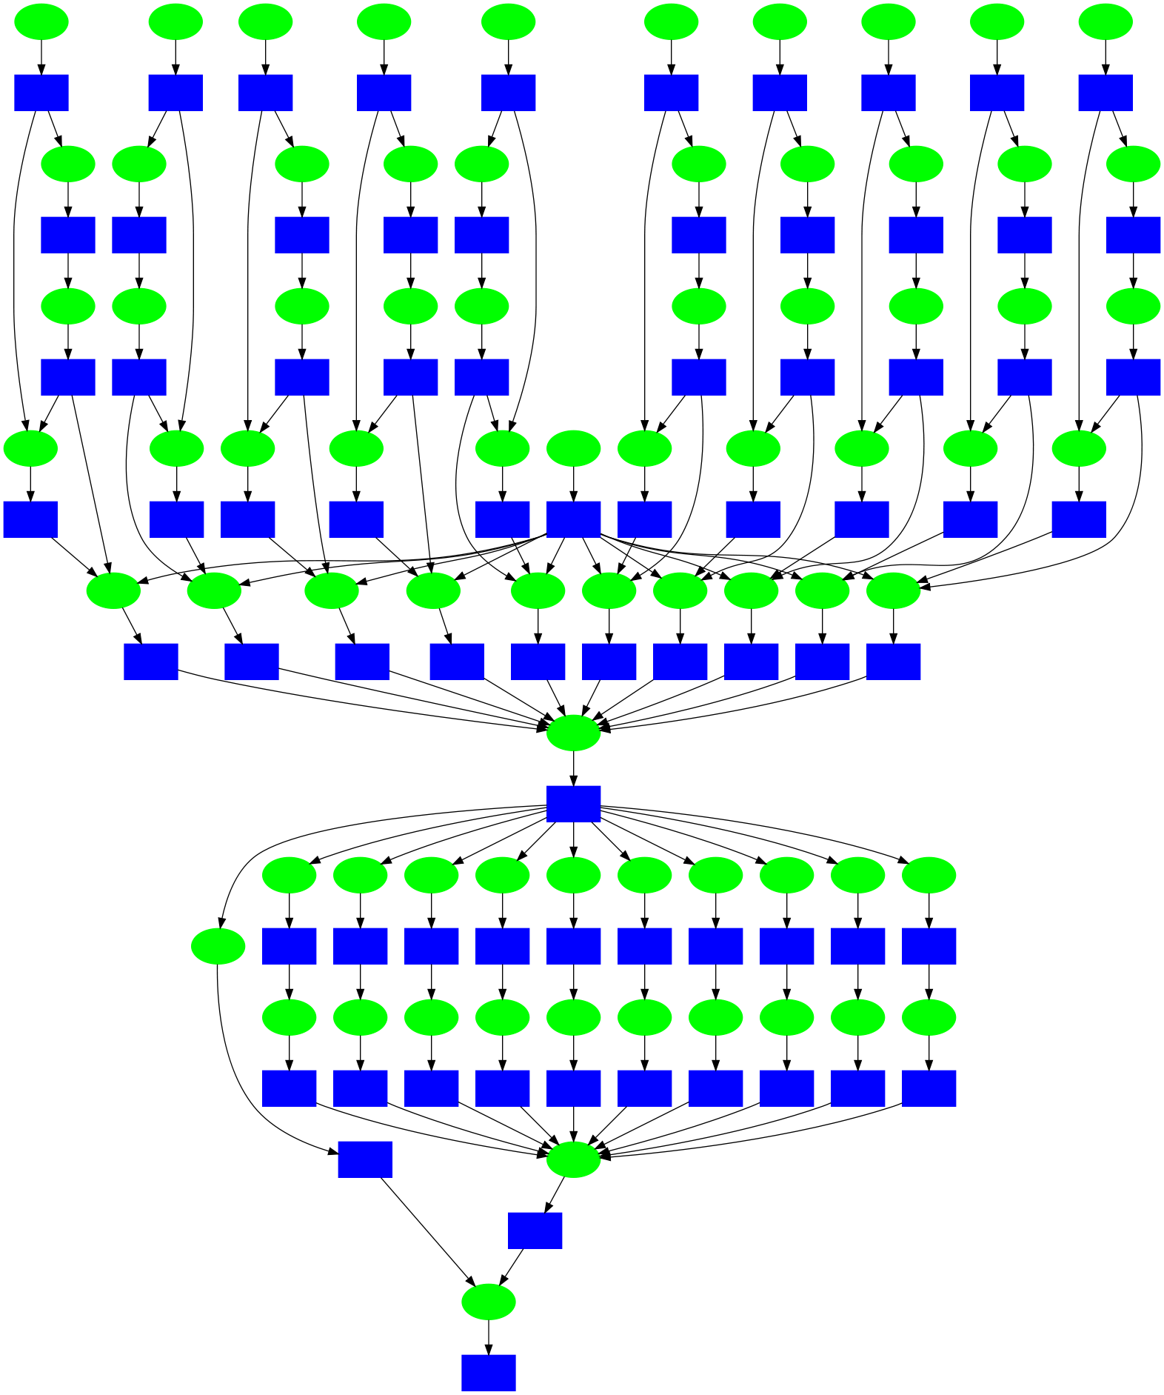
Example: Species Distribution Modeling
Full Workflow:
12,500 species
x 15 climate scenarios
x 6 experiments
x 500 MB per projection
= 1.1M jobs, 72TB of output
Small Example: 10 species x 10 expts

Slide 15
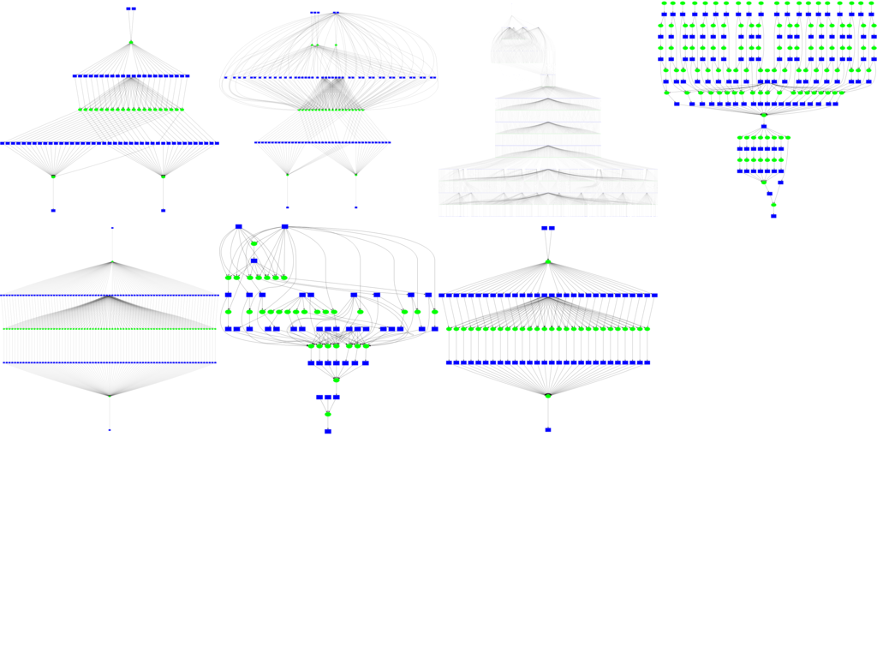
More Examples
http://github.com/cooperative-computing-lab/makeflow-examples

Slide 16
How to Express a DAG?
XML, JSON, DOT, Edges+Vertexes, ...

Slide 17
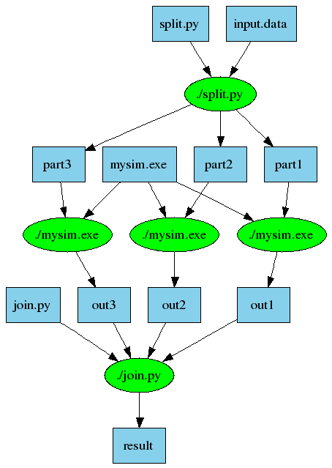
An Old Idea: Makefiles
part1 part2 part3: input.data split.py
./split.py input.data
out1: part1 mysim.exe
./mysim.exe part1 >out1
out2: part2 mysim.exe
./mysim.exe part2 >out2
out3: part3 mysim.exe
./mysim.exe part3 >out3
result: out1 out2 out3 join.py
./join.py out1 out2 out3 > result
(Simple, portable, and technology independent.)

Slide 18
Makeflow = Make + Workflow
Provides portability across batch systems.
Enables parallelism (but not too much!)
Fault tolerance at multiple scales.
Data and resource management.
Transactional semantics for job execution.
Makeflow
Local
HTCondor
Torque
Work
Queue
http://ccl.cse.nd.edu/software/makeflow

Slide 19
Makeflow Shapes a Workflow
Concurrency
and Policy Control
Millions of Tasks
Batch System
Make
Flow
Precise
Cleanup
Transaction Log
Performance
Monitoring

Slide 20
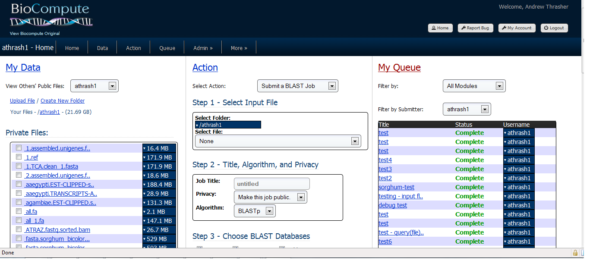

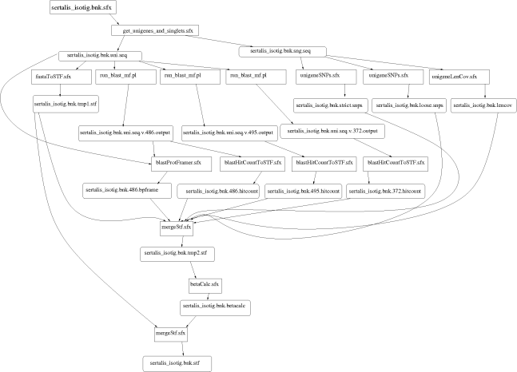
Example: Bioinformatics Portal
BLAST
SSAHA
SHRIMP
EST
MAKER
…
Progress
Bar
Generate Makefile
Transaction Log
HTCondor Pool
Update
Status
Run
Workflow
Make
flow

Slide 21
Robustness in Time and Space
A workflow with 1M jobs is potentially a big mess for users and system administrators.
Over the course of days or months:
  Cluster nodes can crash and restart.
  The head node itself could crash and restart.
  User might want to pause/halt the workflow.
  Sysadmin may want to examine and relate jobs/users/workflows.
Must avoid orphan, zombie, duplicated, or missing jobs, even in the presence of failures!

Slide 22
Think of Jobs as Long-Running Transactions:
SubmitJob( Details );
<- JobID
CommitJob( JobID );l
GetStatus( JobID );
<- Status
WaitForAJob();
<- JobID
RemoveJob( JobID );
Input
Files
Batch System
One
Job
Output
Files
(Many cluster managers get this interface wrong, and the result is orphaned, zombie, or duplicated jobs.)

Slide 23
A Workflow Requires
Nested Transactions
Workflow
Batch System
-> BeginJob(…)
<- JobID 123
-> CommitJob(123)
<- OK
-> BeginJob(…)
<- JobID 124
-> CommitJob(124)
-> WaitForAJob()
<- JobID 124 Done
Make
flow
Transaction Log
12:00:05 Job 123 Created
12:00:06 Job 123 Committed
12:00:10 Job 124 Created
12:00:11 Job 124 Committed
12:36:06 Job 124 Done
. . .

Slide 24
Upshot: Treat an Entire Workflow Like a Single Reliable Job
Start Workflow:
  Submit jobs and record details in the log.
Get Status of Workflow:
  Read log, compare to desired end state.
Crash/Restart of Workflow:
  Read log, look for completions during outage, then continues without loss.
Abort Workflow:
  Record intent to abort, then remove jobs, log removals as they complete, then exit.
Safe to crash/restart during recovery or abort!

Slide 25
Outline
Scientific Computing at Notre Dame
About DAG Structured Workflows
Workflows + Filesystems = Trouble!
Exploit Workflow Structure!
  Metadata Distribution
  Explicit Data Movement
Lessons Learned and Future Thoughts

Slide 26
Workflows Stress Filesystems!
Thought experiment: Start 1000x instances of a program simultaneously on a cluster, each loading the same software and input file.
CPU
CPU
CPU
CPU
CPU
CPU
Compute Cluster
Meta
Data
Disk
Disk
Disk
Disk
Disk
Scalable File System

Slide 27
Metadata Bottleneck
First, they all attack the metadata server as they attempt to traverse the filesystem!
Job
Job
Job
Job
Job
Job
CPU
CPU
CPU
CPU
CPU
CPU
Compute Cluster
Meta
Data
Disk
Disk
Disk
Disk
Disk
Scalable File System

Slide 28
Data Bottleneck
Next, they all attack the same data server(s) because they are all consuming the same data!
Job
Job
Job
Job
Job
Job
CPU
CPU
CPU
CPU
CPU
CPU
Compute Cluster
Meta
Data
Disk
Disk
Disk
Disk
Disk
Scalable File System

Slide 29
Temporal Inconsistencies
One job finishes and writes its output.
The next job starts, but cannot find the (still buffered) data!
CPU
CPU
Job
2
CPU
CPU
Job
1
CPU
CPU
$$$$
Compute Cluster
???
Meta
Data
Disk
Disk
Disk
Disk
Disk
Scalable File System

Slide 30
What's the Problem Here?
A conventional filesystem has no knowledge of what workload is going to be applied, so it can only proceed in reaction to each event.
Although it should be conservative, almost every filesystem "fudges" the rules and buffers/caches too aggressively to gain performance.
These problems have been known since the 1980s and there is no general solution. ☹

Slide 31
But, a workflow explains all of it's I/O behavior in advance!

Slide 32
Outline
Scientific Computing at Notre Dame
About DAG Structured Workflows
Workflows + Filesystems = Trouble!
Exploit Workflow Structure!
  Metadata Distribution
  Explicit Data Movement
Lessons Learned and Future Thoughts

Slide 33
Example: Metadata Storms
Common behavior: long burst of metadata access at the beginning of an application:
  Search through PATH for executables.
  Search through LD_LIBRARY_PATH for libraries.
  Load Java classes from CLASSPATH.
  Load extensions from file system.
  Bash script? Repeat for every single line!
Complex program startup can result in millions of metadata transactions!

Slide 34
Metadata Storm
Program
Same problem on any parallel filesystem: Ceph, HDFS, Panasas, Lustre, …
stat
readdir
access
open
read/write
Metadata Server
Data Server
Data Server
Directory Tree

Slide 35
Idea: Bulk Metadata Distribution
We know some things in advance:
  Which nodes need to load the software.
  Which software is needed.
  Software won't change during the run.
Idea:
  Build up all the metadata needed in advance.
  Deliver it in bulk to each node.
  Cache it for as long as the workflow runs.

Slide 36
Bulk Metadata Load
Program
Metadata
Listing
Software metadata is cached
on all nodes for the
duration of the workflow
and served at $$$ speed.
FUSE
Bulk Transfer
read / write
Metadata Server
Traversal
Script
Metadata
Listing
Directory Tree

Slide 37
CVMFS Filesystem on >100K Cores
Around the World
App
App
FUSE
FUSE
CVMFS
CVMFS
$$$
$$$
$$$
Proxy
Cache
Network
CMS Software
967GB File System
at CERN
Metadata
And
Checksums
A
B
C
Generate
Index
Individual Files
CVMFS: Cern-VM Filesystem

Slide 38
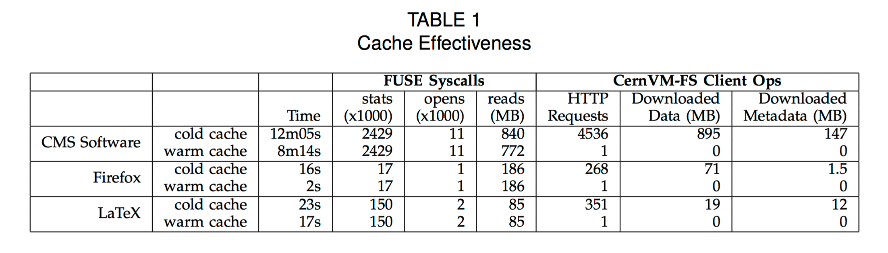
Some Quick Numbers
Nearly 2.5M metadata ops to start application
Reduced to a load of a single 147MB metadata file.
Jakob Blomer, Predrag Buncic, Rene Meusel, Gerardo Ganis, Igor Sfiligoi and Douglas Thain, The Evolution of Global Scale Filesystems for Scientific Software Distribution, IEEE/AIP Computing in Science and Engineering, 17(6), pages 61-71, December, 2015. DOI: 10.1109/MCSE.2015.111

Slide 39
Outline
Scientific Computing at Notre Dame
About DAG Structured Workflows
Workflows + Filesystems = Trouble!
Exploit Workflow Structure!
  Metadata Distribution
  Explicit Data Movement
Lessons Learned and Future Thoughts

Slide 40
Invert the Approach
A traditional system design:
  Dispatch programs to nodes, then allow them to request access to arbitrary files.
But if we know the file needs in advance:
  Send files to nodes first, then execute the programs on those local copies.
  Cache / copy / delete files based on our high level structural knowledge of the workflow!

Slide 41
Work Queue
Architecture
Submit
Complete
4-core machine
Work Queue
Master
Send files
Worker Process
Send tasks
A
A
A
A
B
C
T
T
C
B
B
C
Local Files and Programs
Cache
Dir
Task.1
Sandbox
Task.2
Sandbox
2-core task
2-core task

Slide 42
Harness Multiple Resources
torque_submit_workers
National
Computing
Resource
Private
Cluster
W
W
Thousands of Workers in a
Personal Cloud
W
submit
tasks
W
W
W
Work Queue Master
Campus
HTCondor
Pool
Public
Cloud
Provider
W
W
W
W
W
W
W
Local Files and Programs
condor_submit_workers
ssh

Slide 43
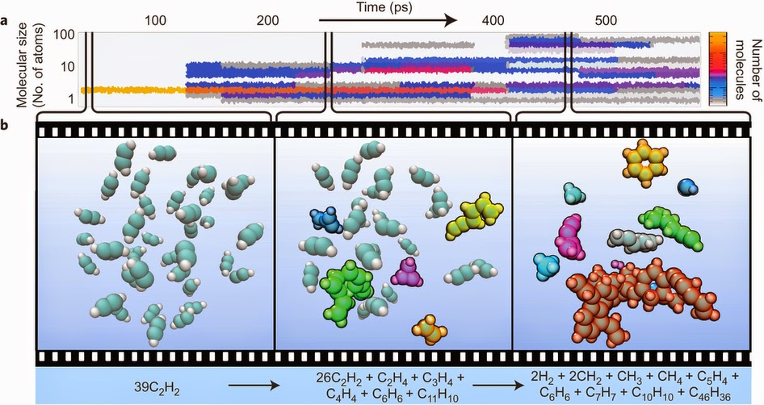
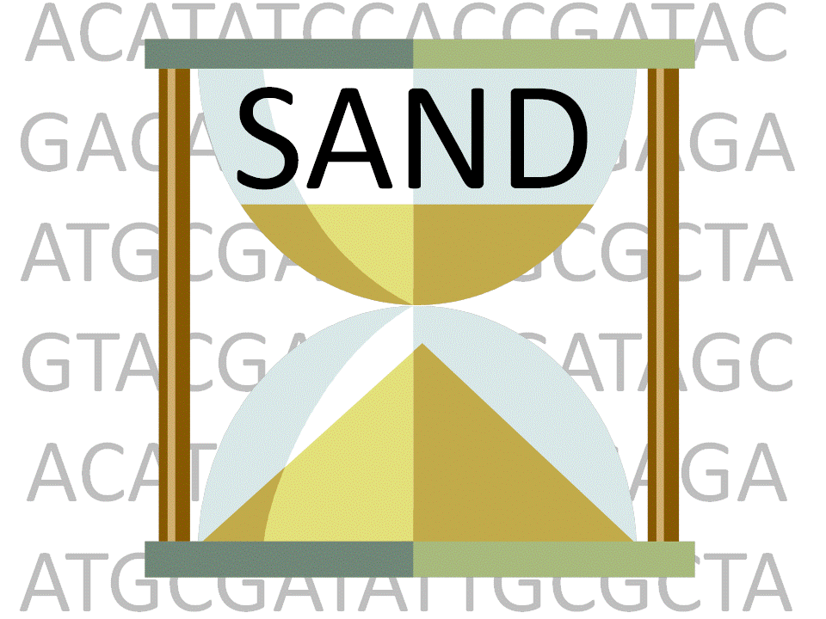
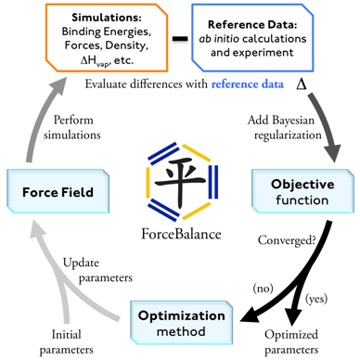
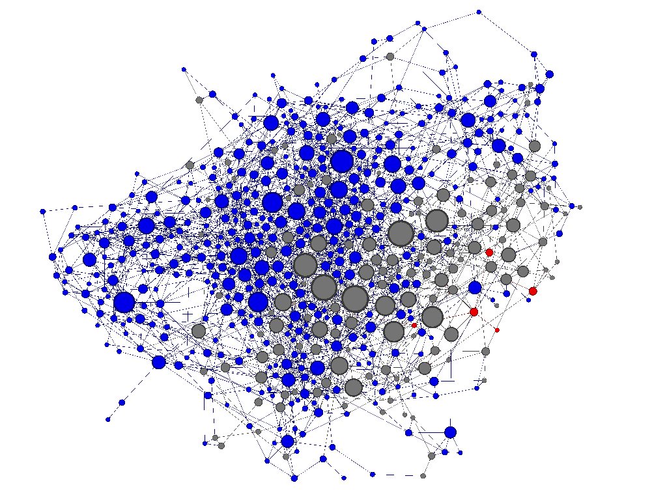
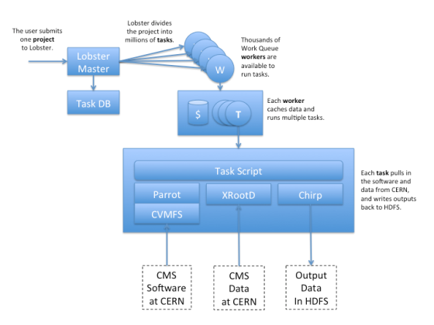
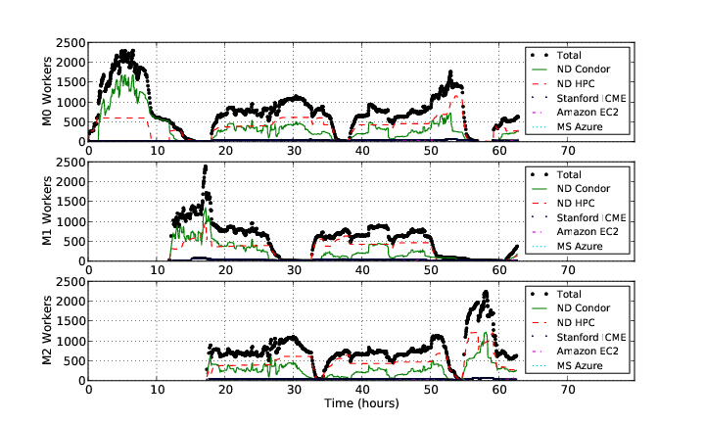
Work Queue Applications
Nanoreactor MD Simulations
Scalable Assembler at Notre Dame
ForceBalance
Adaptive Weighted Ensemble
Lobster HEP

Slide 44
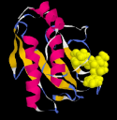
Adaptive Weighted Ensemble
Proteins fold into a number of distinctive states, each of which affects its function in the organism.
How common is each state?
How does the protein transition between states?
How common are those transitions?
44

Slide 45
AWE on Clusters, Clouds, and Grids
Badi Abdul-Wahid, Haoyun Feng, Dinesh Rajan, Ronan Costaouec, Eric Darve, Douglas Thain, and Jesus A. Izaguirre,AWE-WQ: Fast-Forwarding Molecular Dynamics using the Accelerated Weighted Ensemble,
Journal of Chemical Information and Modeling, 54(10), pages 3033-3043, September, 2014. DOI: 10.1021/ci500321g
45

Slide 46
Outline
Scientific Computing at Notre Dame
About DAG Structured Workflows
Workflows + Filesystems = Trouble!
Exploit Workflow Structure!
  Metadata Distribution
  Explicit Data Movement
Lessons Learned and Future Thoughts

Slide 47
Some Ruminations on Workflows
Classic interfaces and concepts have enduring value, even in our "new world":
  Transactions, Unix Processes, Make (all 1970s)
End users are willing to provide some information and high level structure about their intentions – if it pays off for them!
We can step over some unsolvable problems by exploiting workflow structure.

Slide 48
Some Ruminations on Filesystems
Open/read/write/close has worked well for a long time, but seems to be too small a granularity for large scale systems.
Do we need new filesystem ops?
  fd = Opentree("/home/dthain",O_RDONLY);
  Results = Search("$PATH","sim.exe");
  Something like SQL for metadata?

Slide 49
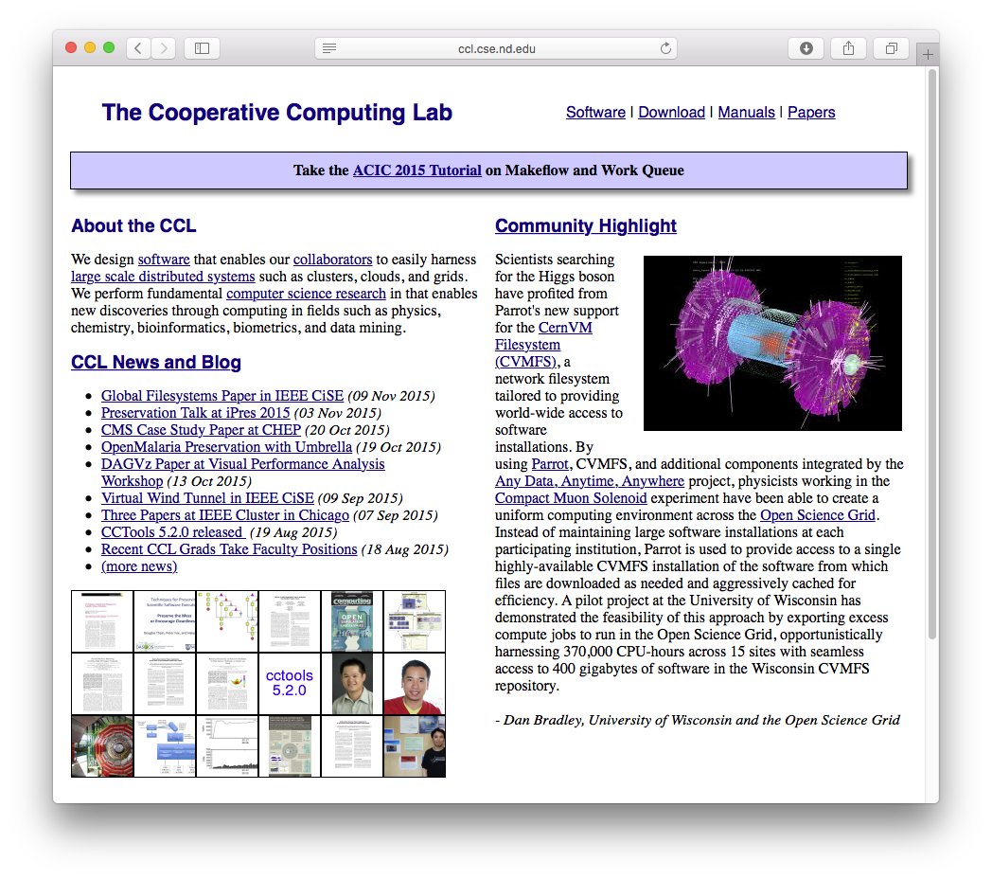
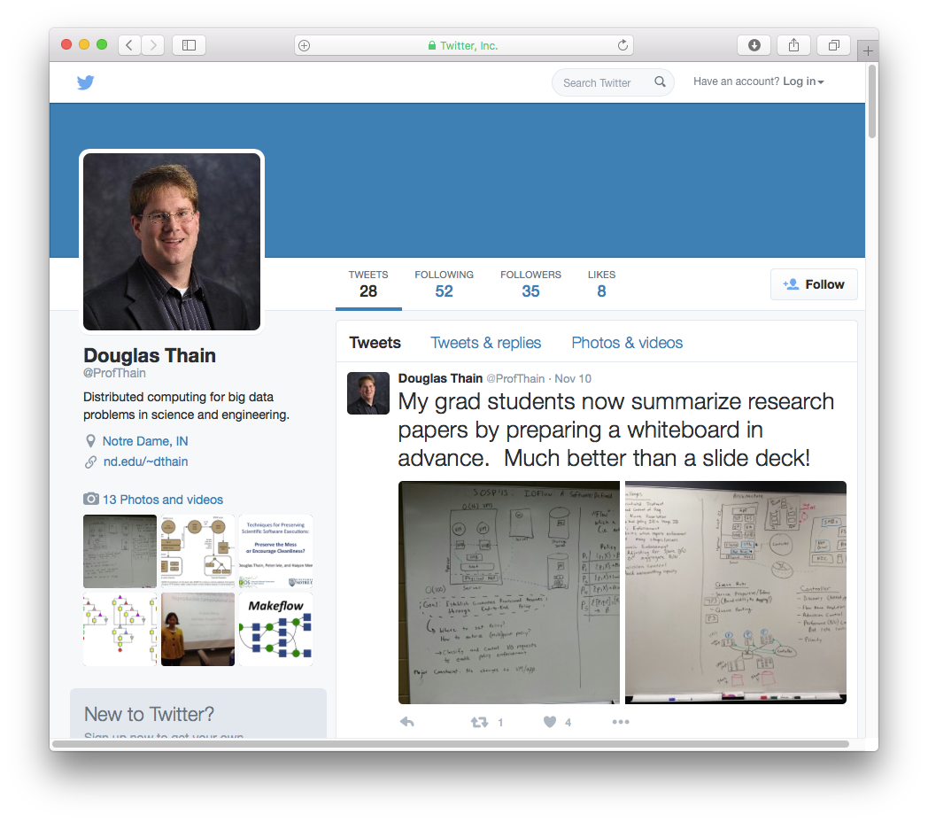
http://ccl.cse.nd.edu
@ProfThain

Slide 50
Extra Slides

Slide 51
(Brief detour about containers)

Slide 52
Containers Create Precise Execution Environments
docker run ubuntu-38.23 mysim.exe
code
code
mysim
libraries
libraries
kernel
ubuntu-38.23
image
Container
Environment

Slide 53
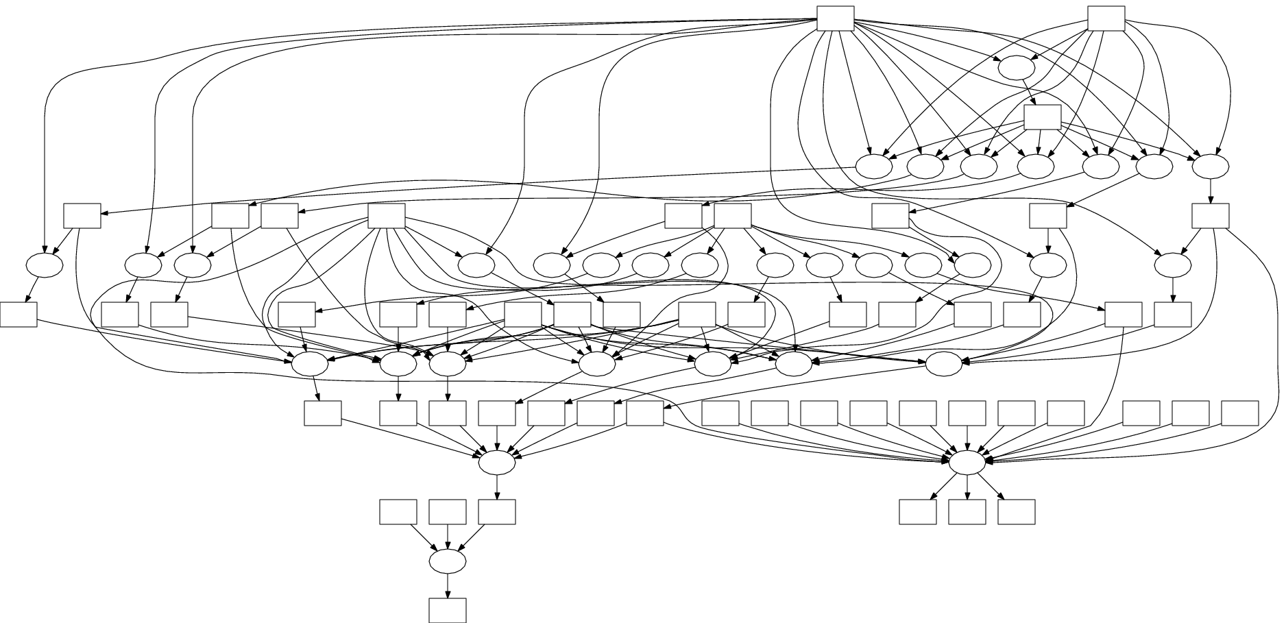
Containers and Workflows
Docker Image:
ubuntu-38.23
Millions of Tasks
Thousands of Nodes
Batch
System
T
T
Make
Flow
T
T
makeflow --docker ubuntu-38.23 –T condor . . .

Slide 54


Container Technology is Evolving
docker run ubuntu command
docker
dockerd
container
docker.io
installed service running as root
singularity exec ubuntu command
singular
container
singularity.lbl.gov
container runs directly as a child process
(still needs setuid tool, though)

Slide 55
Same Thing Using Singularity
Singularity image:
ubuntu.img
Millions of Tasks
Thousands of Nodes
Batch
System
T
T
Make
Flow
T
T
makeflow –singularity ubuntu.img –T sge . . .

