Slide 1
High Throughput Scientific Computing with Condor:
Computer Science Challenges in Large Scale Parallelism
Douglas Thain
University of Notre Dame
UAB
27 October 2011

Slide 2
In a nutshell:
Using Condor, you can build a high throughput computing system on thousands of cores.
My research: How do we design applications so that it is easy to run on 1000s of cores?

Slide 3
High Throughput Computing
In many fields, the quality of the science, depends on the quantity of the computation.
User-relevant metrics:
  Simulations completed per week.
  Genomes assembled per month.
  Molecules x temperatures evaluated.
To get high throughput requires fault tolerance, capacity management, and flexibility in resource allocation.

Slide 4
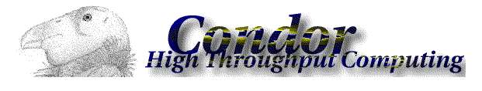
Condor creates a high-throughput computing environment from any heterogeneous collection of machines.
Volunteer desktops to dedicated servers.
Allows for complex sharing policies.
Tolerant to a wide variety of failures.
Scales to 10K nodes, 1M jobs.
Created at UW – Madison in 1987.
http://www.cs.wisc.edu/condor

Slide 5
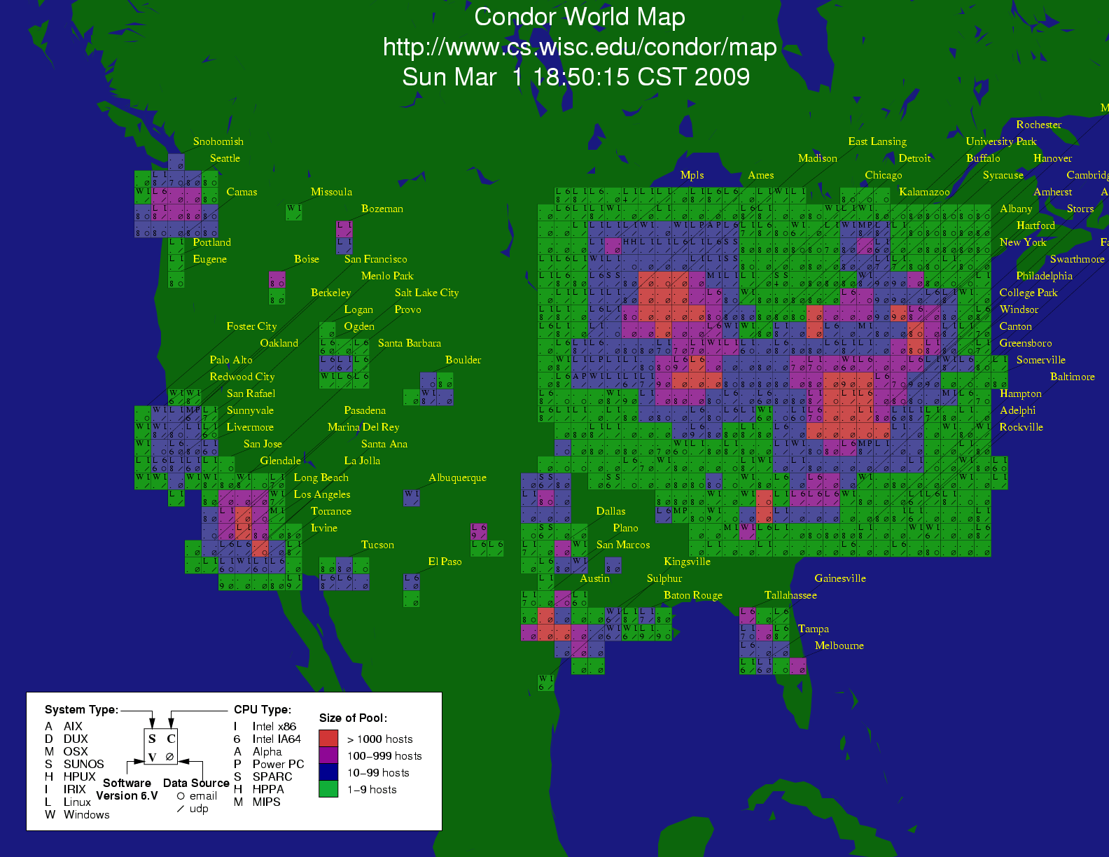

Slide 6
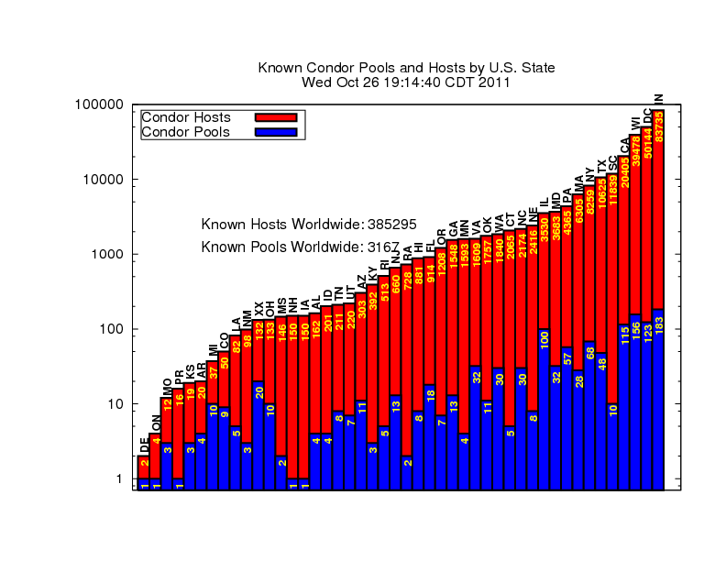

Slide 7
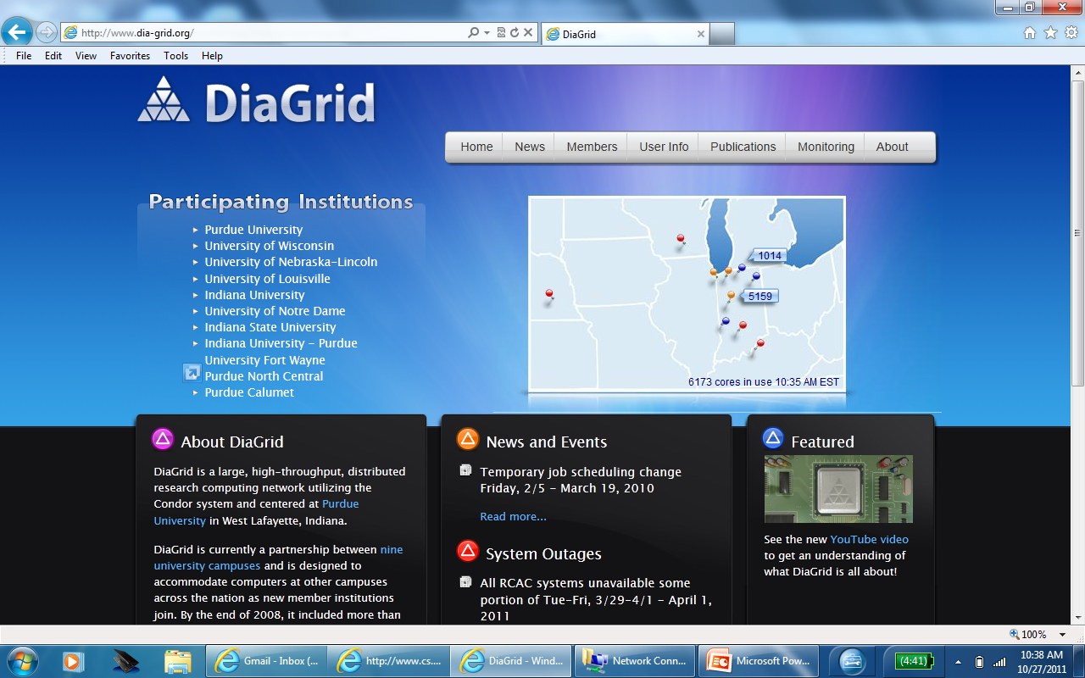

Slide 8
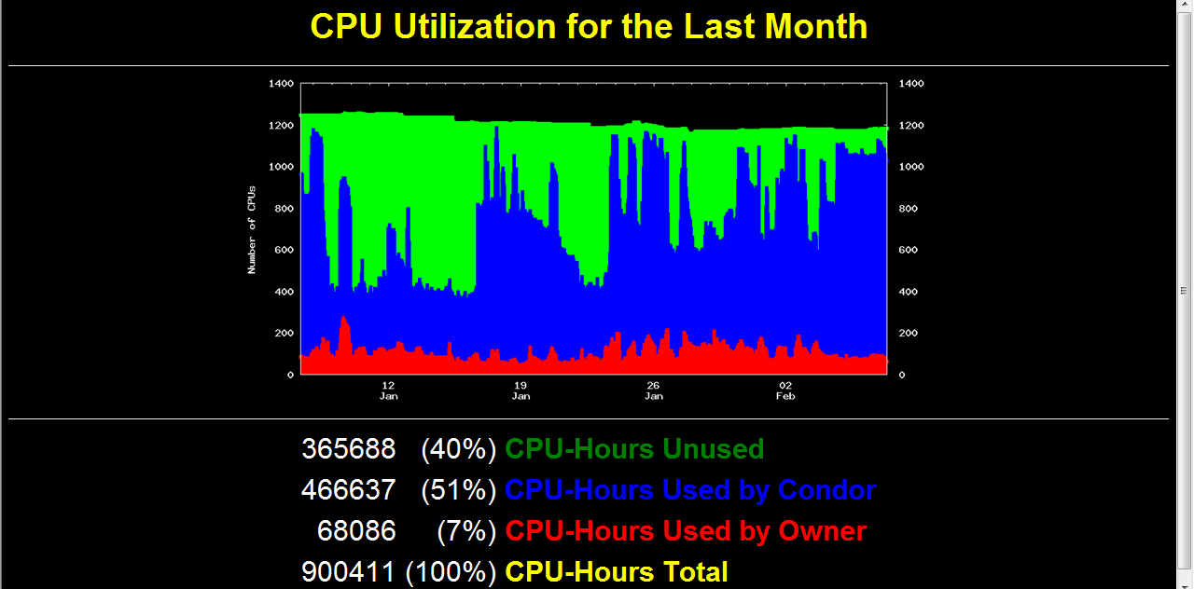

Slide 9
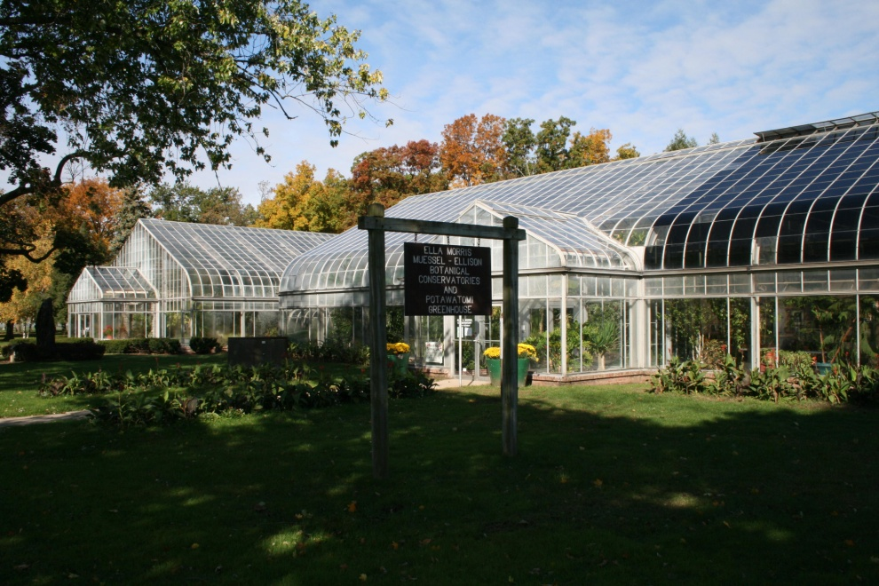
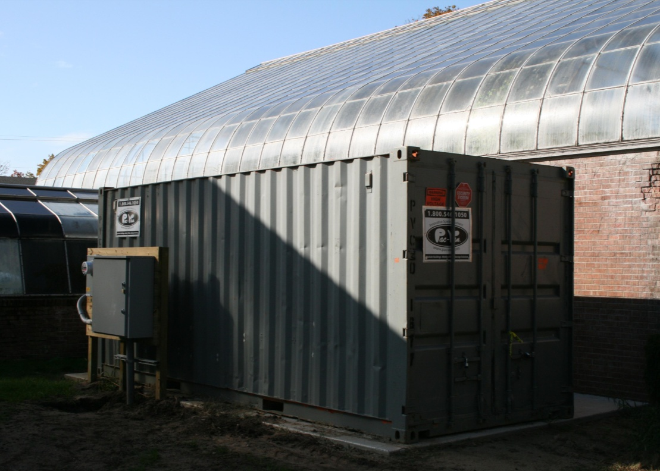
greencloud.crc.nd.edu

Slide 10
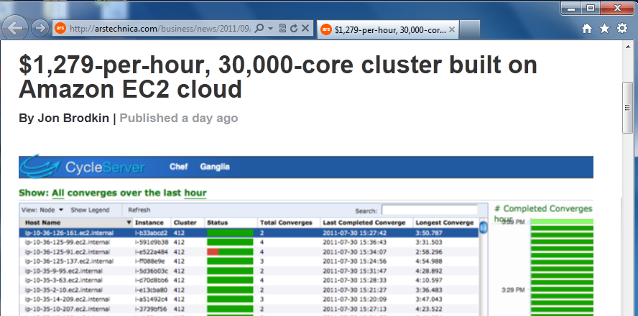
Just last month…
Cycle Cloud Using Condor
http://arstechnica.com/business/news/2011/09/30000-core-cluster-built-on-amazon-ec2-cloud.ars

Slide 11
The Matchmaking Framework
Advertise:
I have jobs to run
match
maker
Advertise
I am free to run jobs.
ClassAd
ClassAd
Represents
job owner.
Represents
machine owner.
schedd
Match:
You two are compatible.
startd
Job
Activate:
I want to run a job there:
Job
Job
Job
Job
Job
Job
Job
Job
Job
condor_submit

Slide 12
The ClassAd Language
Job ClassAd
Cmd = “mysim.exe”
Owner = “dthain”
Dept = “CSE”
ImageSize = 512M
Requirements =
Arch == “LINUX” &&
Disk >ImageSize
Rank =
Memory
Machine ClassAd
OpSys = “LINUX”
Arch = “X86_64”
Memory = 1024M
Disk = 55GB
LoadAvg = 0.23
Requirements =
LoadAvg < 0.5
Rank =
Dept==“Physics”

Slide 13
At Campus Scale
I will only run jobs between midnight and 8 AM
I will only run jobs when there is no-one working at the keyboard
Miscellaneous CSE Workstations
CPU
CPU
CPU
CPU
Fitzpatrick Workstation Cluster
Job
CPU
CPU
CPU
Job
Job
Disk
CPU
CPU
CPU
Disk
Disk
Disk
Disk
Disk
Disk
Disk
match
maker
I prefer to run a job submitted by a CSE student.
Job
Job
Job
Job
CPU
CPU
CPU
CPU
CPU
CPU
CPU
Job
Job
Disk
Disk
Disk
Disk
Disk
Disk
Disk
Job
Job
Job
Job
Job
Job
Job
CVRL Research Cluster
CCL Research Cluster

Slide 14
The Design Challenge
A high throughput computing system gives you lots of CPUs over long time scales.
But, they are somewhat inconvenient:
  Heterogeneous machines vary in capacity.
  Cannot guarantee machines are available simultaneously for communication.
  A given machine could be available for a few minutes, or a few hours, but not months.
  Condor manages computation, but doesn’t do much to help with data management.

Slide 15
The Cooperative Computing Lab
We collaborate with people who have large scale computing problems in science, engineering, and other fields.
We operate computer systems on the O(1000) cores: clusters, clouds, grids.
We conduct computer science research in the context of real people and problems.
We release open source software for large scale distributed computing.
http://www.nd.edu/~ccl

Slide 16


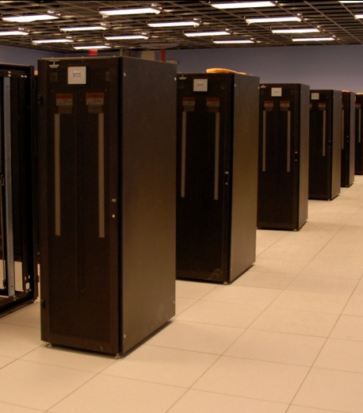
I have a standard, debugged, trusted application that runs on my laptop.
A toy problem completes in one hour.
A real problem will take a month (I think.)
Can I get a single result faster?
Can I get more results in the same time?
Last year,
I heard about
this grid thing.
This year,
I heard about
this cloud thing.
What do I do next?

Slide 17
Our Application Communities
Bioinformatics
  I just ran a tissue sample through a sequencing device. I need to assemble 1M DNA strings into a genome, then compare it against a library of known human genomes to find the difference.
Biometrics
  I invented a new way of matching iris images from surveillance video. I need to test it on 1M hi-resolution images to see if it actually works.
Data Mining
  I have a terabyte of log data from a medical service. I want to run 10 different clustering algorithms at 10 levels of sensitivity on 100 different slices of the data.

Slide 18
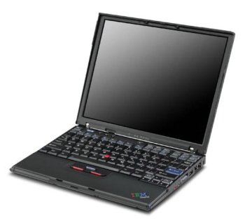
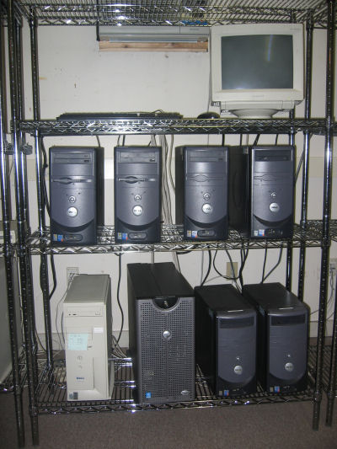
What they want.
What they get.

Slide 19
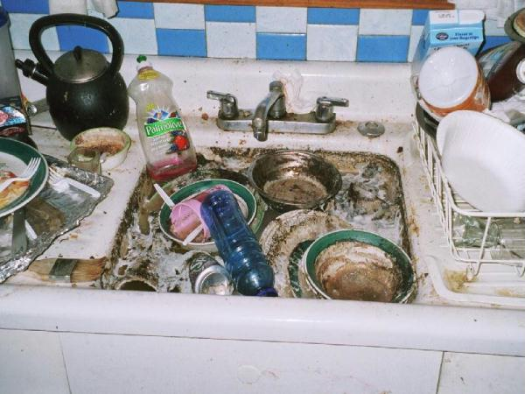
The Traditional
Application Model?
Every program attempts to grow until it can read mail. - Jamie Zawinski

Slide 20
An Old Idea: The Unix Model
input < grep | sort | uniq > output

Slide 21
Advantages of Little Processes
Easy to distribute across machines.
Easy to develop and test independently.
Easy to checkpoint halfway.
Easy to troubleshoot and continue.
Easy to observe the dependencies between components.
Easy to control resource assignments from an outside process.

Slide 22
Our approach:
Encourage users to decompose their applications into simple programs.
Give them frameworks that can assemble them into programs of massive scale with high reliability.

Slide 23


Working with Frameworks
A1
A1
A2
A2
F
An
Bn
AllPairs( A, B, F )
Custom
Workflow
Engine
Cloud or Grid
Compact Data Structure

Slide 24
Examples of Frameworks
AllPairs( A, B, F ) -> M
Wavefront( X, Y, F ) -> M
A1
A2
A3
R[0,4]
F
R[2,4]
R[3,4]
R[4,4]
x
B1
F
F
F
R[0,3]
d
y
R[3,2]
R[4,3]
x
F
x
F
R[0,2]
d
y
d
y
R[4,2]
x
F
x
F
x
F
B2
F
F
F
d
y
d
y
d
y
R[0,1]
F
F
F
F
x
x
x
x
R[0,0]
d
y
d
y
d
y
d
y
B3
F
F
F
R[1,0]
R[2,0]
R[3,0]
R[4,0]
Classify( T, P, F, R ) -> V
Makeflow
T1
F
V1
1
A
4
C
T
P
T2
F
V2
C
V
2
T3
F
V3
B
D
5
R
3

Slide 25
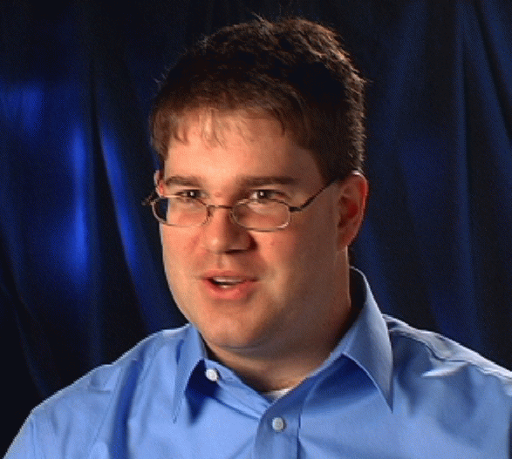


Example: Biometrics Research
Goal: Design robust face comparison function.
F
F
0.97
0.05

Slide 26




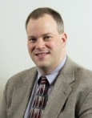

Similarity Matrix Construction
 | 1.0 | 0.8 | 0.1 | 0.0 | 0.0 | 0.1
 |  | 1.0 | 0.0 | 0.1 | 0.1 | 0.0
 |  |  | 1.0 | 0.0 | 0.1 | 0.3
 |  |  |  | 1.0 | 0.0 | 0.0
 |  |  |  |  | 1.0 | 0.1
 |  |  |  |  |  | 1.0
Challenge Workload:
60,000 images
1MB each
.02s per F
833 CPU-days
600 TB of I/O

Slide 27
All-Pairs Abstraction
AllPairs( set A, set B, function F )
returns matrix M where
M[i][j] = F( A[i], B[j] ) for all i,j
A1
A1
A2
A3
A1
allpairs A B F.exe
An
AllPairs(A,B,F)
B1
F
F
F
B1
B1
Bn
B2
F
F
F
F
B3
F
F
F
Moretti et al, All-Pairs: An Abstraction for Data Intensive Cloud Computing, IPDPS 2008.

Slide 28
User Interface
% allpairs compare.exe set1.data set2.data
Output:
img1.jpg img1.jpg 1.0
img1.jpg img2.jpg 0.35
img1.jpg img3.jpg 0.46
…

Slide 29
How Does the Abstraction Help?
The custom workflow engine:
  Chooses right data transfer strategy.
  Chooses blocking of functions into jobs.
  Recovers from a larger number of failures.
  Predicts overall runtime accurately.
  Chooses the right number of resources.
All of these tasks are nearly impossible for arbitrary workloads, but are tractable (not trivial) to solve for a specific abstraction.

Slide 30
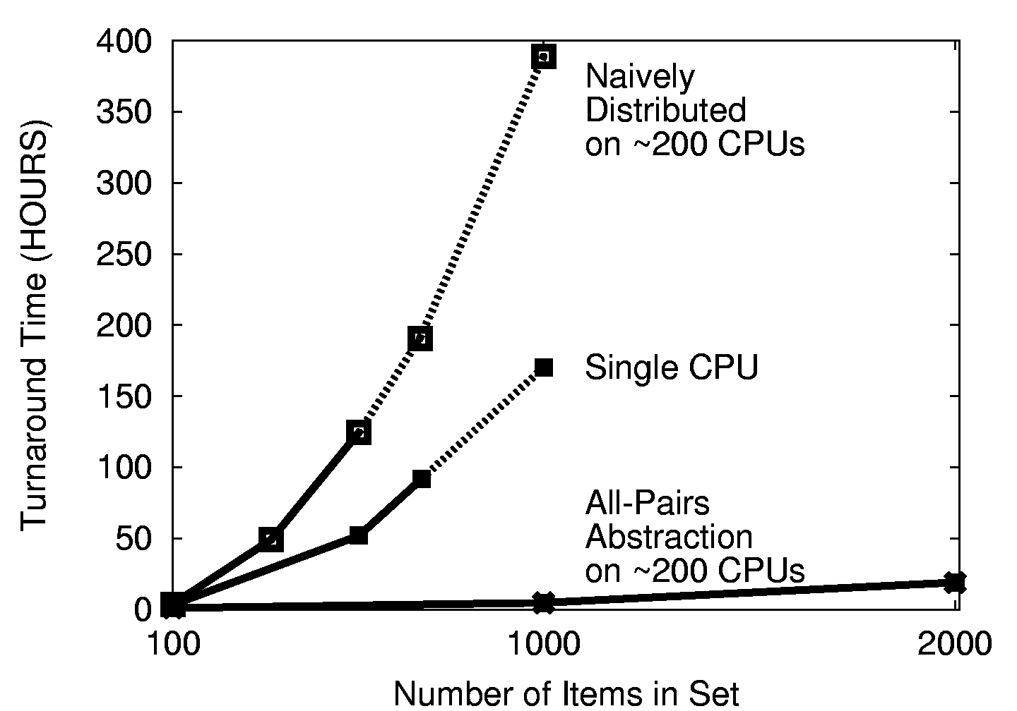

Slide 31
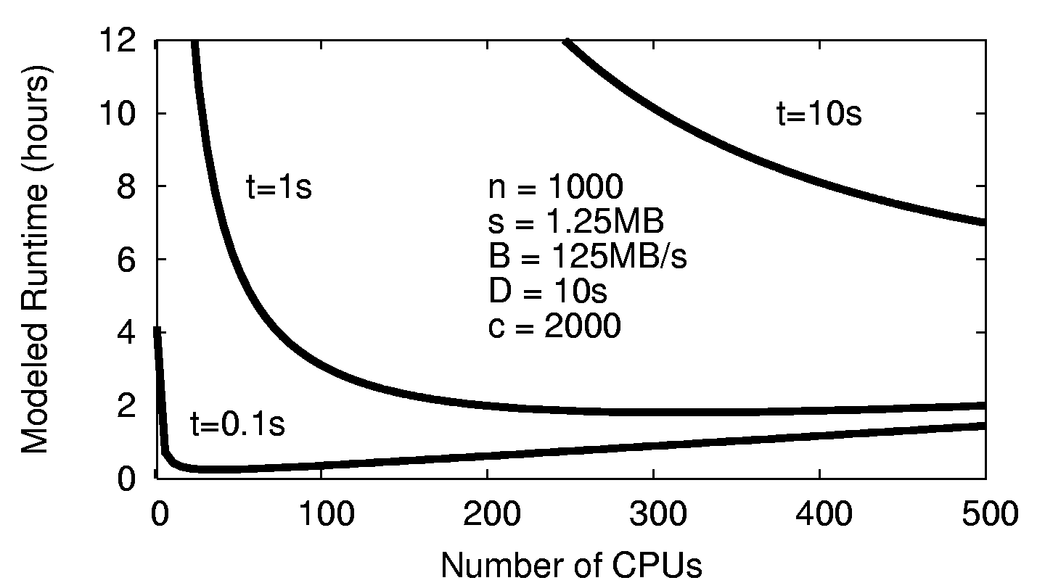
Choose the Right # of CPUs

Slide 32
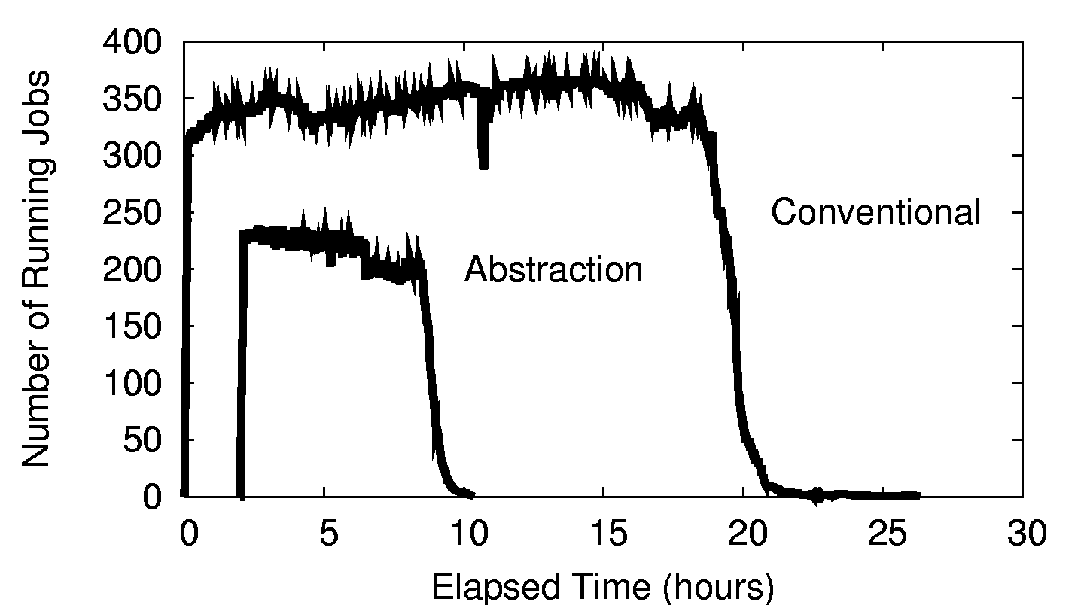
Resources Consumed

Slide 33
All-Pairs in Production
Our All-Pairs implementation has provided over 57 CPU-years of computation to the ND biometrics research group in the first year.
Largest run so far: 58,396 irises from the Face Recognition Grand Challenge. The largest experiment ever run on publically available data.
Competing biometric research relies on samples of 100-1000 images, which can miss important population effects.
Reduced computation time from 833 days to 10 days, making it feasible to repeat multiple times for a graduate thesis. (We can go faster yet.)

Slide 34
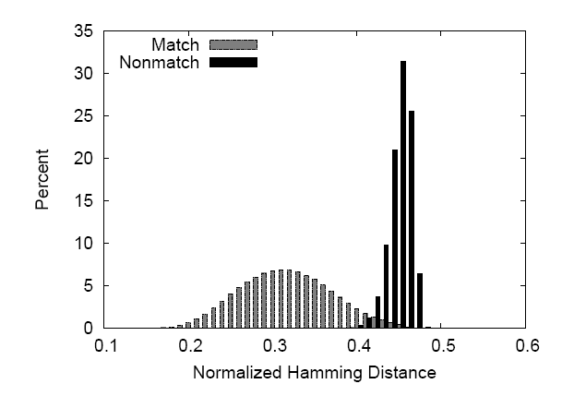

Slide 35
All-Pairs Abstraction
AllPairs( set A, set B, function F )
returns matrix M where
M[i][j] = F( A[i], B[j] ) for all i,j
A1
A1
A2
A3
A1
allpairs A B F.exe
An
AllPairs(A,B,F)
B1
F
F
F
B1
B1
Bn
B2
F
F
F
F
B3
F
F
F
Moretti et al, All-Pairs: An Abstraction for Data Intensive Cloud Computing, IPDPS 2008.

Slide 36
Are there other abstractions?

Slide 37
Wavefront( matrix M, function F(x,y,d) )
returns matrix M such that
M[i,j] = F( M[i-1,j], M[I,j-1], M[i-1,j-1] )
M[0,4]
M[2,4]
M[3,4]
M[4,4]
x
F
d
y
M[0,3]
M[3,2]
M[4,3]
Wavefront(M,F)
x
F
x
F
M
d
y
d
y
M[0,2]
x
M[4,2]
x
F
x
F
F
d
y
d
y
d
y
F
M[0,1]
x
F
x
F
x
F
x
F
d
y
d
y
d
y
d
y
M[0,0]
M[1,0]
M[2,0]
M[3,0]
M[4,0]
Li Yu et al, Harnessing Parallelism in Multicore Clusters with the
All-Pairs, Wavefront, and Makeflow Abstractions, Journal of Cluster Computing, 2010.

Slide 38
Applications of Wavefront
Bioinformatics:
  Compute the alignment of two large DNA strings in order to find similarities between species. Existing tools do not scale up to complete DNA strings.
Economics:
  Simulate the interaction between two competing firms, each of which has an effect on resource consumption and market price. E.g. When will we run out of oil?
Applies to any kind of optimization problem solvable with dynamic programming.

Slide 39
Problem: Dispatch Latency
Even with an infinite number of CPUs, dispatch latency controls the total execution time: O(n) in the best case.
However, job dispatch latency in an unloaded grid is about 30 seconds, which may outweigh the runtime of F.
Things get worse when queues are long!
Solution: Build a lightweight task dispatch system. (Idea from Falkon@UC)

Slide 40
Solution:
Work Queue
1000s of workers
Dispatched
to the cloud
worker
worker
worker
worker
worker
worker
queue
tasks
wavefront
engine
work
queue
put F.exe
put in.txt
exec F.exe <in.txt >out.txt
get out.txt
worker
tasks
done
In.txt
F
out.txt

Slide 41
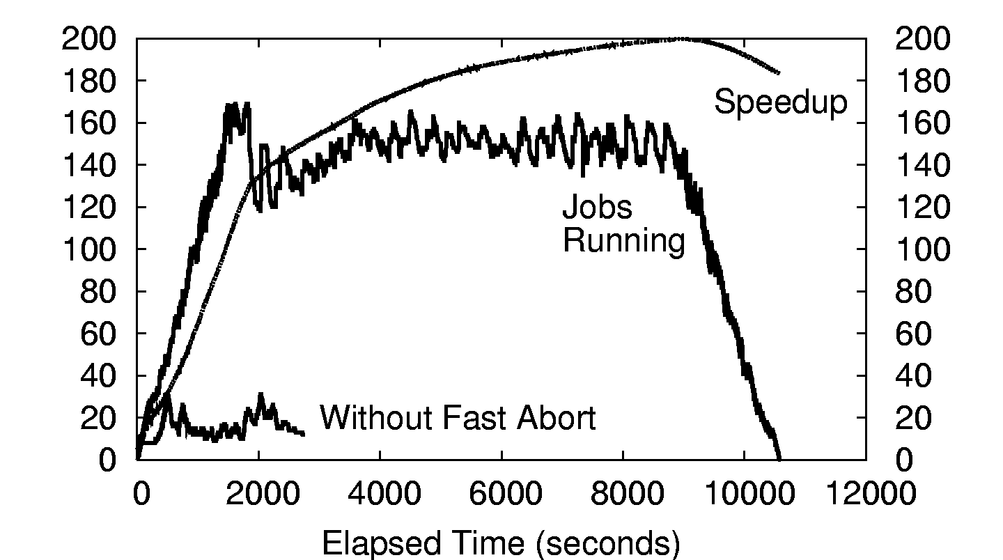
500x500 Wavefront on ~200 CPUs

Slide 42
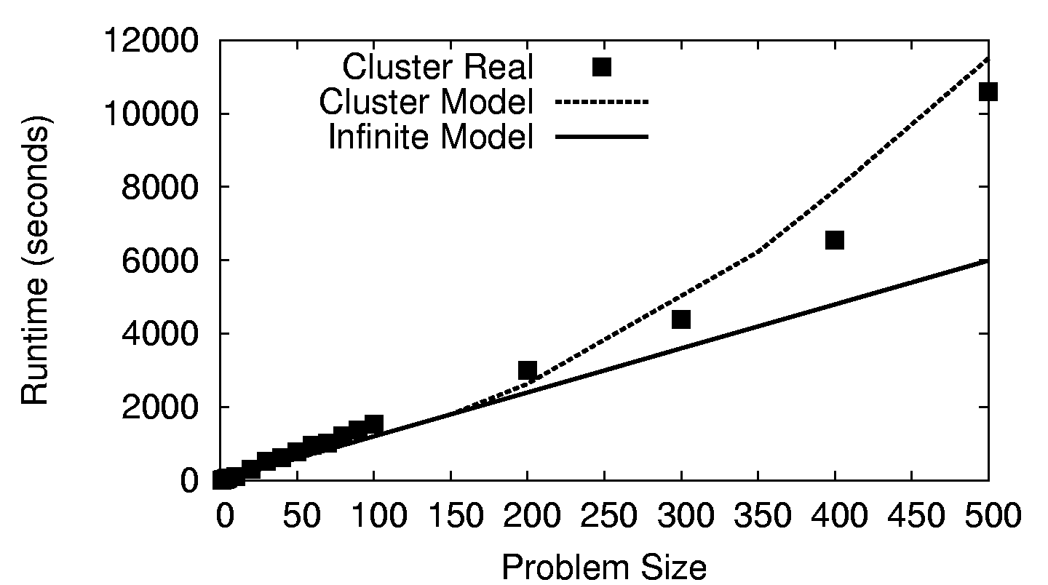
Wavefront on a 200-CPU Cluster

Slide 43
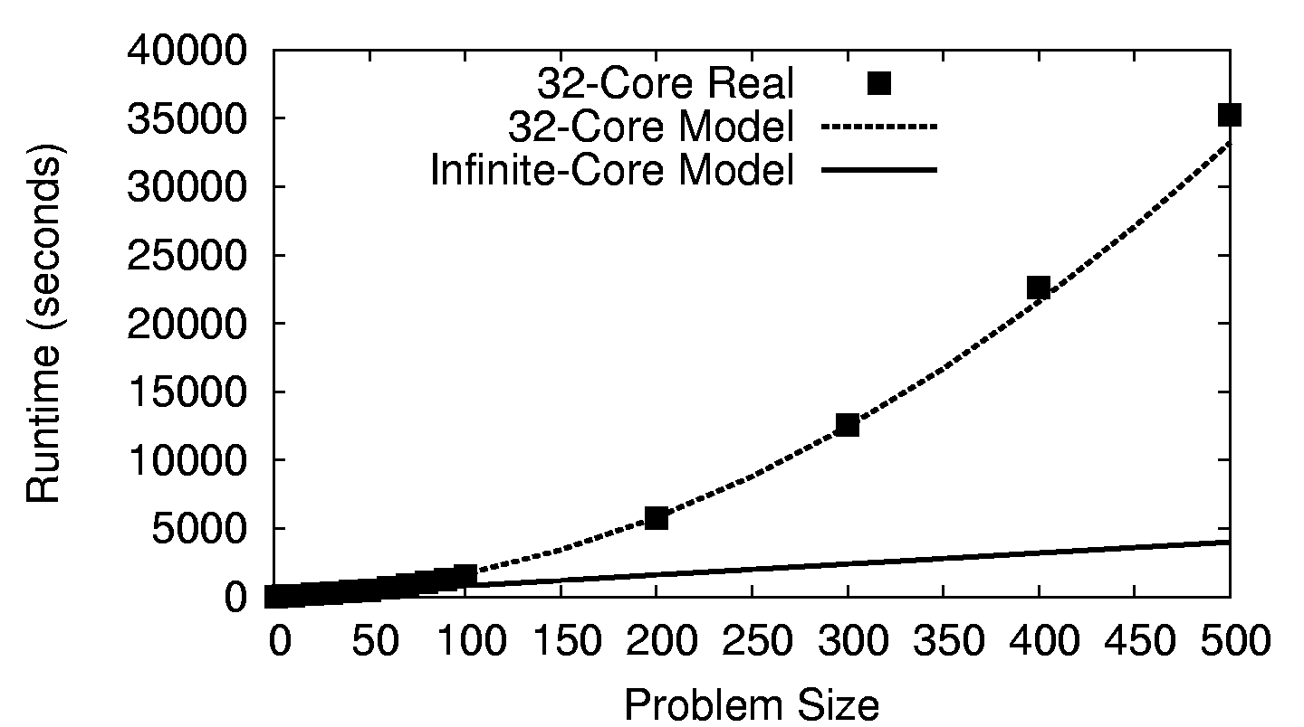
Wavefront on a 32-Core CPU

Slide 44
The Genome Assembly Problem
AGTCGATCGATCGATAATCGATCCTAGCTAGCTACGA
Chemical Sequencing
AGTCGATCGATCGAT
Millions of “reads”
100s bytes long.
TCGATAATCGATCCTAGCTA
AGCTAGCTACGA
Computational Assembly
AGTCGATCGATCGAT
TCGATAATCGATCCTAGCTA
AGCTAGCTACGA

Slide 45
SAND Genome Assembler
Using Work Queue
100s of workers
dispatched to
Notre Dame,
Purdue, and
Wisconsin
(1,2)
(2,1)
(2,3)
(3,3)
worker
A1
worker
A1
F
worker
An
worker
worker
worker
queue
tasks
detail of a single worker:
somepairs
master
work
queue
put align.exe
put in.txt
exec F.exe <in.txt >out.txt
get out.txt
worker
tasks
done
in.txt
F
out.txt

Slide 46
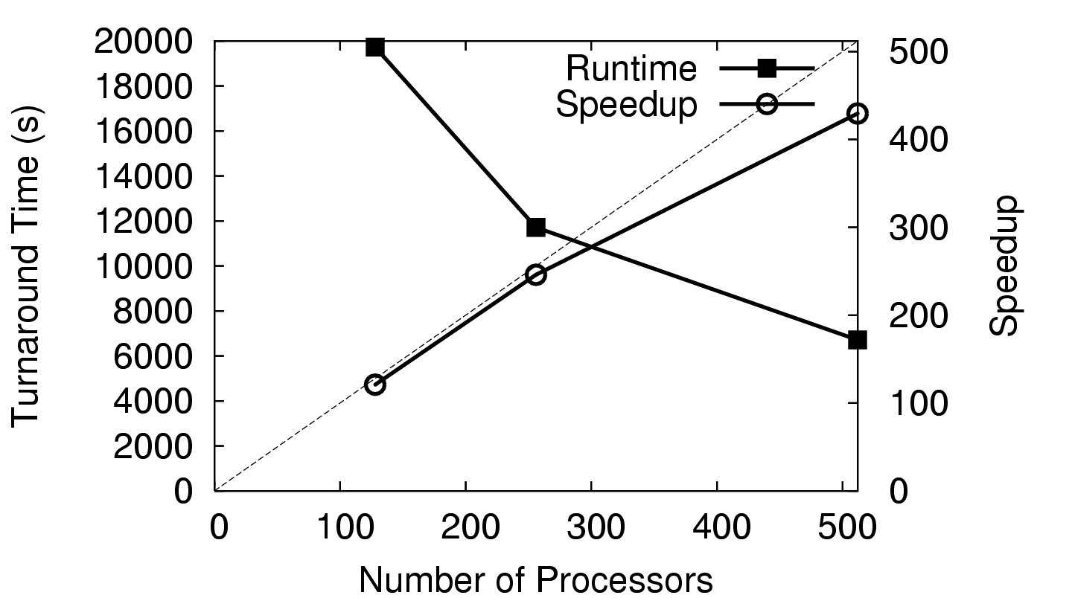
Large Genome (7.9M)

Slide 47
What’s the Upshot?
We can do full-scale assemblies as a routine matter on existing conventional machines.
Our solution is faster (wall-clock time) than the next faster assembler run on 1024x BG/L.
You could almost certainly do better with a dedicated cluster and a fast interconnect, but such systems are not universally available.
Our solution opens up assembly to labs with “NASCAR” instead of “Formula-One” hardware.
SAND Genome Assembler (Celera Compatible)
  http://nd.edu/~ccl/software/sand

Slide 48
What if your application doesn’t fit a regular pattern?

Slide 49
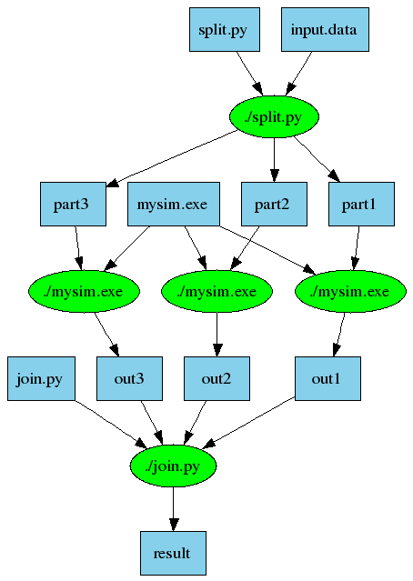
An Old Idea: Make
part1 part2 part3: input.data split.py
./split.py input.data
out1: part1 mysim.exe
./mysim.exe part1 >out1
out2: part2 mysim.exe
./mysim.exe part2 >out2
out3: part3 mysim.exe
./mysim.exe part3 >out3
result: out1 out2 out3 join.py
./join.py out1 out2 out3 > result

Slide 50
Makeflow: Direct Submission
Private
Cluster
Shared
SGE
Cluster
Makefile
Makeflow
submit
jobs
Campus
Condor
Pool
Public
Cloud
Provider
Local Files and Programs

Slide 51
Problems with Direct Submission
Software Engineering: too many batch systems with too many slight differences.
Performance: Starting a new job or a VM takes 30-60 seconds. (Universal?)
Stability: An accident could result in you purchasing thousands of cores!
Solution: Overlay our own work management system into multiple clouds.
  Technique used widely in the grid world.

Slide 52
Makeflow: Overlay Workerrs
sge_submit_workers
Private
Cluster
Shared
SGE
Cluster
Makefile
Wv
W
Hundreds of Workers in a
Personal Cloud
W
submit
tasks
W
W
W
Makeflow
Campus
Condor
Pool
Public
Cloud
Provider
W
W
W
W
W
W
W
Local Files and Programs
condor_submit_workers
ssh

Slide 53
Makeflow: Overlay Workers
worker
100s of workers
dispatched to
the cloud
worker
bfile: afile prog
prog afile >bfile
worker
worker
worker
worker
queue
tasks
detail of a single worker:
makeflow
master
work
queue
put prog
put afile
exec prog afile > bfile
get bfile
worker
tasks
done
Two optimizations:
Cache inputs and output.
Dispatch tasks to nodes with data.
afile
prog
bfile

Slide 54
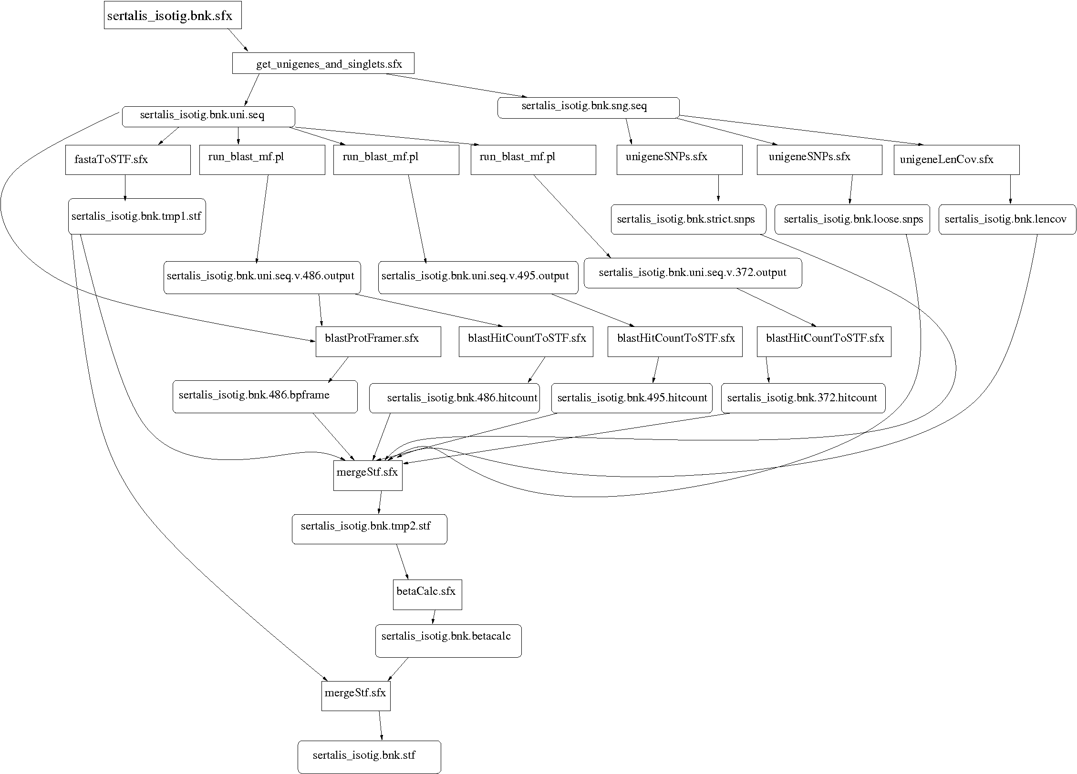
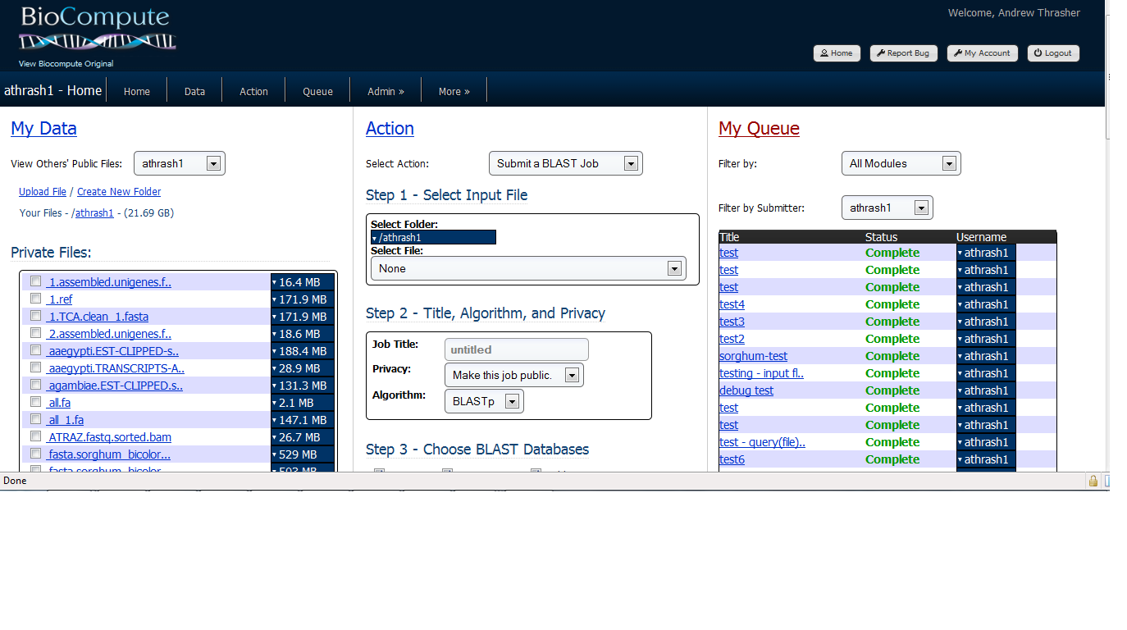
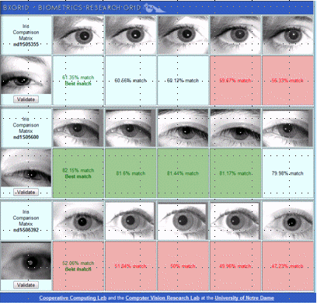
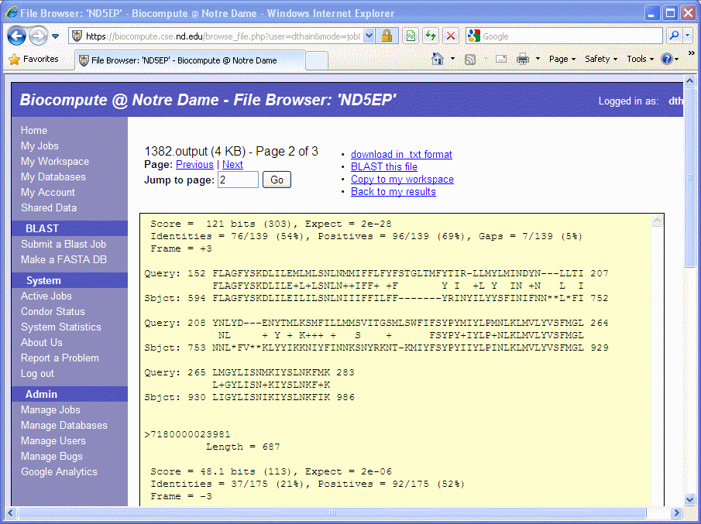
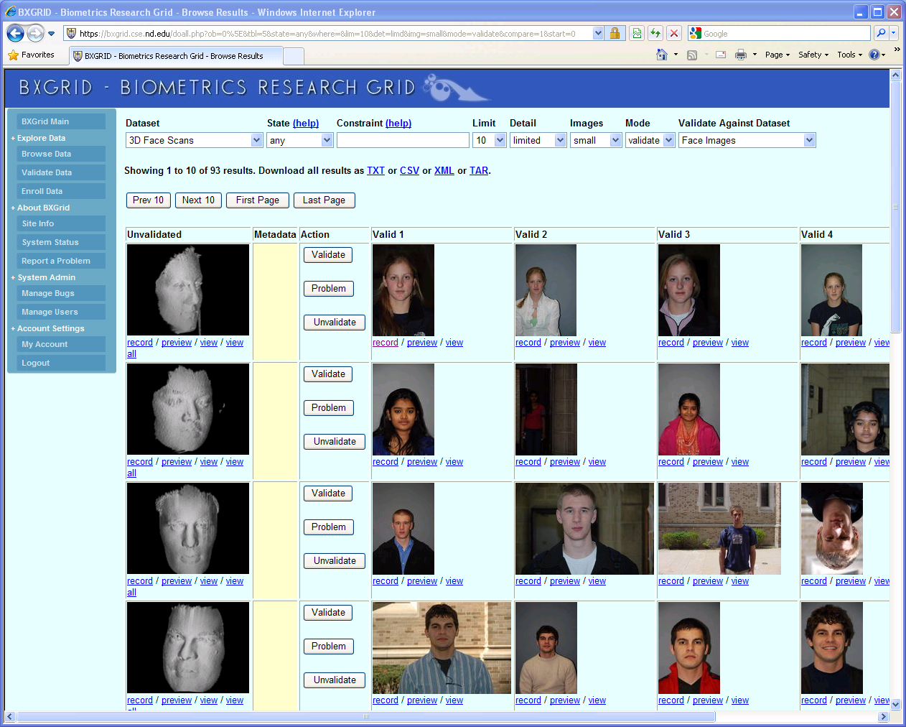
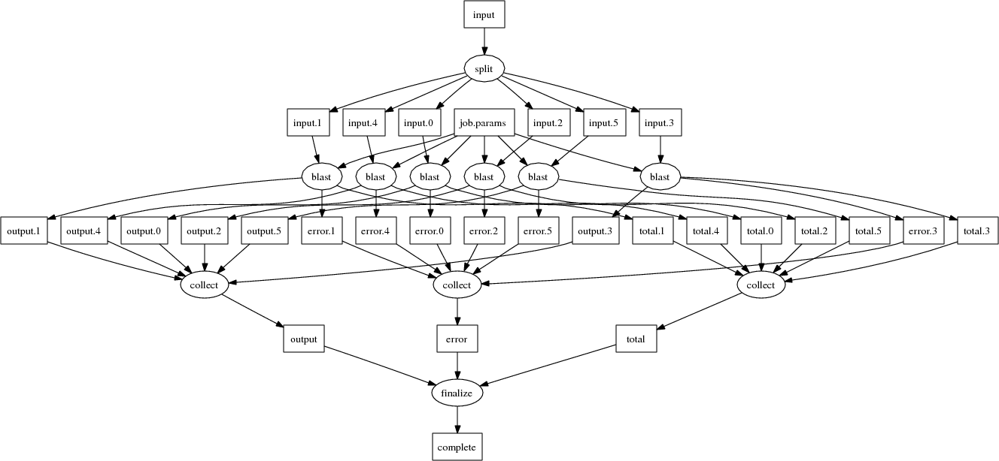
Makeflow Applications

Slide 55
Makeflow for Bioinformatics
BLAST
SHRIMP
SSAHA
BWA
Maker..
http://biocompute.cse.nd.edu

Slide 56
Why Users Like Makeflow
Use existing applications without change.
Use an existing language everyone knows. (Some apps are already in Make.)
Via Workers, harness all available resources: desktop to cluster to cloud.
Transparent fault tolerance means you can harness unreliable resources.
Transparent data movement means no shared filesystem is required.

Slide 57
Common Application Stack
All-Pairs
Wavefront
Makeflow
Custom
Apps
Work Queue Library
Hundreds of Workers in a
Personal Cloud
Public
Cloud
Provider
Shared
SGE
Cluster
Campus
Condor
Pool
Private
Cluster
W
W
Wv
W
W
W
W
W
W

Slide 58
To Recap:
There are lots of cycles available (for free) to do high throughput computing.
However, HTC requires that you think a little differently: chain together small programs, and be flexible!
A good programming model helps the user to specify enough detail, leaving the runtime some flexibility to adapt.

Slide 59
A Team Effort
Faculty:
  Patrick Flynn
  Scott Emrich
  Jesus Izaguirre
  Nitesh Chawla
  Kenneth Judd
Grad Students
  Hoang Bui
  Li Yu
  Peter Bui
  Michael Albrecht
  Peter Sempolinski
  Dinesh Rajan
Undergrads
  Rachel Witty
  Thomas Potthast
  Brenden Kokosza
  Zach Musgrave
  Anthony Canino
NSF Grants CCF-0621434, CNS-0643229, and CNS 08-554087.

Slide 60
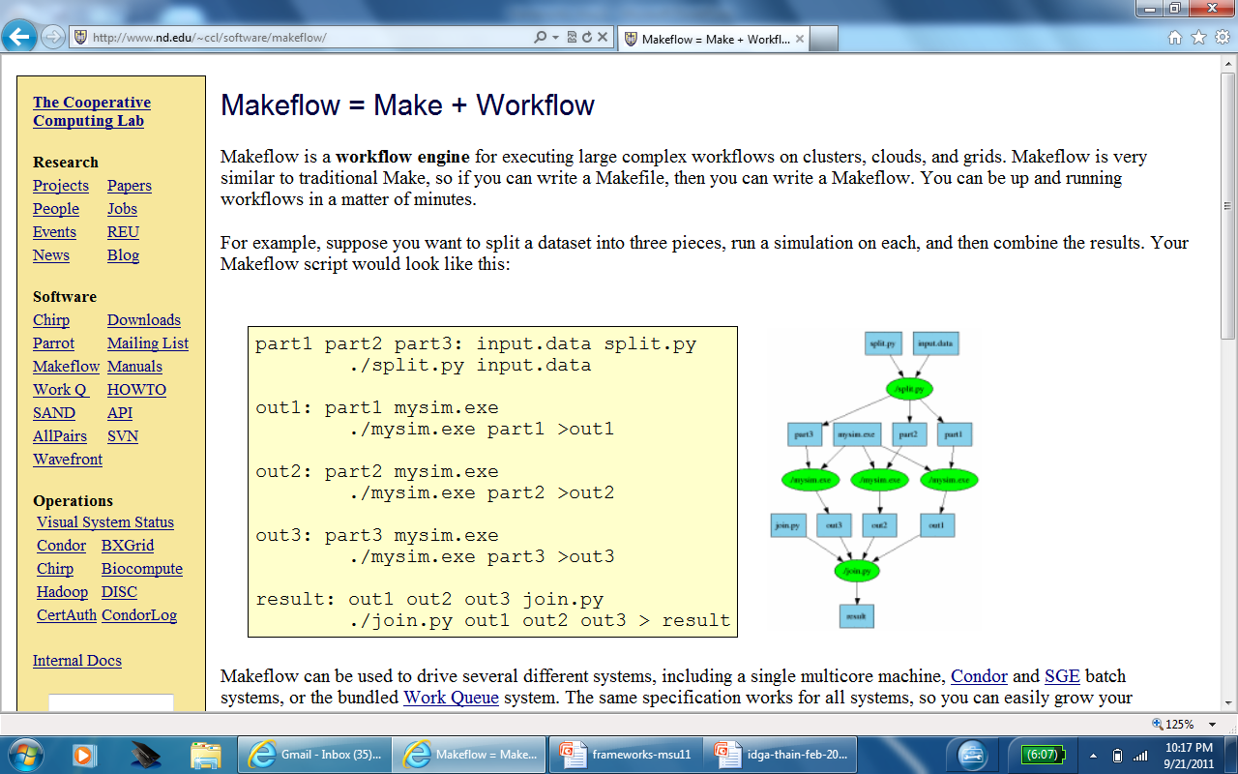
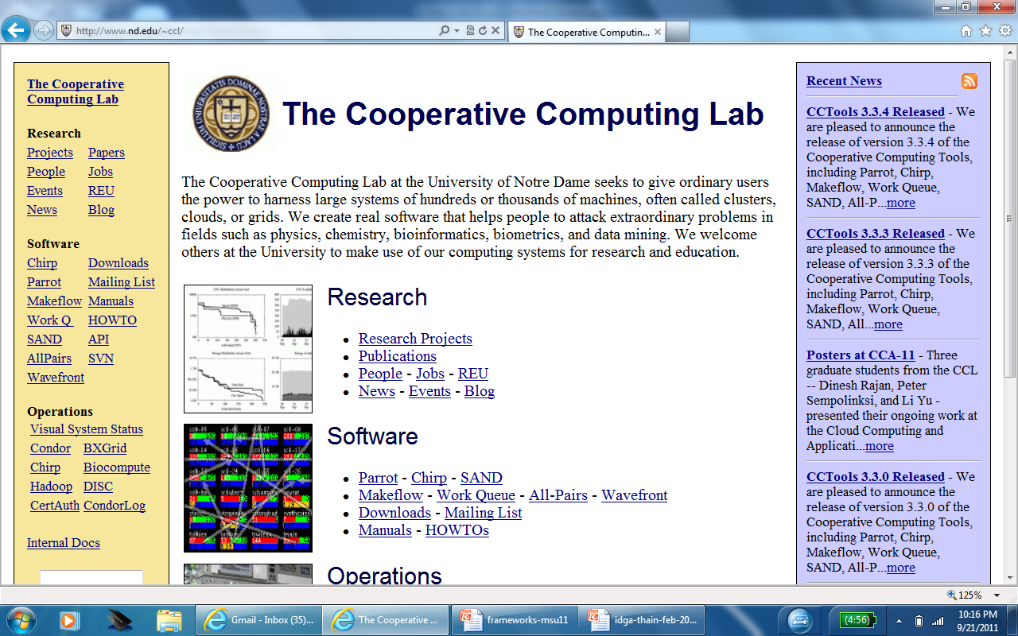
Open Source Software
http://www.nd.edu/~ccl

Slide 61
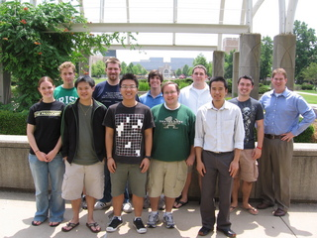
The Cooperative Computing Lab
http://www.nd.edu/~ccl

