Slide 1
Strategic Overview of Docker in Fifteen Minutes for MAGIC Big Data IWG 7 February 2018
Prof. Douglas Thain, University of Notre Dame
http://www.nd.edu/~dthain
dthain@nd.edu
@ProfThain

Slide 2
Container Overview
Container
(Active)
Image
(Passive)
Build Script
(Dockerfile)
Private Filesystem
Resource Limits
Namespaces:
pid/net/ipc/mn/uts
Portable
Filesystem
in a Single File
FROM parent-image
WORKDIR /data
ADD mydata /data
RUN yum install mysim
EXPOSE 8080
CMD [ "mysim", . . . ]
run
build
Purpose:
To provide independent applications with the ability to define private, customized environments that are easily distributable.

Slide 3
Docker Structure
docker
(access control)
dockerd
(root)
(user)
Running Containers
Image Store
Containers:
run
create
attach
ps
cp
commit
start/stop
rm
Images:
images
pull / push
build
rmi
load / save
MyDatabase
MyWebserver
push/pull
Docker Hub

Slide 4
Container Sub-Structure
Appl
Kernel Storage Driver
r/w
AUFS
OverlayFS
Device
Mapper
Writeable Scratch Layer
3986ab + Data
Dockerfile:
FROM rhel7.2
RUN yum install myexe
COPY mydata /data
Running Container
e7b38ac + Application
Passive Image
abcf1234 Base OS Layer

Slide 5
Encourage De-Duplication
Writeable
Scratch Layer
Writeable
Scratch Layer
Writeable
Scratch Layer
+ Data A (100MB)
+ Data B (200MB)
+ Data C (1GB)
+ Appl A (10MB)
+ Appl B (20MB)
Base OS Layer (10GB)

Slide 6
Docker Compose (Static)
Common case: a web-service that consists of multiple concurrent services.
Database
Webserver
Memcached
DF
IMG
CNT
DF
IMG
CNT
DF
IMG
CNT
myservice.yml
docker-compose build myservice.yml
docker-compose up myservice.yml
Persistent state is outside the cluster.
Requires external supervision to maintain.

Slide 7
Docker Swarm (Dynamic)
Manager
Worker
Worker
Worker
WWW
WWW
Swarm
State
Manager
RAFT
Consensus
Worker
Worker
Worker
$$$
$$$
$$$
Manager
Worker
Worker
Worker
DB
DB
DB
create service www (2)
create service memcached (3)
create service database (2)
Persistent state is inside the cluster.
Once created, self-maintaining.

Slide 8
Docker Ecosystem
Docker containers are used widely in industry and have become an interchange format.
Google GCE, Amazon ECS, Mesos, Kubernetes all support Docker container execution. (But not necessarily using Docker per se.)
Running your own container cluster is rather challenging! One opinion:
https://thehftguy.com/2016/11/01/docker-in-production-an-history-of-failure/

Slide 9
Problem: Garbage Collection
Problem: Any authenticated user can consume storage by create/pulling new images, and nothing removes them automatically. Any automated activity will eventually consume all storage and wedge docker.
A cronjob seems to be the community solution:
However, this doesn't take into account containers that are "needed" even if not currently run.
Effective use requires one of several ideas:
Use a small number of containers widely.
Trust users to delete unneeded containers.
Make use cases robust to periodic removal.
docker images –q –a | xargs –no-run-if-empty docker rmi

Slide 10
Problem: Adding Docker to HPC
Idea sounds simple: You already have a batch system, just put Docker on every node.
Very challenging to get this right:
Docker has very specific kernel requirements, consumes large amounts of local space, resources conflict with each other, independent scheduling.
Underlying challenge: Docker really wants to be your core resource manager. It's fighting with the ones you already have: batch system, parallel file system..
(Shifter, Singularity, CharlieCloud, and others are working to address this space directly.)

Slide 11
Takeaways
Designed for deploying micro services, which is different than executing HTC/HPC jobs.
Docker container format is now standard.
Docker works very well within its own ecosystem, but is quite difficult to integrate into existing facilities.
Garbage collection remains unsolved prob.
Very sensitive to underlying kernel tech.

Slide 12
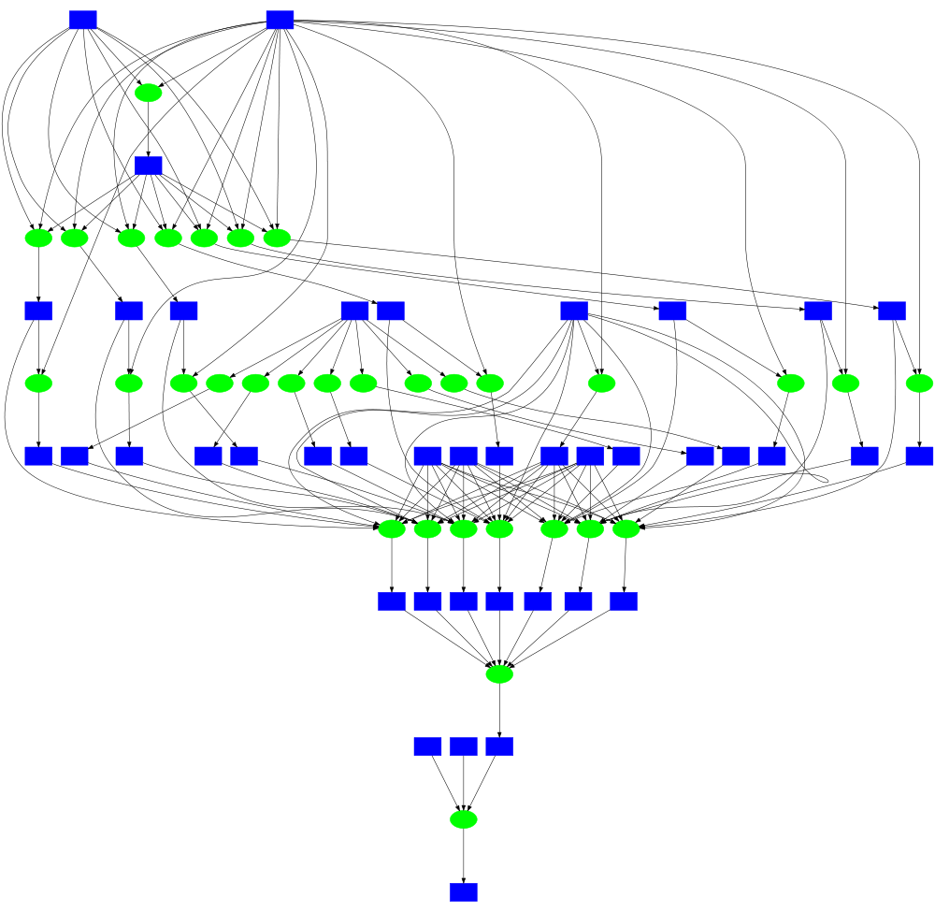
Container Portability
In Makeflow
Wharf: Containers on Shared Filesystems
dockerd A
dockerd B
Cont.
Store
Cont.
Store
Shared Image Store
Task
Task
Task
Data
Data
Data
MDS
Docker
Singularity
RHEL6
RHEL7
SLES8
Parallel Filesystem

Slide 13
http://ccl.cse.nd.edu
@ProfThain

