Slide 1
Reproducibility and Preservation of Scientific Applications
Douglas Thain, Haiyan Meng, and Peter Ivie
University of Notre Dame
(on behalf of the DASPOS project)
HPDC Workshop, March 2015

Slide 2
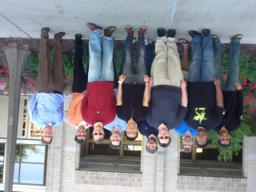
The Cooperative Computing Lab
University of Notre Dame
http://www.nd.edu/~ccl

Slide 3
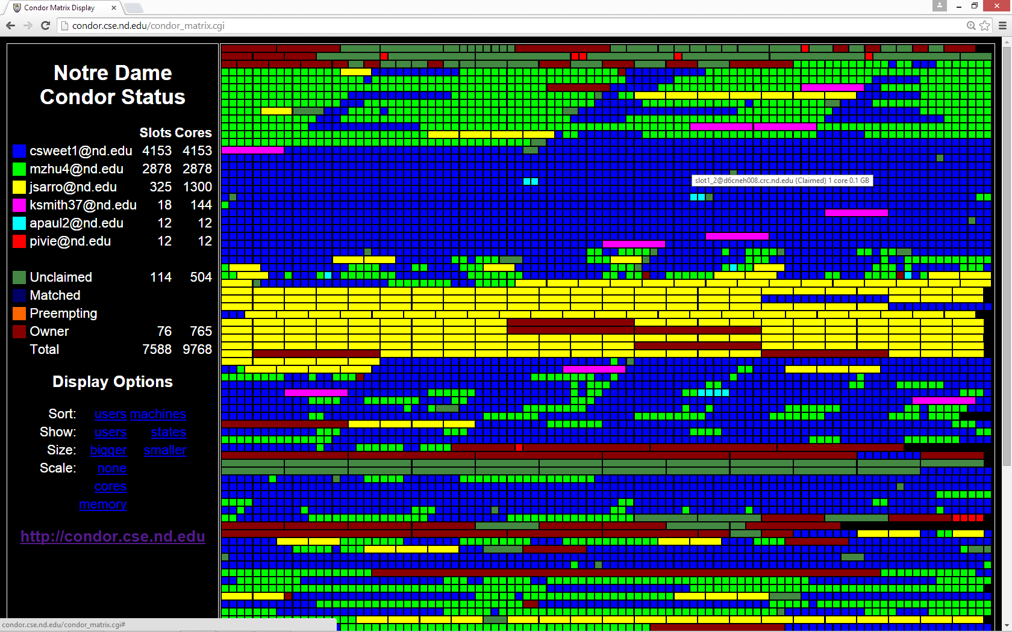

Slide 4
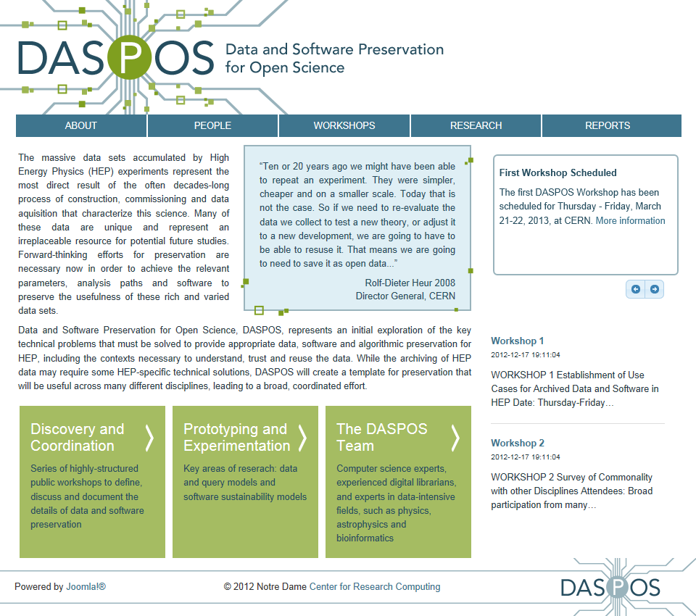
DASPOS Project
www.daspos.org

Slide 5
Reproducibility is the cornerstone of the scientific method.
Can we really claim to be conducting science?

Slide 6
Reproducibility in e-Science is absolutely terrible today!
Can I re-run a result from a colleague from five years ago successful, and obtain the same result? How about a student in my lab?
Today, are we preparing for our current results to be re-used by others five years from now?
Multiple reasons why not:
Rapid technological change.
No archival of artifacts.
Many implicit dependencies.
Lack of backwards compatibility.
Lack of social incentives.

Slide 7
Many different Rs…
Reproduce precisely what someone else did on the same resources, with the same techniques.
Recreate an equivalent computation on different resources, with similar techniques.
Repurpose an experiment by running it again with a slight change to the data, software, or environment.
Reuse the same artifact across many different experiments, for a longitudinal comparison.
Rely on one party to set up an environment and make it usable for multiple parties. (Think sysadmins.)
Other Rs?

Slide 8
Typical Computing Experiment
PI gives student some general directions. Student writes some code, does some experiments, saves the outputs, writes the paper.
Source code is often carefully curated. But what about the operating system, the software dependencies, the experimental configuration, the input data, etc…
If we did manage to re-run everything, do we have a means of verifying equivalence?
Concurrency + Floating Point != Bitwise Equality.

Slide 9
Preserve the Mess or Encourage Organization? (let’s do some of each)

Slide 10
Preserve the Mess: Stick it all into a VM
sim.exe input.dat –p 5 –out output.dat
sim.exe input.dat –p 5 –out output.dat
Sim
Sim
File
File
File
File
File
File
Kernel
Kernel
VM Image

Slide 11
Preserve the Mess: Stick it all into a VM
A good place to start, however:
Captures more things than necessary.
For many experiments will duplicate large amounts of software/data in the VM images.
Hard to disentangle things logically – what if you want to run the same experiment with some component of the OS/software/data changed?
Doesn’t capture network interactions.
May be coupled to specific a VM technology.
VMs are not the place to archive data.

Slide 12
Preserve the Mess: Trace All Interactions
sim.exe input.dat –p 5 –out output.dat
sim.exe input.dat –p 5 –out output.dat
Sim
Sim
Parrot
File
File
File
File
File
Observe all
System calls
At runtime.
(also CDE/PTU)
Kernel
http://some.archive.com/mydata
A portable package that can be re-executed using Docker, Parrot, or Amazon

Slide 13
Preserve the Mess: Trace All Interactions
Solves some problems:
Only captures what is actually used.
Once captured, not coupled to a technology.
Observes network dependencies.
But not all of them:
For many experiments will duplicate large amounts of software/data in the VM/package images.
Hard to disentangle things logically – what if you want to run the same experiment with some component of the OS/software/data changed.
VMs/packages are not the place to archive data.

Slide 14
What we really want: A structured way to compose an application with all of its dependencies. Enable preservation, but also re-use of data and images for efficiency.

Slide 15
Umbrella
myenv1.json
kernel = { name = “Linux”;
version = “83.21.blue.42”
} opsys = {
name = “RedHat”;
version = “6.1”
} software = {
simulator = {
mount = “/soft/sim”;
name = “mysim-3.1”;
}
data = {
input = {
mount = “/data/input”;
url = “http://some.url”; }
calib = {
mount = “/data/calib”;
url = “http://other.url”; }
}
umbrella run myenv1.json
Mysim 3.1
input
calib
RedHat 6.1
Linux 83.21.blue.42
Online Data Archives
RedHat 6.1
Mysim 3.1
RedHat 6.2
Mysim 3.2

Slide 16
Umbrella specifies a reproducible environment while avoiding duplication and enabling precise adjustments.
Same thing, but use
different input data.
Same thing, but
update the OS
Run the experiment
input1
input2
input2
Mysim 3.1
Mysim 3.1
Mysim 3.1
RedHat 6.1
RedHat 6.1
RedHat 6.2
Linux 83
Linux 83
Linux 83
Online Data Archive
RedHat 6.1
input1
input2
Linux 83
Mysim 3.1
RedHat 6.2
calib1
calib2
Linux 84
Mysim 3.2

Slide 17
Specification is More Important Than Mechanism
Current version of Umbrella can work with:
Docker – create container, mount volumes.
Parrot – Download tarballs, mount at runtime.
Amazon – allocate VM, copy and unpack tarballs.
Condor – Request compatible machine.
More ways will be possible in the future as technologies come and go.
Key requirement: Efficient runtime composition, rather than copying. (Compare to Dockerfile.)

Slide 18
How do we construct complex workflows from these building blocks?

Slide 19
PRUNE – Preservation Run Environment
Problem: Our user interfaces do not accurately capture the dependencies or the environment of the codes that we run.
Can we improve upon the standard command-line shell interface to make it reproducible?
Re-use a good idea: functional representation.
output = mysim( input, calib ) USING ENV myenv.json
Build on ideas from GridDB, VDL, Swift, Taverna, Galaxy, but focus is on precise reproduction, not on performance. (Coarse granularity.)

Slide 20
PRUNE – Preservation Run Environment
PUT “/tmp/input1.dat” AS “input1” [gets id 3ba8c2]
PUT “/tmp/input2.dat” AS “input2” [gets id dab209]
PUT “/tmp/calib.dat” AS “calib” [gets id 64c2fa]
PUT “sim.function” AS “sim” [gets id fffda7]
out1 = sim( input1, calib ) IN ENV myenv1.json
[out1 is bab598]
out2 = sim( input1, calib ) IN ENV myenv2.json
[out2 is 392caf]
out3 = sim( input2, calib ) IN ENV myenv2.json
[out3 is 232768]

Slide 21
PRUNE connects together precisely reproducible executions and gives each item a unique identifier
output1 = sim( input1, calib1 ) IN ENV myenv1.json
input1
sim
output 1
sim2
calib1
myenv1
myenv1
Bab598 = fffda7 ( 3ba8c2, 64c2fa ) IN ENV c8c832
Online Data Archive
RedHat 6.1
input1
outpu11
Linux 83
Mysim 3.1
RedHat 6.2
calib1
myenv1
Linux 84
Mysim 3.2

Slide 22
All Sorts of Open Problems
Naming: Tension between usability and durability. At least two levels of naming.
What is the intersection of version control (doc deltas) and provenance (doc ops) ?
Usability: Can we accommodate existing work patterns, or do we force new habits?
Repositories: Who will run them, how many should we have, what will they cost…?
Compatibility: Can we work in existing workflow technologies without starting over?
Composition: MPI, BoT, Workflows, Map-Reduce, …

Slide 23
Portability and Reproducibility
Observation by Kevin Lannon @ ND: Portability and reproducibility are two sides of the same coin.
Both require that you know all of the input dependencies and the execution environment in order to save it, or move to the right place.
Workflow systems: Force us to treat tasks as proper functions with explicit inputs and outputs.
Key issue: Identify and name common dependencies, rather than saving everything independently.

Slide 24
Is Reproducibility About Technology or Sociology?

Slide 25
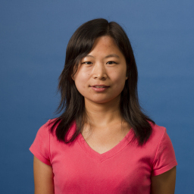
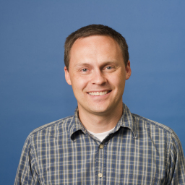
Acknowledgements
CCL Team
Ben Tovar
Patrick Donnelly
Peter Ivie
Haiyan Meng
Nick Hazekamp
Peter Sempolinski
Haipeng Cai
Chao Zheng
Haiyan Meng is leading work on Parrot and Umbrella.
Peter Ivie is leading the work on PRUNE.

Slide 26
Cooperative Computing Lab http://ccl.cse.nd.edu
Douglas Thain
dthain@nd.edu

