Slide 1
Portable Resource Management for Data Intensive Workflows
Douglas Thain
University of Notre Dame

Slide 2
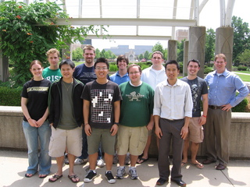
The Cooperative Computing Lab
University of Notre Dame
http://www.nd.edu/~ccl

Slide 3
The Cooperative Computing Lab
We collaborate with people who have large scale computing problems in science, engineering, and other fields.
We operate computer systems on the O(10,000) cores: clusters, clouds, grids.
We conduct computer science research in the context of real people and problems.
We release open source software for large scale distributed computing.
http://www.nd.edu/~ccl

Slide 4
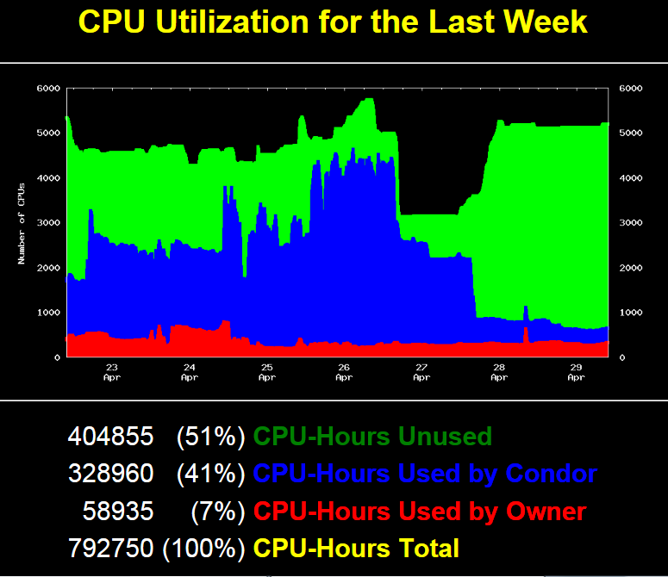

Slide 5
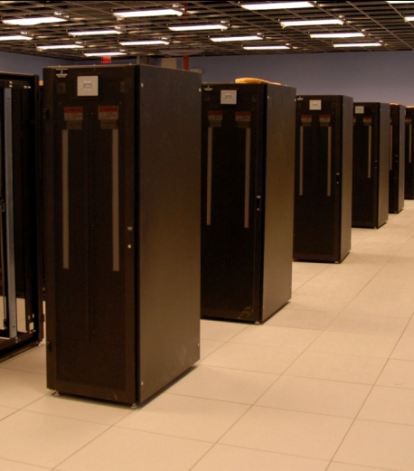
A Familiar Problem
X 100

Slide 6
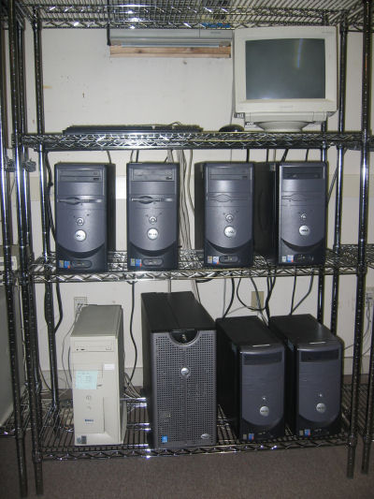
What actually happens:
1 TB
128 GB
X 100
GPU
3M files
of 1K each

Slide 7
Some reasonable questions:
Will this workload at all on machine X?
How many workloads can I run simultaneously without running out of storage space?
Did this workload actually behave as expected when run on a new machine?
How is run X different from run Y?
If my workload wasn’t able to run on this machine, where can I run it?

Slide 8
End users have no idea what resources their applications actually need.
and…
Computer systems are terrible at describing their capabilities and limits.
and…
They don’t know when to say NO.

Slide 9
dV/dt : Accelerating the Rate of Progress Towards Extreme Scale Collaborative Science Miron Livny (UW), Ewa Deelman (USC/ISI), Douglas Thain (ND), Frank Wuerthwein (UCSD), Bill Allcock (ANL)
… make it easier for scientists to conduct large-scale computational tasks that use the power of computing resources they do not own to process data they did not collect with applications they did not develop …

Slide 10
dV/dt Project Approach
Identify challenging applications.
Develop a framework that allows to characterize the application needs, the resource availability, and plan for their use.
Threads of Research:
High level planning algorithms.
Measurement, representation, analysis.
Resource allocation and enforcement.
Resources: Storage, networks, memory, cores…?
Evaluate on major DOE resources: OSG and ALCF.

Slide 11
Stages of Resource Management
Estimate the application resource needs
Find the appropriate computing resources
Acquire those resources
Deploy applications and data on the resources
Manage applications and resources during run.
Can we do it for one task?
How about an app composed of many tasks?

Slide 12
Categories of Applications
Concurrent Workloads
Static Workloads
Dynamic Workloads
Regular Graphs
Irregular Graphs
while( more work to do) {
foreach work unit {
t = create_task();
submit_task(t);
}
t = wait_for_task();
process_result(t);
}
1
2
3
A1
A2
A3
A
B
B1
F
F
F
4
5
6
7
B2
F
F
F
C
D
E
B3
F
F
F
8
9
10
A

Slide 13
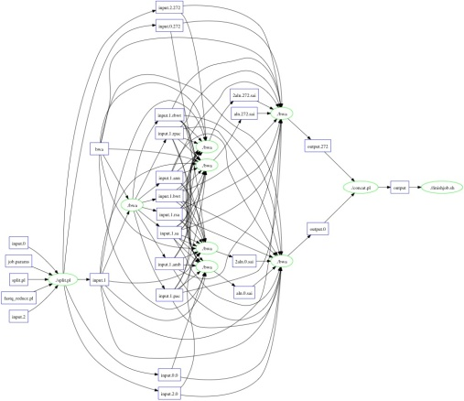
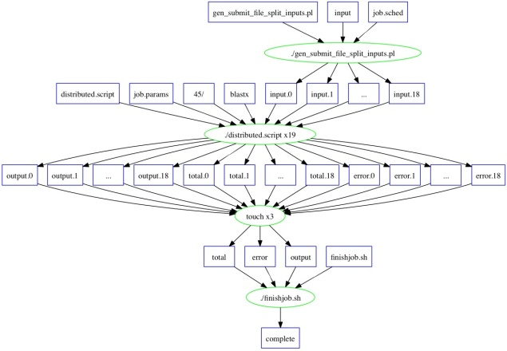
Bioinformatics Portal Generates Workflows for Makeflow
SHRIMP
5080 sub-tasks
~3h on 200 nodes
BLAST (Small)
17 sub-tasks
~4h on 17 nodes
BWA
825 sub-tasks
~27m on 100 nodes

Slide 14
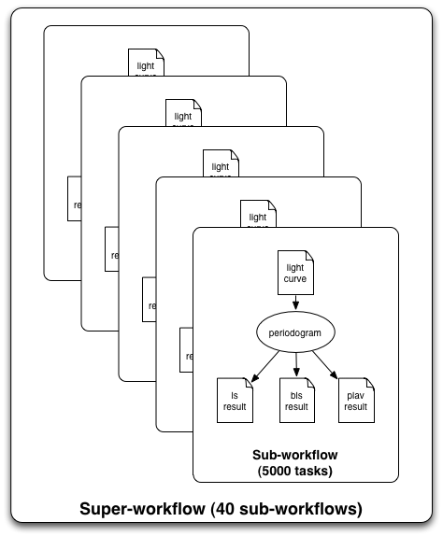
Periodograms: generate an atlas of extra-solar planets
Find extra-solar planets by
Wobbles in radial velocity of star, or
Dips in star’s intensity
210k light-curves released in July 2010
Apply 3 algorithms to each curve
3 different parameter sets
210K input, 630K output files
1 super-workflow
40 sub-workflows
~5,000 tasks per sub-workflow
210K tasks total
Planet
Star
Brightness
Light Curve
Pegasus managed workflows
Time
Notes:
I’m no domain scientist.

Slide 15
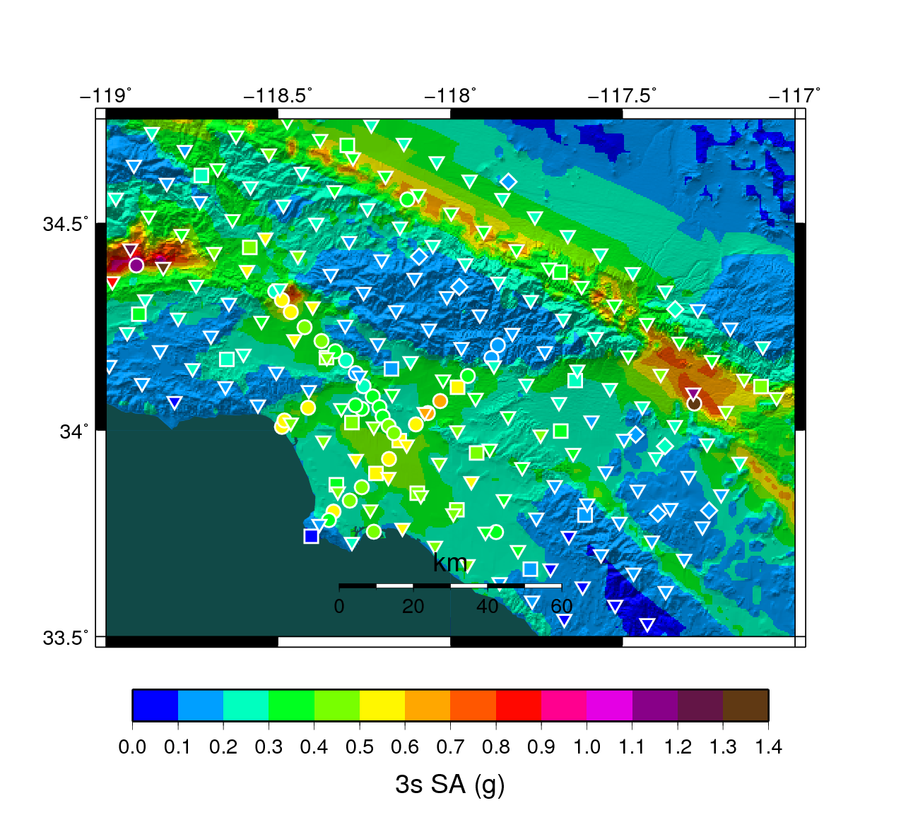
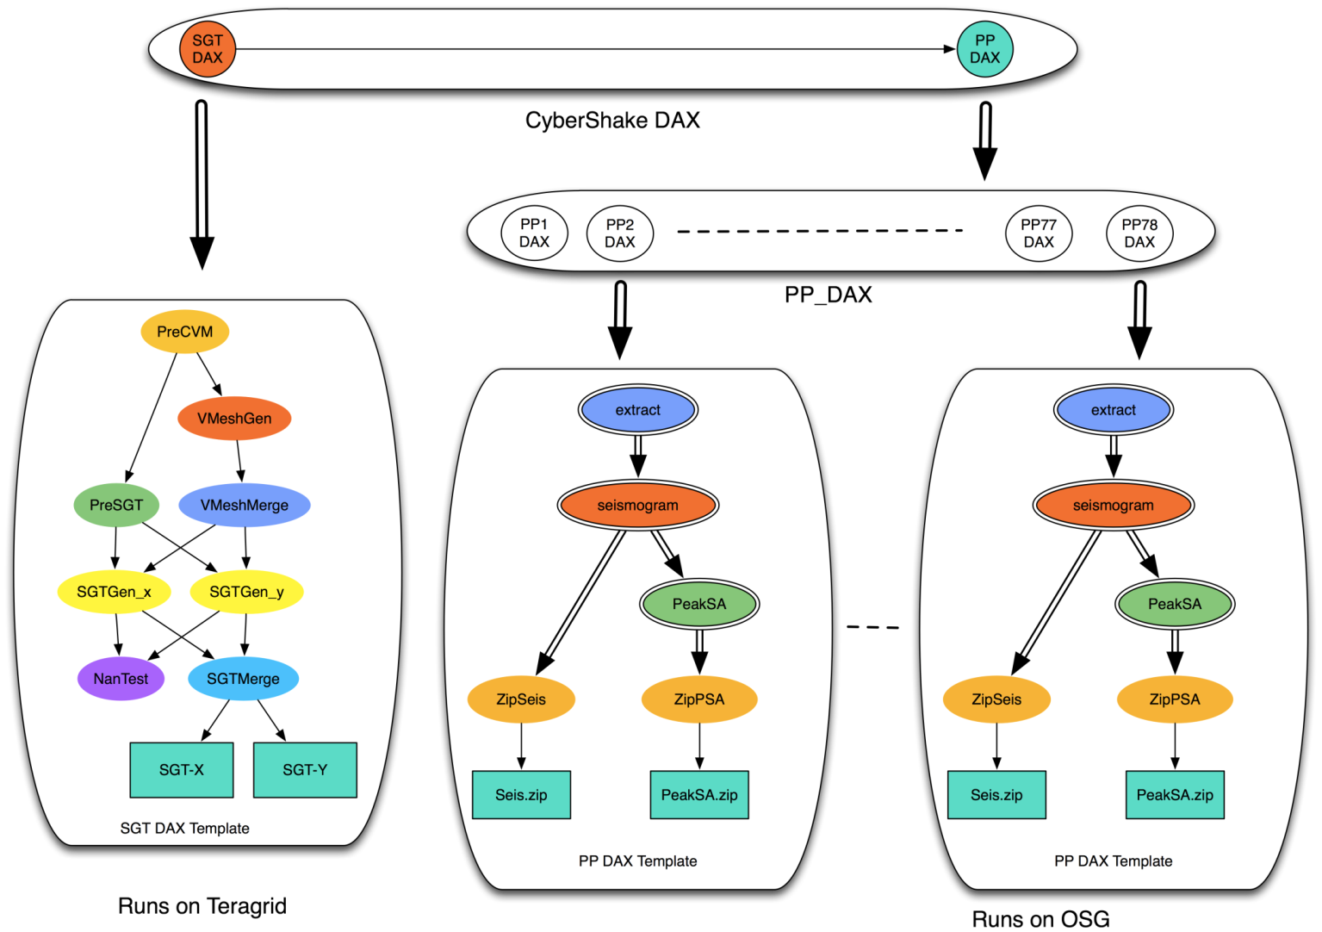
Southern California Earthquake Center
CyberShake PSHA Workflow
Description
Builders ask seismologists: “What will the peak ground motion be at my new building in the next 50 years?”
Seismologists answer this question using Probabilistic Seismic Hazard Analysis (PSHA)
239 Workflows
Each site in the input map corresponds to one workflow
Each workflow has:
820,000 tasks
MPI codes ~ 12,000 CPU hours,
Post Processing 2,000 CPU hours
Data footprint ~ 800GB
Pegasus managed workflows
Workflow Ensembles

Slide 16
Task Characterization/Execution
Understand the resource needs of a task
Establish expected values and limits for task resource consumption
Launch tasks on the correct resources
Monitor task execution and resource consumption, interrupt tasks that reach limits
Possibly re-launch task on different resources

Slide 17
Data Collection and Modeling
Records From
Many Tasks
Task Record
Task Profile
workflow
RAM: 50M
Disk: 1G
CPU: 4 C
RAM: 50M
Disk: 1G
CPU: 4 C
RAM: 50M
Disk: 1G
CPU: 4 C
monitor
RAM: 50M
Disk: 1G
CPU: 4 C
P
RAM
task
min
typ
max
A
A
B
C
B
C
D
E
D
E
F
F
Workflow Schedule
Workflow Profile
Workflow Structure

Slide 18
Resource Monitor
Log File:
#wall_clock(useconds) concurrent_processes cpu_time(useconds) virtual_memory(kB) resident_memory(kB) swap_memory(kB) bytes_read bytes_written
1 1 0 8700 376 0 385024 0
2 5 20000 326368 6100 0 27381007 1474560
3 6 20000 394412 7468 0 29735839 1503232
4 8 60000 531468 14092 0 36917793 1503232
5 8 100000 532612 16256 0 39285593 1503232
% resource_monitor mysim.exe
RM
Summary File
start: 1367424802.676755
end: 1367424881.236612
exit_type: normal
exit_status: 0
max_concurrent_processes: 16
wall_time: 78.559857
cpu_time: 54.181762
virtual_memory: 1051160
resident_memory: 117604
swap_memory: 0
bytes_read: 4847233552
bytes_written: 256950272
Local
Process
Tree

Slide 19
Monitoring Strategies
Indirect | Direct
Monitor how the world changes while the process tree is alive. | Monitor what functions, and with which arguments the process tree is calling.
Summaries | Snapshot | Events
getrusage and times | Reading /proc and measuring disk at given intervals. | Linker wrapper to libc
Available only at the end of a process. | Blind while waiting for next interval. | Fragile to modifications of the environment, no statically linked processes.

Slide 20
Portable Resource Management
Pegasus
RM
Job-1.res
Job-2.res
job-3.res
Task
Makeflow
other batch system
RM
rule-1.res
Jrule2.res
rule-3.res
Task
while( more work to do) {
foreach work unit {
t = create_task();
submit_task(t);
}
t = wait_for_task();
process_result(t);
}
W
RM
task 1 details:
cpu, ram, disk
task 2 details:
cpu, ram, disk
task 3 details:
cpu, ram, disk
Work
Queue
W
Task
W

Slide 21
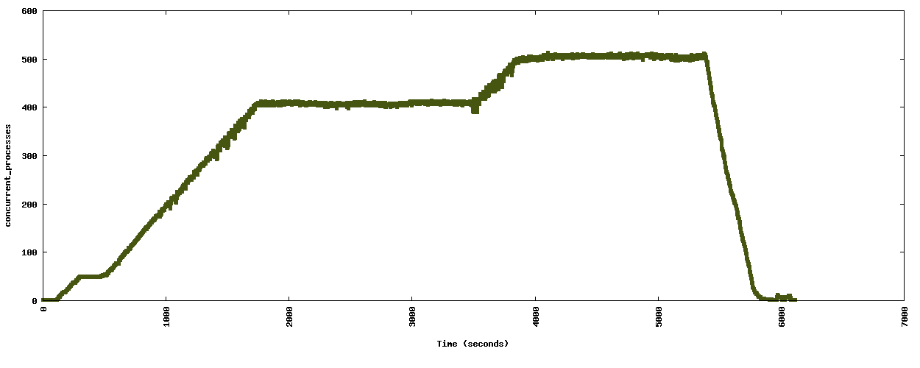
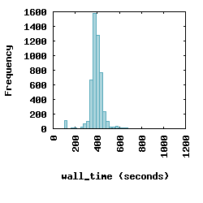
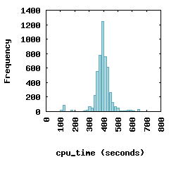
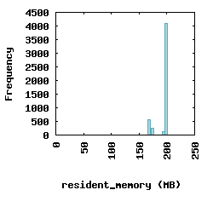
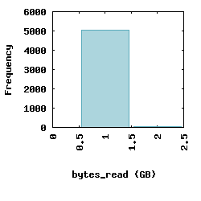
Resource Visualization of SHRiMP

Slide 22
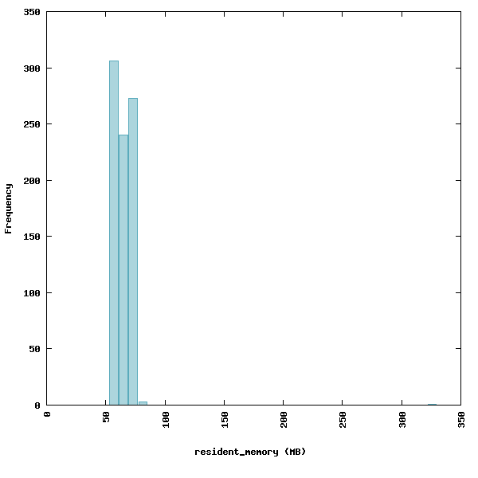
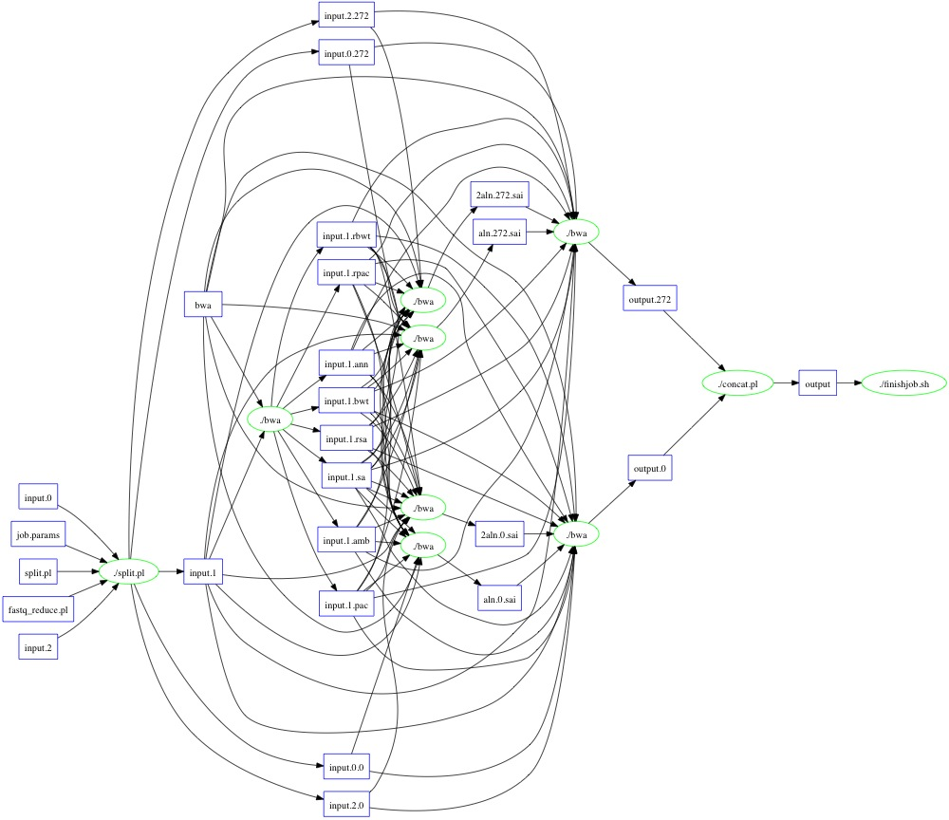
Outliers Happen: BWA Example

Slide 23
Completing the Cycle
Allocate Resources
Measurement
and Enforcement
CPU: 10s
RAM: 16GB
DISK: 100GB
RM
task
Exception Handling
Is it an outlier?
task
Historical Repository
Observed Resources
CPU: 5s
RAM: 15GB
DISK: 90GB
P
RAM
min
typ
max

Slide 24
Multi-Party Resource Management
SDN
WF
Coord
Batch
System
Storage
Allocator

Slide 25
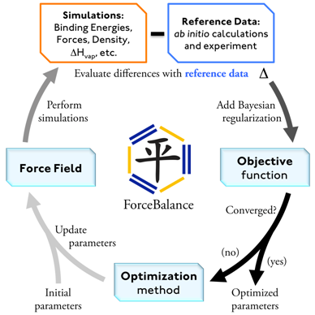
Application to Work Queue
while( more work to do) {
foreach work unit {
t = create_task();
submit_task(t);
}
t = wait_for_task();
process_result(t);
}
Application Logic
Work Queue Library
$
$
$
Campus
Condor Pool
Campus
HPC Cluster
Amazon EC2
W
W
W
W
W
W
W
W
W

Slide 26
Coming up soon in CCTools…
Makeflow
Integration with resource management.
Built-in linker pulls in deps to make a portable package.
Work Queue
Hierarchy, multi-slot workers, cluster caching.
Automatic scaling of workers with network capacity.
Parrot
Integration with CVMFS for CMS and (almost?) ATLAS.
Continuous improvement of syscall support.
Chirp
Support for HDFS as a storage backend.
Neat feature: search() system call.

Slide 27
Acknowledgements
dV/dT Project PIs
Bill Allcock (ALCF)
Ewa Deelman (USC)
Miron Livny (UW)
Frank Weurthwein (UCSD)
CCL Staff
Ben Tovar
CCL Graduate Students:
Michael Albrecht
Patrick Donnelly
Dinesh Rajan
Casey Robinson
Peter Sempolinski
Li Yu

Slide 28
The Cooperative Computing Lab
University of Notre Dame
http://www.nd.edu/~ccl

