Slide 1
Scaling Up Without Blowing Up
Douglas Thain
University of Notre Dame

Slide 2
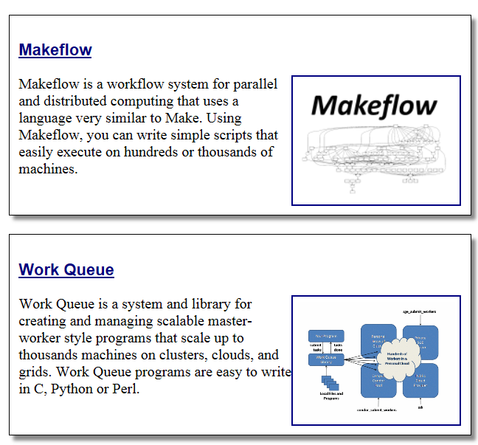
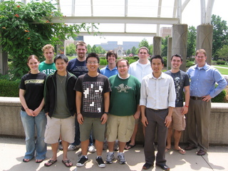
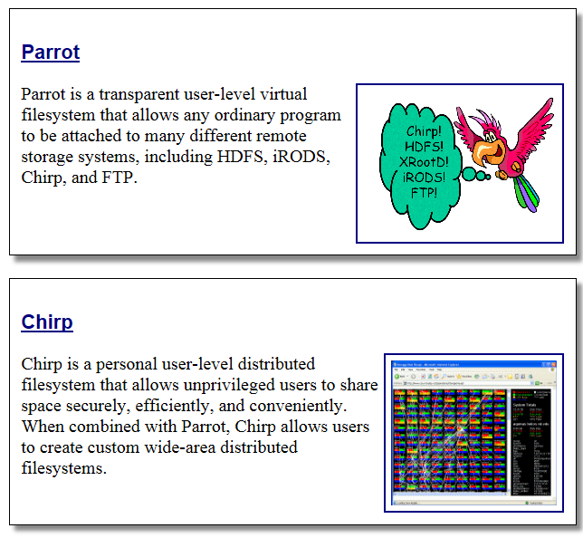
The Cooperative Computing Lab
University of Notre Dame
http://www.nd.edu/~ccl

Slide 3
The Cooperative Computing Lab
We collaborate with people who have large scale computing problems in science, engineering, and other fields.
We operate computer systems on the O(10,000) cores: clusters, clouds, grids.
We conduct computer science research in the context of real people and problems.
We release open source software for large scale distributed computing.
http://www.nd.edu/~ccl

Slide 4
Good News:
Computing is Plentiful

Slide 5
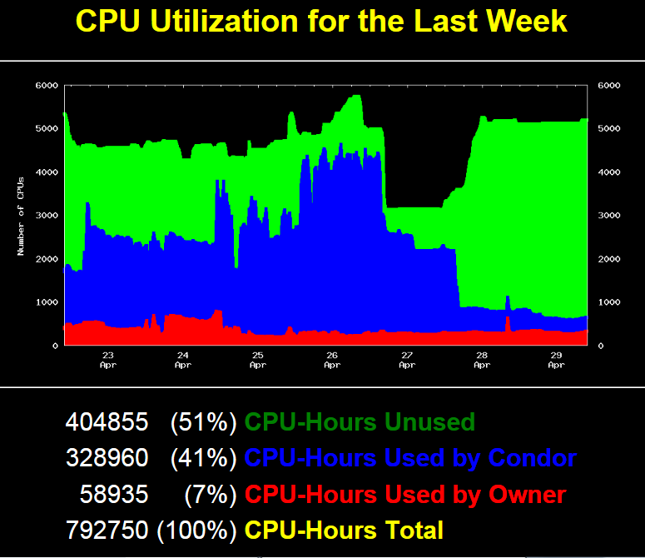

Slide 6
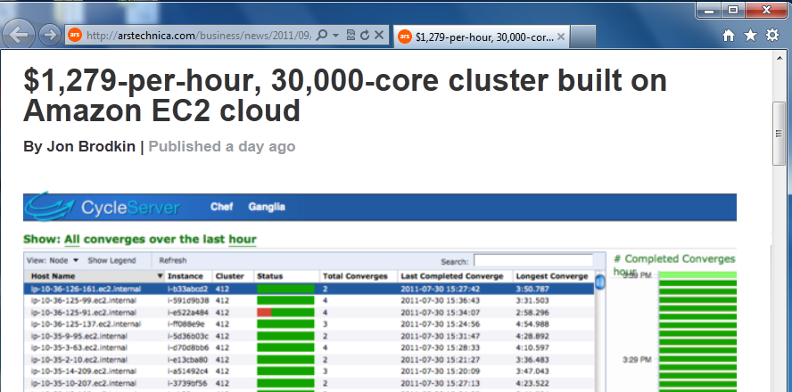
Superclusters by the Hour
http://arstechnica.com/business/news/2011/09/30000-core-cluster-built-on-amazon-ec2-cloud.ars

Slide 7
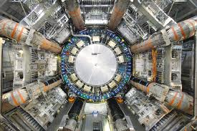
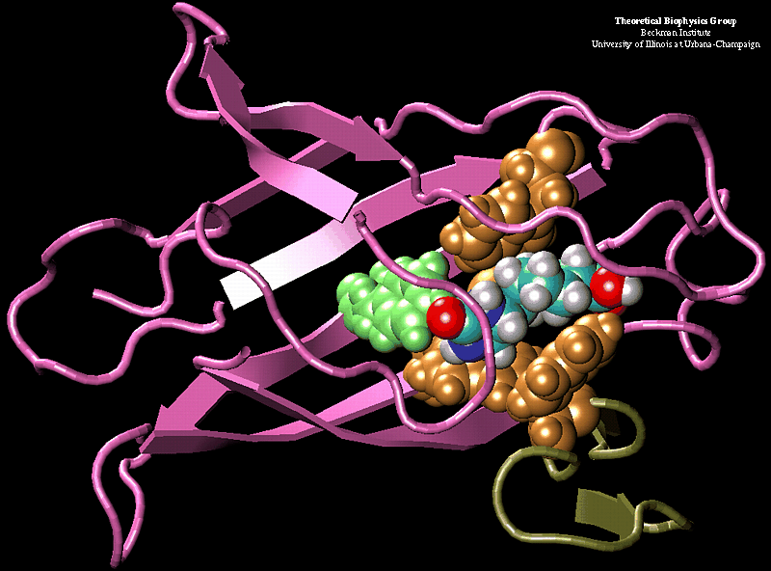
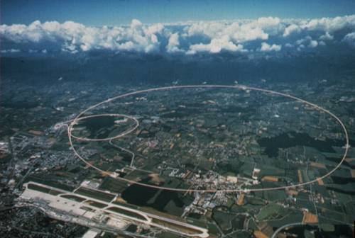
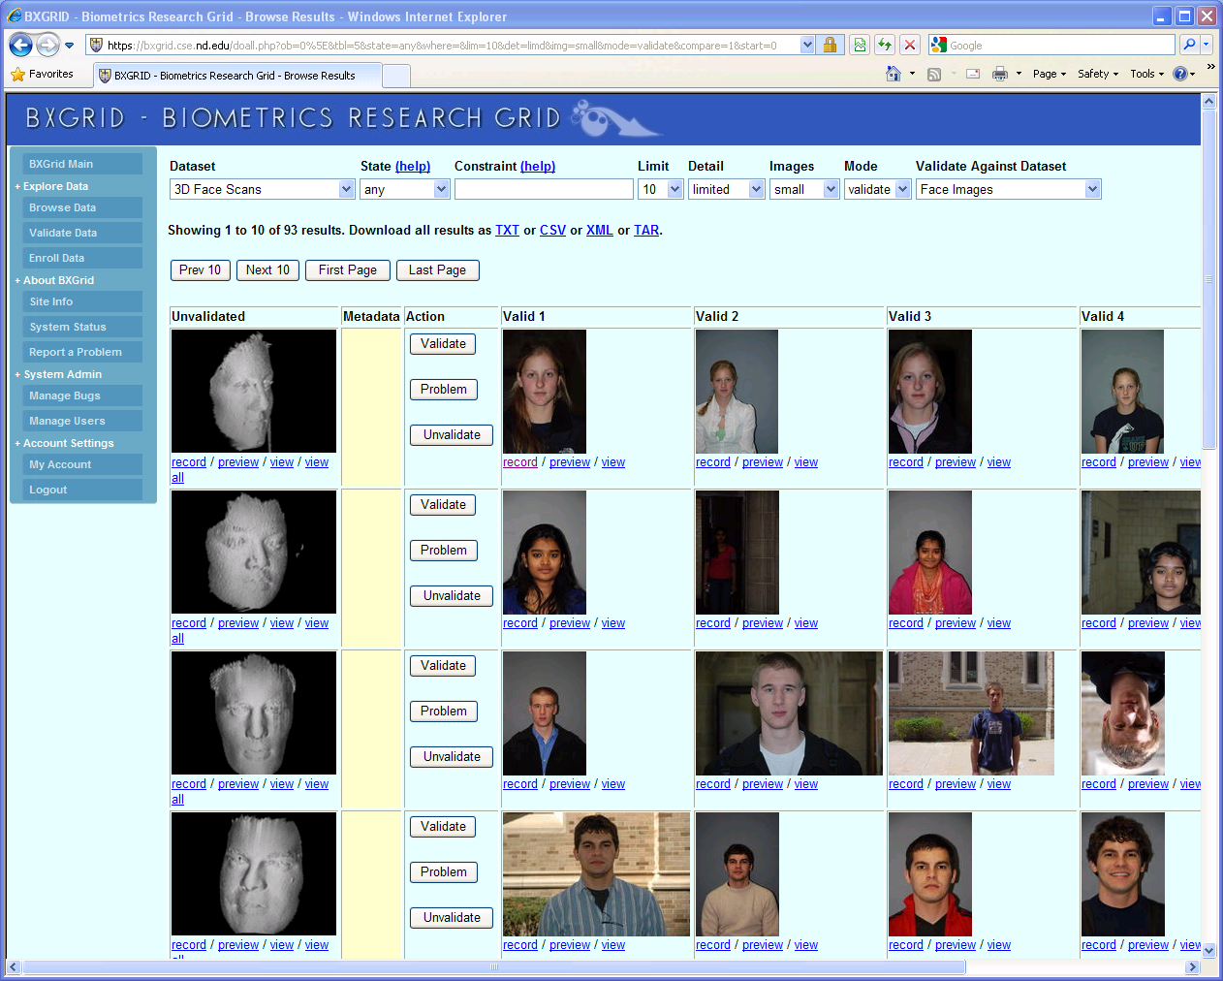
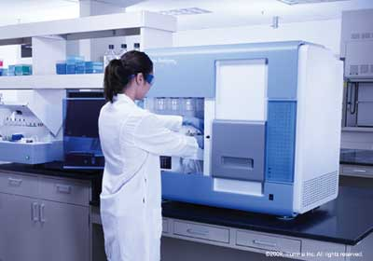

Our Collaborators
AGTCCGTACGATGCTATTAGCGAGCGTGA…

Slide 8
The Cooperative Computing Tools
http://www.nd.edu/~ccl

Slide 9
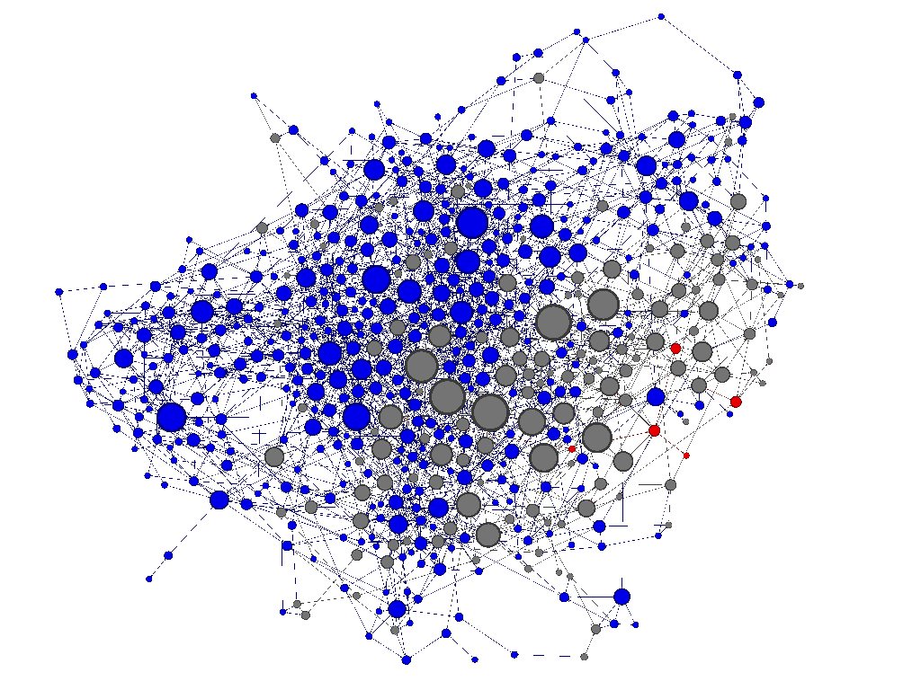
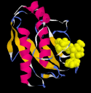
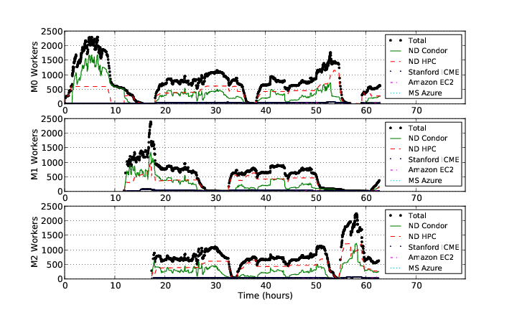
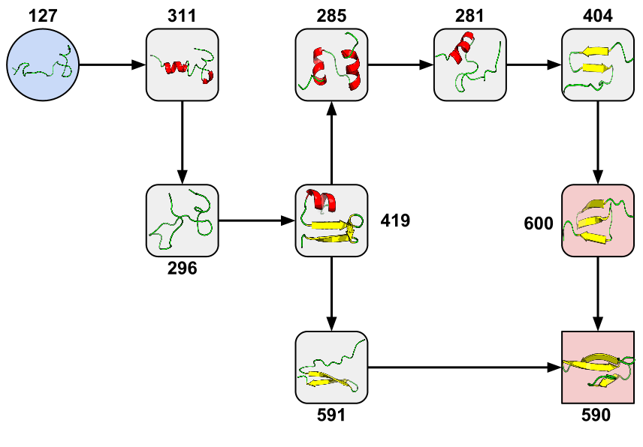
Example: Adaptive Weighted Ensemble
1: Start with Standard
MD Simulation
2: Research Goal:
Generate Network of States
3: Build AWE Logic
Using Work Queue Library
AWE Logic
Work Queue
Amazon EC2
Personal Cloud
HPC Cluster
GPU Cluster
Condor
4: Run on 2000+ CPUs/GPUs at
Notre Dame, Stanford, and Amazon
5: New State Transition Discovered!
Badi Abdul-Wahid, Li Yu, Dinesh Rajan, Haoyun Feng, Eric Darve, Douglas Thain, Jesus A. Izaguirre,
Folding Proteins at 500 ns/hour with Work Queue, IEEE e-Science Conference, 2012
Notes:
This slide shows an example of a recent result generated using parts of the Cooperative Computing Tools.
This work was done in collaboration with Jesus Izaguirre (Notre Dame) and Eric Darve at Stanford University.
Many of you are familiar with the concept of protein folding, in which a molecular dynamics (MD) simulation is run for a long time in order to observe the many ways in which a complex molecule can bend and fold, thus affecting how it interacts with other biomolecules. If we consider each configuration of a protein (#1) to be a distinct state, then we can generate a network (#2) in which each state is a node and the transitions between the states are edges. To fully understand the behavior of the molecule, we would like to know the probability associated with each state and transition. Simulating one protein is excruciatingly slow, and running one simulation would never explore all of these states in any reasonable time.
Using the Cooperative Computing Tools, we were able to build a distributed implementation of the Adaptive Weighted Ensemble technique using the Work Queue library. In about 2000 lines of Python (#3), we created a system to efficiently explore the network of states by running many simulations simultaneously. These codes were easily distributed across multiple clusters, clouds, and grids gained from Notre Dame, Stanford, and Amazon EC2. The Work Queue library transparently handles fault tolerance, data distribution, and task scheduling across this personal cloud.
This implementation scaled up to over 2000 CPUs and GPUs spread across the country, achieving a consistent simulation rate of about 500 simulated nanoseconds per hour of wall clock time. Multiple AWE instances can run simultaneously, and as the needs of each instance fluctuate, the personal cloud reallocates resources automatically. In a recent result (#5) to appear in the IEEE e-Science conference this fall, we discovered a new state transition in the Fip35 protein.
By making use of the Cooperative Computing Tools, the distributed algorithm is not tied to any one computing infrastructure and can migrate to whatever clusters, clouds, or grids that the researcher can access at any given moment.

Slide 10
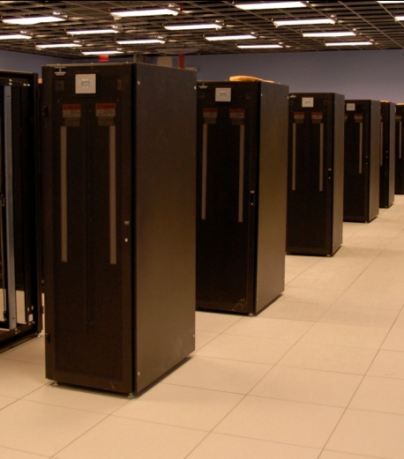
The Ideal Picture
X 1000

Slide 11
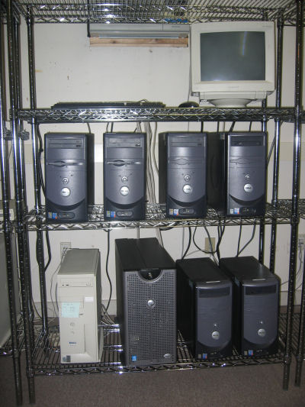
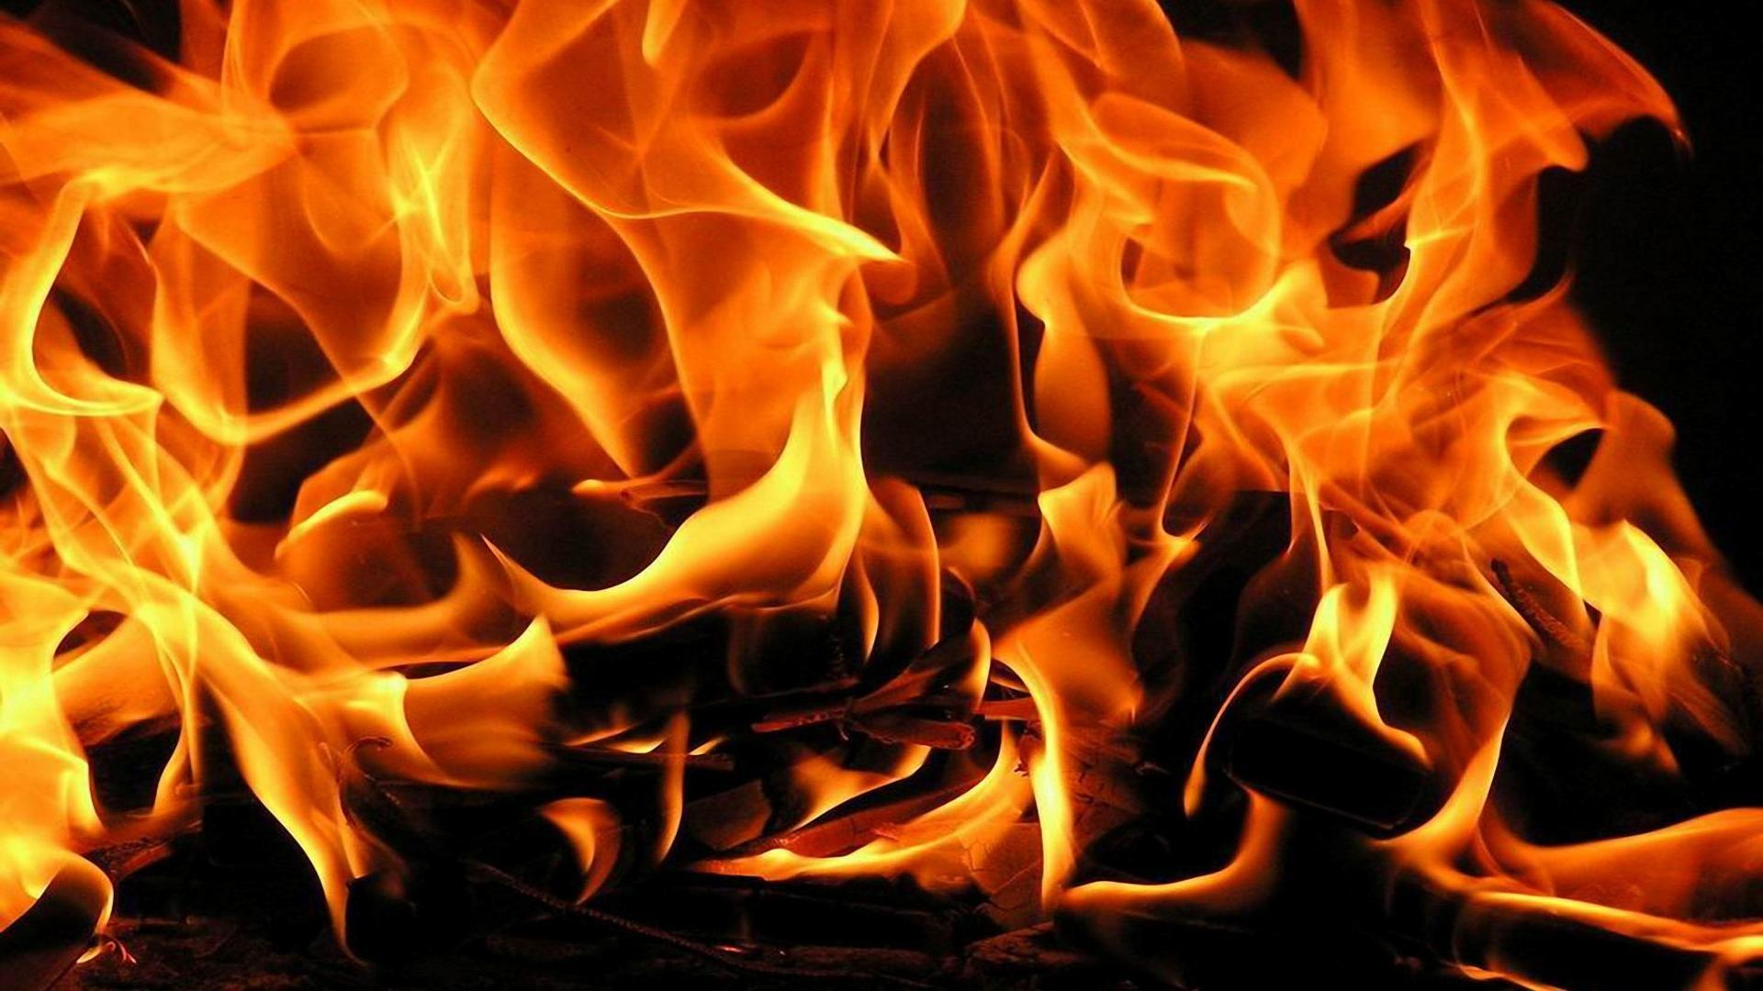
What actually happens:
1 TB
128 GB
X 1000
GPU
3M files
of 1K each

Slide 12
Some reasonable questions:
Will this workload at all on machine X?
How many workloads can I run simultaneously without running out of storage space?
Did this workload actually behave as expected when run on a new machine?
How is run X different from run Y?
If my workload wasn’t able to run on this machine, where can I run it?

Slide 13
End users have no idea what resources their applications actually need.
and…
Computer systems are terrible at describing their capabilities and limits.
and…
They don’t know when to say NO.

Slide 14
dV/dt : Accelerating the Rate of Progress
Towards Extreme Scale Collaborative Science
Miron Livny (UW), Ewa Deelman (USC/ISI), Douglas Thain (ND),
Frank Wuerthwein (UCSD), Bill Allcock (ANL)
… make it easier for scientists to conduct large-scale computational tasks that use the power of computing resources they do not own to process data they did not collect with applications they did not develop …

Slide 15
Stages of Resource Management
Estimate the application resource needs
Find the appropriate computing resources
Acquire those resources
Deploy applications and data on the resources
Manage applications and resources during run.
Can we do it for one task?
How about an app composed of many tasks?

Slide 16
Categories of Applications
Concurrent Workloads
Static Workloads
Dynamic Workloads
Regular Graphs
Irregular Graphs
while( more work to do) {
foreach work unit {
t = create_task();
submit_task(t);
}
t = wait_for_task();
process_result(t);
}
1
2
3
A1
A2
A3
A
B
B1
F
F
F
4
5
6
7
B2
F
F
F
C
D
E
B3
F
F
F
8
9
10
A

Slide 17
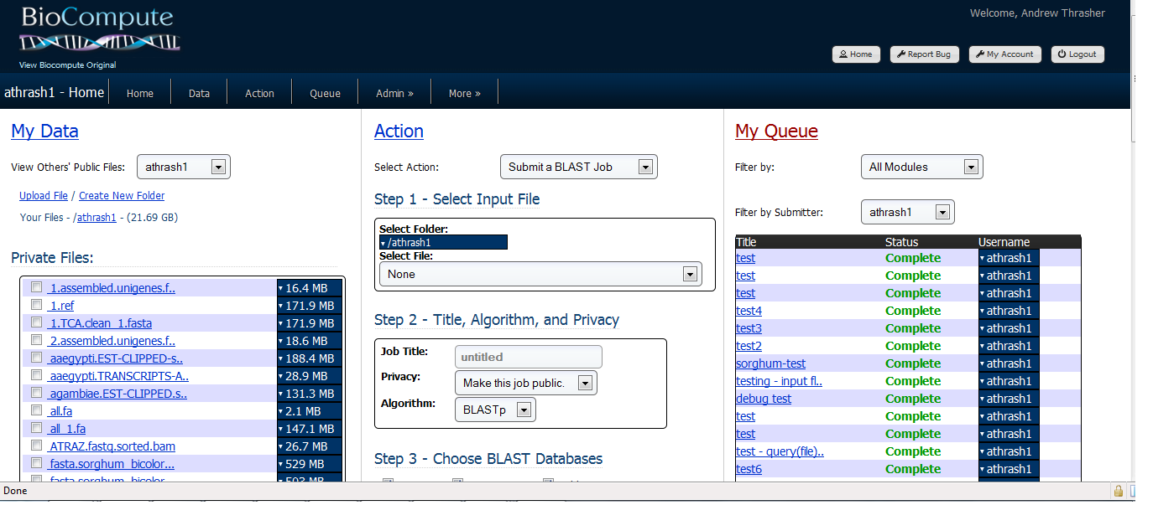
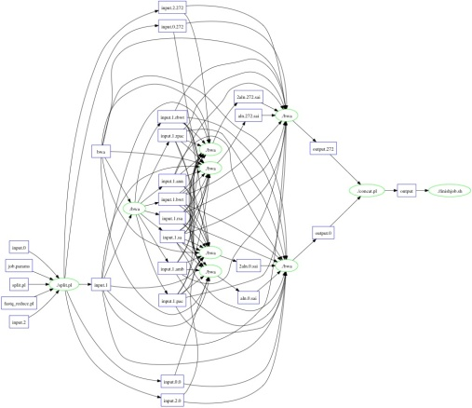
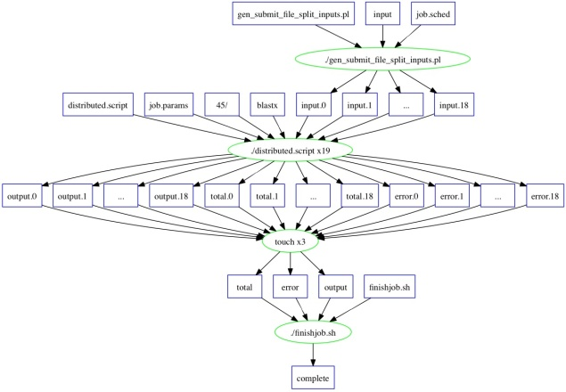
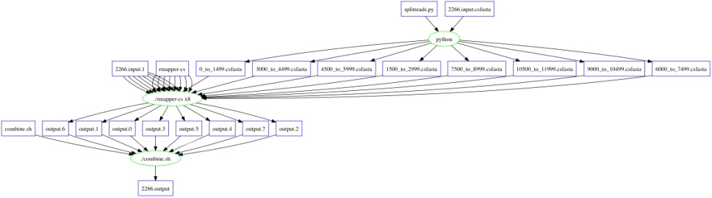
Bioinformatics Portal Generates
Workflows for Makeflow
SHRIMP
5080 sub-tasks
~3h on 200 nodes
BLAST (Small)
17 sub-tasks
~4h on 17 nodes
BWA
825 sub-tasks
~27m on 100 nodes

Slide 18
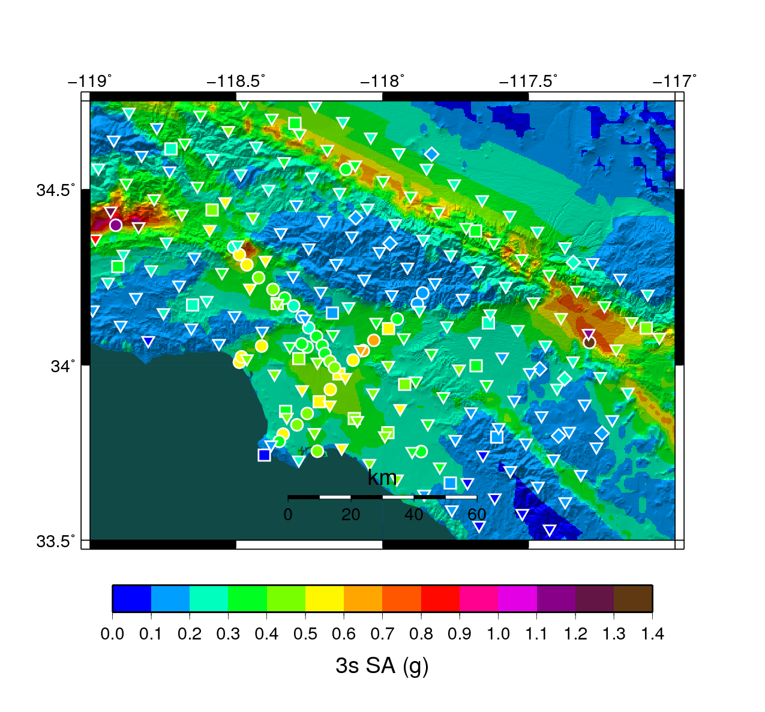
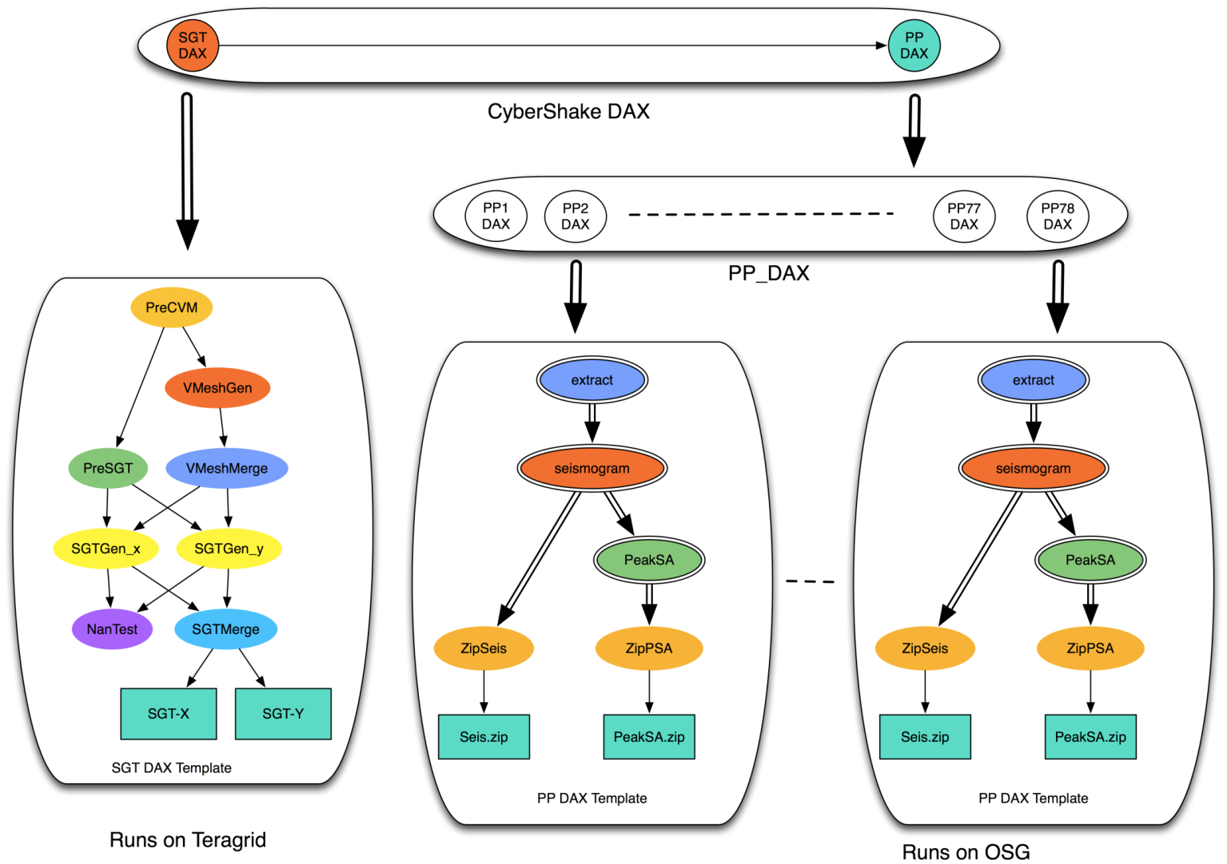
Southern California Earthquake Center
CyberShake PSHA Workflow
Description
  Builders ask seismologists: “What will the peak ground motion be at my new building in the next 50 years?”
  Seismologists answer this question using Probabilistic Seismic Hazard Analysis (PSHA)
239 Workflows
Each site in the input map corresponds to one workflow
Each workflow has:
820,000 tasks
MPI codes ~ 12,000 CPU hours,
Post Processing 2,000 CPU hours
Data footprint ~ 800GB
Pegasus managed workflows
Workflow Ensembles

Slide 19
Task Characterization/Execution
Understand the resource needs of a task
Establish expected values and limits for task resource consumption
Launch tasks on the correct resources
Monitor task execution and resource consumption, interrupt tasks that reach limits
Possibly re-launch task on different resources

Slide 20
Data Collection and Modeling
Records From
Many Tasks
Task Record
Task Profile
workflow
RAM: 50M
Disk: 1G
CPU: 4 C
RAM: 50M
Disk: 1G
CPU: 4 C
RAM: 50M
Disk: 1G
CPU: 4 C
monitor
RAM: 50M
Disk: 1G
CPU: 4 C
P
RAM
task
min
typ
max
A
A
B
C
B
C
D
E
D
E
F
F
Workflow Schedule
Workflow Profile
Workflow Structure

Slide 21
Resource Monitor
Log File:
#wall_clock(useconds) concurrent_processes cpu_time(useconds) virtual_memory(kB) resident_memory(kB) swap_memory(kB) bytes_read bytes_written
1 1 0 8700 376 0 385024 0
2 5 20000 326368 6100 0 27381007 1474560
3 6 20000 394412 7468 0 29735839 1503232
4 8 60000 531468 14092 0 36917793 1503232
5 8 100000 532612 16256 0 39285593 1503232
% resource_monitor mysim.exe
RM
Summary File
start: 1367424802.676755
end: 1367424881.236612
exit_type: normal
exit_status: 0
max_concurrent_processes: 16
wall_time: 78.559857
cpu_time: 54.181762
virtual_memory: 1051160
resident_memory: 117604
swap_memory: 0
bytes_read: 4847233552
bytes_written: 256950272
Local
Process
Tree

Slide 22
Monitoring Strategies
Indirect | Direct
Monitor how the world changes while the process tree is alive. | Monitor what functions, and with which arguments the process tree is calling.
Summaries | Snapshot | Events
getrusage and times | Reading /proc and measuring disk at given intervals. | Linker wrapper to libc
Available only at the end of a process. | Blind while waiting for next interval. | Fragile to modifications of the environment, no statically linked processes.

Slide 23

Portable Resource Management
Pegasus
RM
Job-1.res
Job-2.res
job-3.res
Task
Makeflow
other batch system
RM
rule-1.res
Jrule2.res
rule-3.res
Task
while( more work to do) {
foreach work unit {
t = create_task();
submit_task(t);
}
t = wait_for_task();
process_result(t);
}
W
RM
task 1 details:
cpu, ram, disk
task 2 details:
cpu, ram, disk
task 3 details:
cpu, ram, disk
Work
Queue
W
Task
W

Slide 24
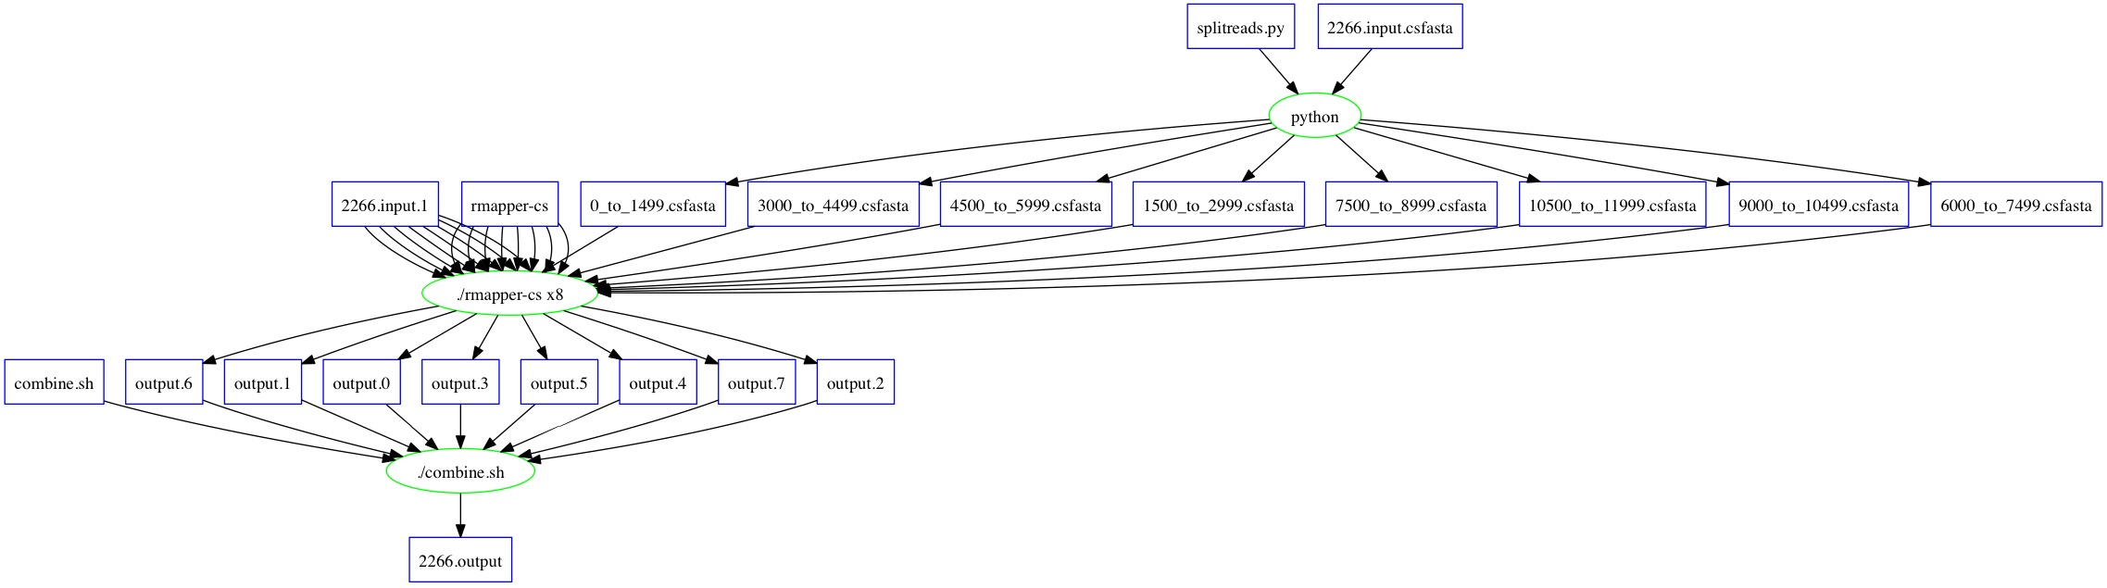
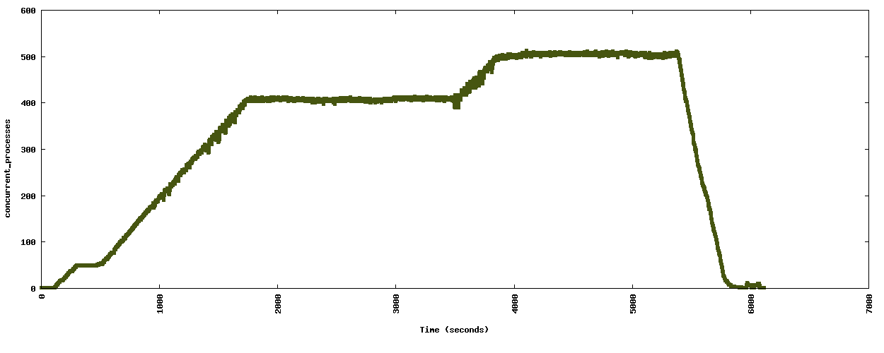
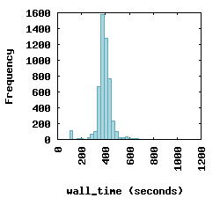
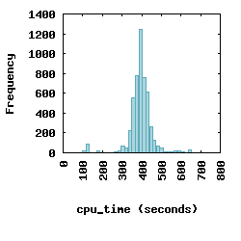
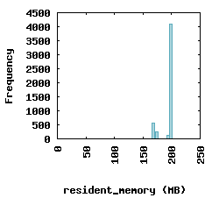
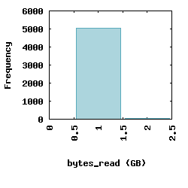
Resource Visualization of SHRiMP

Slide 25
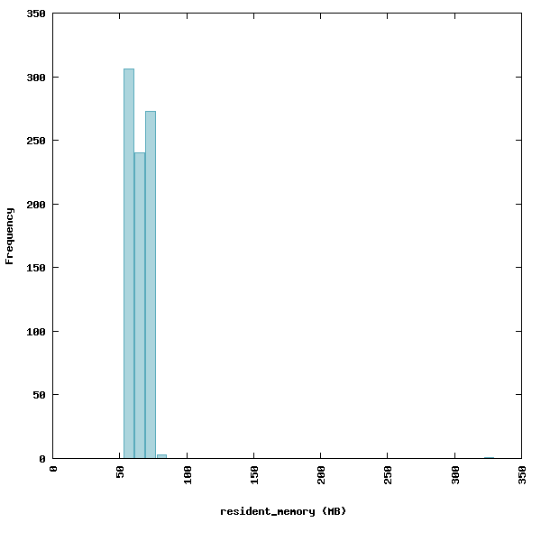
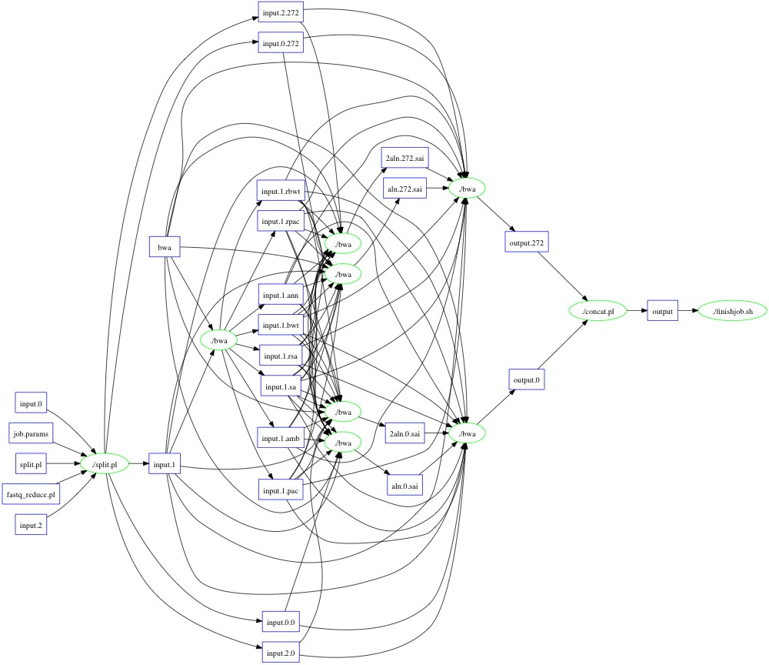
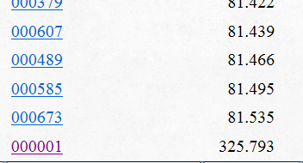
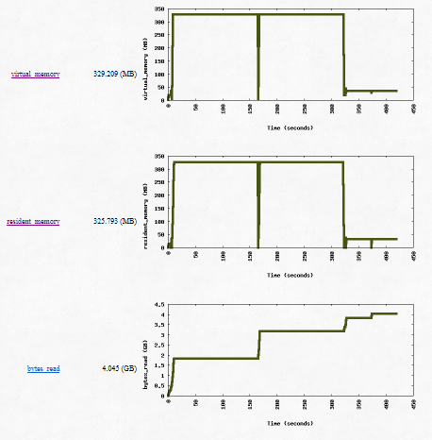
Outliers Happen: BWA Example

Slide 26
Completing the Cycle
Allocate Resources
Measurement
and Enforcement
CPU: 10s
RAM: 16GB
DISK: 100GB
RM
task
Exception Handling
Is it an outlier?
task
Historical Repository
Observed Resources
CPU: 5s
RAM: 15GB
DISK: 90GB
P
RAM
min
typ
max

Slide 27
Complete Workload Characterization
128 GB
32 cores
16 GB
4 cores
12 hours
500 Gb/s I/O
X 1
X 10
128 GB
32 cores
16 GB
4 cores
1 hour
5 Tb/s I/O
X 1
X 100
X 1000
We can approach the question:
Can it run on this particular machine?
What machines could it run on?

Slide 28
Two jokes about computer scientists.

Slide 29
How do you tell the difference between a computer scientist and a real scientist?

Slide 30
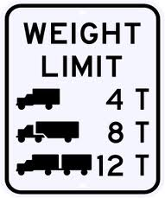
What’s the difference between a computer scientist and an engineer?
Throughput
System Scale

Slide 31
Posters Preview
Hierarchical Resource Management
  Michael Albrecht
Workflow Dependency Management
  Casey Robinson
Application Assembly Technologies
  Peter Sempolinski

Slide 32


Acknowledgements
dV/dT Project PIs
Bill Allcock (ALCF)
Ewa Deelman (USC)
Miron Livny (UW)
Frank Weurthwein (UCSD)
CCL Staff
Ben Tovar
CCL Graduate Students:
Michael Albrecht
Patrick Donnelly
Dinesh Rajan
Casey Robinson
Peter Sempolinski
Li Yu

Slide 33
The Cooperative Computing Lab
University of Notre Dame
http://www.nd.edu/~ccl

