Slide 1
Techniques for Preserving Scientific Software Executions: Preserve the Mess or Encourage Cleanliness?
Douglas Thain, Peter Ivie, and Haiyan Meng

Slide 2
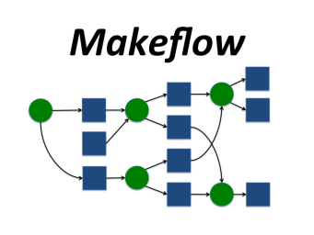
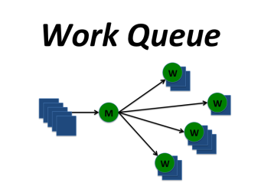
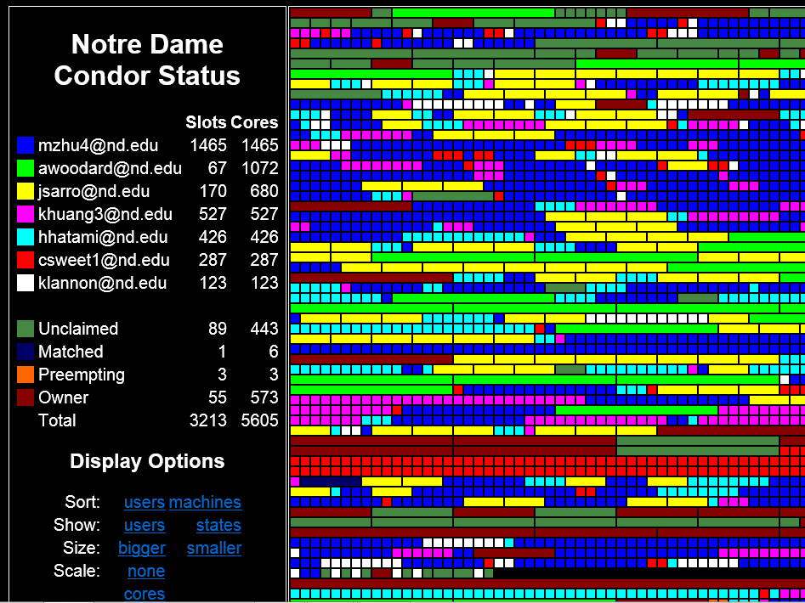
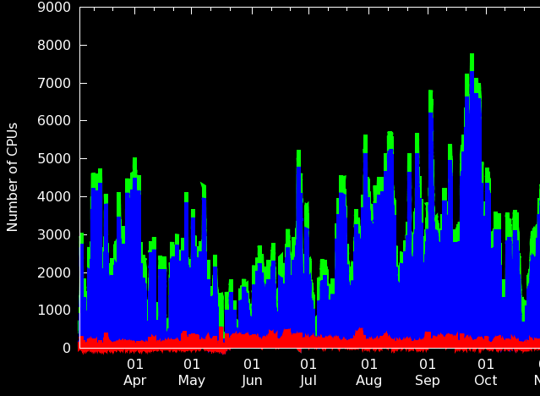
The Cooperative Computing Lab
http://ccl.cse.nd.edu

Slide 3
The Cooperative Computing Lab
We collaborate with people who have large scale computing problems in science, engineering, and other fields.
We operate computer systems on the O(10,000) cores: clusters, clouds, grids.
We conduct computer science research in the context of real people and problems.
We release open source software for large scale distributed computing.
http://ccl.cse.nd.edu

Slide 4
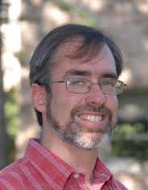
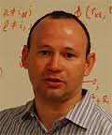
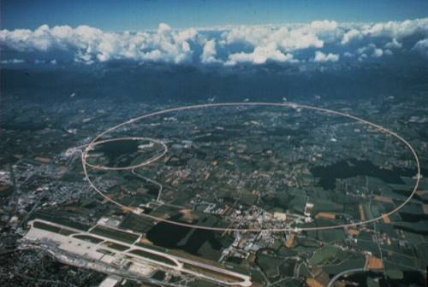
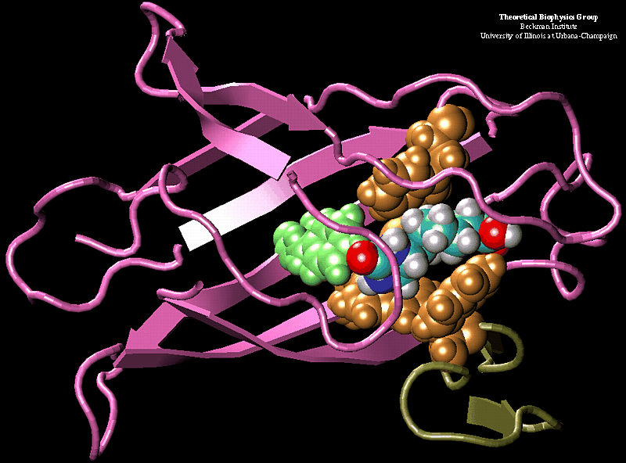
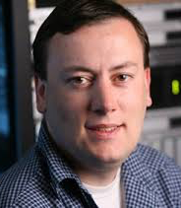
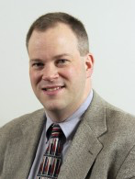
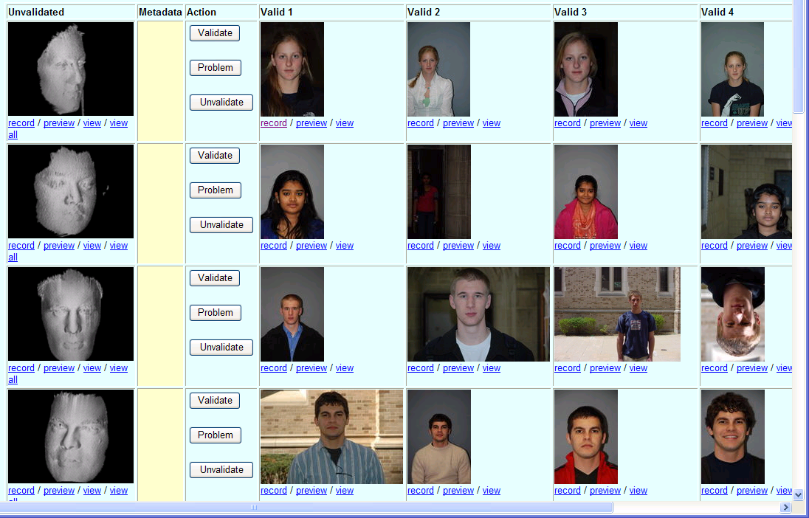
Some of Our Collaborators
K. Lannon: Analyze 2PB of data produced by the LHC experiment at CERN
J. Izaguirre: Simulate 10M different configurations of a complex protein.
S. Emrich: Analyze DNA in thousands of genomes for similar sub-sequences.
P. Flynn: Computational experiments on millions of acquired face videos.

Slide 5
Reproducibility in Scientific Computing is Very Poor Today
Can I re-run a result from a colleague from five years ago, and obtain the same result?
How about a student in my lab from last week?
Today, are we preparing for our current results to be re-used by others five years from now?
Multiple reasons why not:
Rapid technological change.
No archival of artifacts.
Many implicit dependencies.
Lack of backwards compatibility.
Lack of social incentives.

Slide 6
Our scientific collaborators see the value in reproducibility… But only if it can be done - easily - at large scale - with high performance

Slide 7
In principle, preserving a software execution is easy.

Slide 8
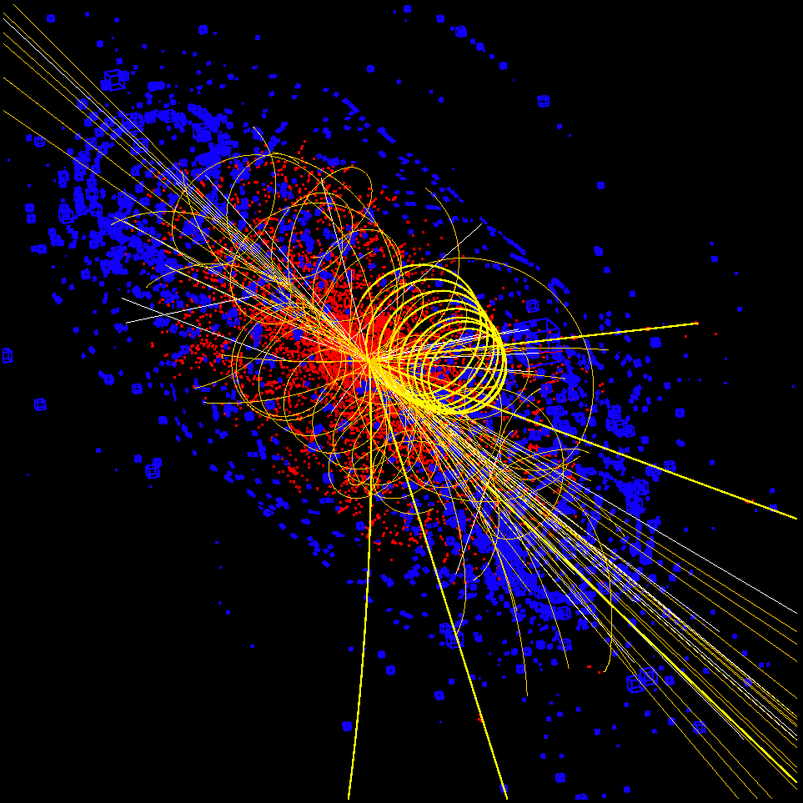
I want to preserve my simulation method and results so other people can try it out.
mysim.exe –in data –out output –p 10
data
output
DOI:10.XXXX
DOI:10.YYYY
DOI:10.ZZZZ
DOI:10.CCCC
… and repeat this 1M times with different –p values.

Slide 9
But it’s not that simple!

Slide 10
I want to preserve my simulation method and results so other people can try it out.
mysim.exe –in data –out output –p 10
calib
HTTP GET
SIM_MODE=clever
data
output
config
ruby
libsim
Green Goat Linux 57.83.09.B
X86-64 CPU / 64GB RAM / 200GB Disk

Slide 11
The problem is implicit dependencies: (things you need but cannot see) How do we find them? How do we deliver them?

Slide 12
Two approaches: Preserve the Mess (VMs and Parrot) Encourage Cleanliness (Umbrella and Prune)

Slide 13
Preserve the Mess: Save a VM
DOI:10.XXXX
sim.exe –in data –out output –p 10
sim.exe –in data –out output –p 10
calib
HTTP GET
SIM_MODE=clever
SIM_MODE=clever
data
output
data
output
config
ruby
config
ruby
libsim
libsim
Green Goat Linux 57.83.09.B
Green Goat Linux 57.83.09.B
Hardware
Virtual Hardware
VMM

Slide 14
Preserve the Mess: Save a VM
Not a bad place to start, but:
Captures more things than necessary.
Duplication across similar VM images.
Hard to disentangle things logically – what if you want to run the same thing with a new OS?
Doesn’t capture network interactions.
May be coupled to a specific VM technology.
VM services are not data archives.

Slide 15
Preserve the Mess: Trace Individual Dependencies
Original Machine
Resource Actually Used
Trace all
system calls
sim.exe –in data –out output –p 10
/home/fred/data
/home/fred/config
/home/fred/sim.exe
/usr/lib/libsim
/usr/bin/ruby
http://somewhere/calib
. . .
calib
HTTP GET
SIM_MODE=clever
Parrot
data
output
config
ruby
libsim
Green Goat Linux 57.83.09.B
Hardware
A portable package that can be re-executed using Docker, Parrot, or Amazon
Case Study: 166TB reduced to a 21GB package.
Haiyan Meng, Matthias Wolf, Peter Ivie, Anna Woodard, Michael Hildreth, Douglas Thain,
A Case Study in Preserving a High Energy Physics Application with Parrot,
Journal of Physics: Conference Series, December, 2015.

Slide 16
Preserve the Mess: Trace Individual Dependencies
Solves some problems:
Captures only what is necessary.
Observes network interactions.
Portable across VM technologies.
Still has some of the same problems:
Hard to disentangle things logically – what if you want to run the same thing with a new OS?
Duplication across similar VM images / packages.
VM services are not data archives.

Slide 17
What we really want: A structured way to compose an application with all of its dependencies. Enable preservation and sharing of data and images for efficiency.

Slide 18
Encourage Cleanliness: Umbrella
mysim.json
“umbrella run mysim.json”
kernel: { name: “Linux”, version: “3.2”; } opsys: { name: “Red Hat”, version: “6.1” }
software: {
mysim: {
url: “doi://10.WW/ZZZZ”
mount: “/soft/sim”,
}
}
data: {
input: {
url: “http://some.url”
mount : “/data/input”,
}
calib: {
url: “doi://10.XX/YYYY”
mount: “/data/calib”,
}
}
mysim
input
calib
RedHat 6.1
Linux 3.2.4
Online Data Archives
RedHat 6.1
mysim
input
calib

Slide 19
Umbrella specifies a reproducible environment while avoiding duplication and enabling precise adjustments.
Same thing, but use
different input data.
Same thing, but
update the OS
Run the experiment
input1
input2
input2
Mysim 3.1
Mysim 3.1
Mysim 3.1
RedHat 6.1
RedHat 6.1
RedHat 6.2
Linux 3.2.4
Linux 3.2.4
Linux 3.2.4
Institutional Repository
RedHat 6.1
input1
input2
Linux 3.2.4
Mysim 3.1
RedHat 6.2
calib1
calib2
Linux 3.2.5
Mysim 3.2
Haiyan Meng and Douglas Thain, Umbrella: A Portable Environment Creator for Reproducible Computing on Clusters, Clouds, and Grids, Virt. Tech. for Distributed Computing, June 2015.

Slide 20
Specification is More Important Than Mechanism
Umbrella can work in a variety of ways:
Native Hardware: Just check for compatibility.
Amazon: allocate VM, copy and unpack tarballs.
Docker: create container, mount volumes.
Parrot: Download tarballs, mount at runtime.
Condor: Request compatible machine.
More ways will be possible in the future as technologies come and go.
Key requirement: Efficient runtime composition, rather than copying, to allow shared deps.

Slide 21
Encourage Cleanliness: Construct workflows from carefully specified building blocks.

Slide 22
Encouraging Cleanliness: PRUNE
Observation: The Unix execution model is part of the problem, because it allows implicit deps.
Can we improve upon the standard command-line shell interface to make it reproducible?
Instead of interpreting an opaque string:
mysim.exe –in data –out calib
Ask the user to invoke a function instead:
output = mysim( input, calib ) IN ENV mysim.json

Slide 23
PRUNE – Preserving Run Environment
PUT “/tmp/input1.dat” AS “input1” [id 3ba8c2]
PUT “/tmp/input2.dat” AS “input2” [id dab209]
PUT “/tmp/calib.dat” AS “calib” [id 64c2fa]
PUT “sim.function” AS “sim” [id fffda7]
out1 = sim( input1, calib ) IN ENV mysim.json
[out1 is bab598]
out2 = sim( input2, calib ) IN ENV mysim.json
[out2 is 392caf]
out3 = sim( input2, calib2 ) IN ENV bettersim.json
[out3 is 232768]

Slide 24
PRUNE connects together precisely reproducible executions and gives each item a unique identifier
output1 = sim( input1, calib1 ) IN ENV mysim.json
input1
sim
output 1
sim2
calib1
myenv1
myenv1
bab598 = fffda7 ( 3ba8c2, 64c2fa ) IN ENV c8c832
Online Data Archive
RedHat 6.1
input1
outpu11
Linux 3.2.4
Mysim 3.1
RedHat 6.2
calib1
myenv1
Linux 3.2.5
Mysim 3.2

Slide 25
Recapitulation
Key problem: User cannot see the implicit dependencies that are critical to their code.
Preserve the Mess:
VMs: Just capture everything present.
Parrot: Capture only what is actually used.
Encourage Cleanliness:
Umbrella: Describe all deps in a simple specification.
PRUNE: Use a specification with every task run.
Preserving the mess may work for a handful of tasks, but cleanliness is required for millions!

Slide 26
Many Open Problems!
Naming: Tension between usability and durability: DOIs, UUIDs, HMACs, . . .
Overhead: Tools must be close to native performance, or they won’t get used.
Usability: Do users have to change behavior?
Layers: Preserve program binaries, or sources + compilers, or something else?
Repositories: Will they take provisional data?
Compatibility: Can we plug into existing tools?
Composition: Connect systems together?

Slide 27
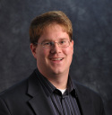
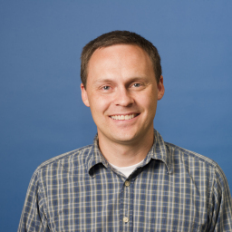
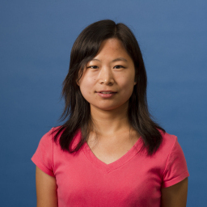
For more information…
Douglas Thain
dthain@nd.edu
Peter Ivie
pivie@nd.edu
Haiyan Meng hmeng@nd.edu
Parrot Packaging: http://ccl.cse.nd.edu/software/parrot
Umbrella Technology Preview:
http://ccl.cse.nd.edu/software/umbrella

