Slide 1
Unsolved
Computer Science Problems in Distributed Computing
Douglas Thain, University of Notre Dame
Zakopane, Poland, January 2012

Slide 2
The Cooperative Computing Lab
We collaborate with people who have large scale computing problems in science, engineering, and other fields.
We operate computer systems on the O(1000) cores: clusters, clouds, grids.
We conduct computer science research in the context of real people and problems.
We release open source software for large scale distributed computing.
http://www.nd.edu/~ccl

Slide 3
How we do research:
PIs get together for many long lunches just to understand each other and scope a problem.
Then, pair together a computer systems student with another in the domain, charged to do real work by using distributed computing.
Four levels of success:
  Task: e.g. Assemble the anopheles gambiae genome.
  Software: Source code (checked in) that can be reliably compiled and run multiple times.
  Product: Software + manual + web page + example data that can be easily run by the PIs.
  Community: Product gets taken up by multiple users that apply it in real ways and complain about problems.

Slide 4
Hard Part:
Agreeing on Useful Abstractions

Slide 5
Abstractions for Software

Slide 6
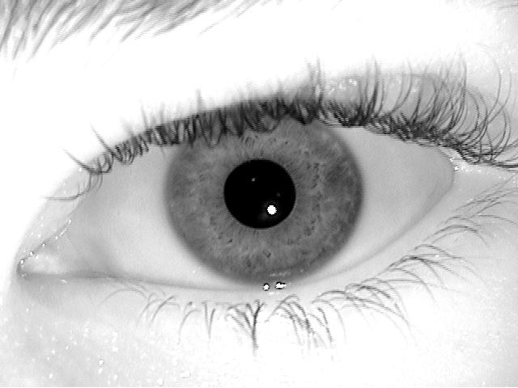
Abstractions for Storage
Immutable
Replicas
Scientific Metadata
replicaid=423
state=ok
Type | Subject | Eye | Color | FileID
Iris | S100 | Right | Blue | 10486
Iris | S100 | Left | Blue | 10487
Iris | S203 | Right | Brown | 24304
Iris | S203 | Left | Brown | 24305
replicaid=105
state=ok
replicaid=293
state=creating
General Metadata
fileid = 24305
size = 300K
type = jpg
sum = abc123…
replicaid=102
state=deleting

Slide 7
Some success stories…
Created a data repository and computation framework for biometrics research that enables research on datasets 100X larger than before. (BXGrid, All-Pairs)
Created scalable modules for the Celera assembler that allow it to run on O(1000) cores across Condor, SGE, EC2, and Azure. (SAND)
Created a high-throughput molecular dynamics ensemble management system that runs continuously (last 6 months) on 4000+ cores across multiple HPC sites. (Folding@Work)
Created a grid-scale POSIX-compatible filesystem used in production by LHC experiments. (Parrot and Chirp)
http://www.nd.edu/~ccl

Slide 8
But have you ever really watched someone use a large distributed system?

Slide 9


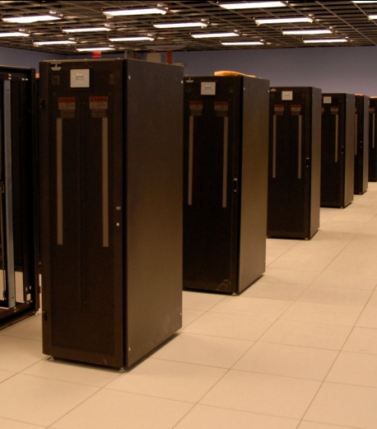
I have a standard, debugged, trusted application that runs on my laptop.
A toy problem completes in one hour.
A real problem will take a month (I think.)
Can I get a single result faster?
Can I get more results in the same time?
Last year,
I heard about
this grid thing.
This year,
I heard about
this cloud thing.
What do I do next?

Slide 10
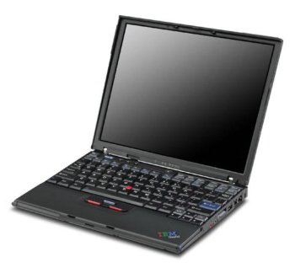
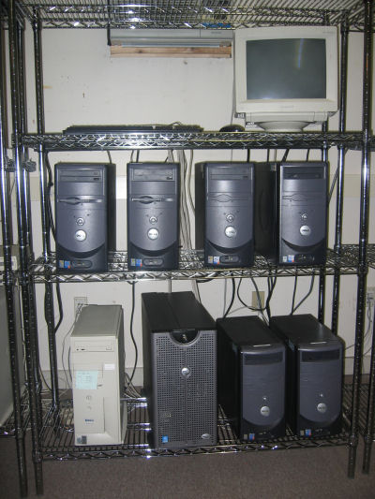
What they want.
What they get.

Slide 11
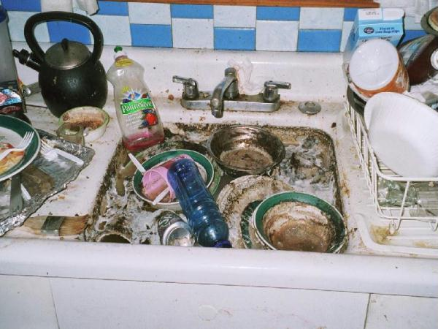
The Most Common App Design…
Every program attempts to grow until it can read mail. - Jamie Zawinski

Slide 12
What goes wrong? Everything!
Scaling up from 10 to 10,000 tasks violates ten different hard coded limits in the kernel, the filesystem, the network, and the application.
Failures are everywhere! Exposing error messages is confusing, but hiding errors causes unbounded delays.
User didn’t know that program relies on 1TB of configuration files, all scattered around the home filesystem.
User discovers that the program only runs correctly on Blue Sock Linux 3.2.4.7.8.2.3.5.1!
User discovers that program generates different results when run on different machines.

Slide 13
In the next ten years:
Let us articulate challenges that are not simply who has the biggest computer.

Slide 14
gigascale terascale petascale exascale
… zottascale?

Slide 15
The Kiloscale Problem:
Any workflow with sufficient concurrency should be able to run correctly on 1K cores the first time and every time with no sysadmin help.
(Appropriate metrics are results/FTE.)

Slide 16
The Halting Problem
Given a workflow running on one thousand nodes, make it stop and clean up all associated state with complete certainty.
(Need closure of both namespaces and resources.)

Slide 17
The Dependency Problem:
(1) Given a program, figure out everything that it actually needs to run on a different machine.
(2) Given a process, figure out the (distributed) resources it actually uses while running.
(3) Extend 1 and 2 to an entire workflow.
(VMs are not the complete solution.)

Slide 18
The Right-Sizing Problem:
Given a (structured) application and a given cluster, cloud, or grid, choose a resource allocation that achieves good performance at acceptable cost.
(Can draw on DB optimization work.)

Slide 19
The Troubleshooting Problem:
When a failure happens in the middle of a 100-layer software stack, how and when do you report/retry/ignore/suppress the error?
(Exceptions? Are you kidding?)

Slide 20
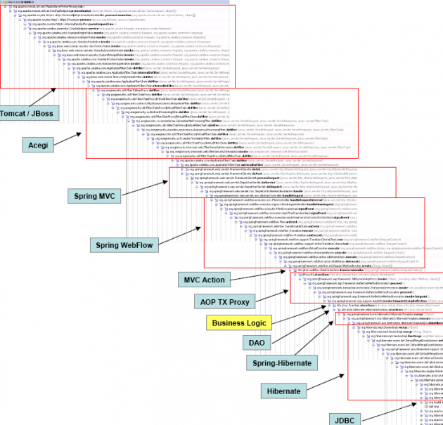

Slide 21
The Design Problem:
How should applications be designed so that they are well suited for distributed computing?
(Object oriented solves everything!)

Slide 22
In the next ten years:
Let us articulate the key principles of distributed computing.

Slide 23
Key Principles of Compilers
The Chomsky Hierarchy
  Relates program models with required execution systems: RE (DFA) CFG (Stack) CSG (Turing)
Approach to Program Structure
  Scanner (Tokens) Parser (AST) Semantics (IR) Emitter (ASM)
Algorithmic Approaches
  Tree matching for instruction selection.
  Graph coloring for register selection.
Software artifacts are seen as examples of the principles, which are widely replicated.

Slide 24
Some Key Concepts from Grids
Workflows
  Restricted declarative programming model makes it possible to reconfigure apps to resources.
Pilot Jobs
  User task scheduling has different constraints and objectives than system level scheduling: let the user overlay their own system for execution.
Distributed Credentials
  Need a way to associate local identity controls with global systems, and carry those along with delegated processes.
Where are the papers that describe the key principles, rather than the artifacts?

Slide 25
In the next ten years:
Let us rethink how we evaluate each other’s work.

Slide 26
The Transformative Criterion Considered Harmful
Makes previous work the competition to be dismissed, not the foundation to employ.
Discourages reflection on the potential downsides of any new approach.
Cannot be reconciled with the scale of most NSF grants.
Encourages us to be advocates of our own work, rather than contributors to and evaluators of a common body of work.

Slide 27
The Sobriety Criterion!

Slide 28
However…
Making software usable and dependable at all scales would have a transformative effect on the users!

Slide 29
In Summary
Large scale distributed computing systems have been enormously successful to those willing to invest significant human capital.
But, we have barely scratched the surface in terms of developing systems that are robust and usable with minimal effort.
In the next ten years, let us:
  Formulate challenges in terms other than measuring who has the largest computer.
  Articulate the portable principles of grid computing, and apply them in many different artifacts.
  Reconsider how we evaluate each other’s work.

Slide 30
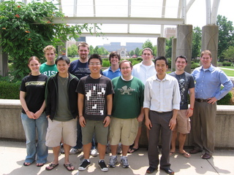
http://www.nd.edu/~ccl

